Slide 1


Generative Models of Images of Objects
S. M. Ali Eslami
Joint work with
Chris Williams
Nicolas Heess
John Winn
June 2012
UoC TTI

Slide 2
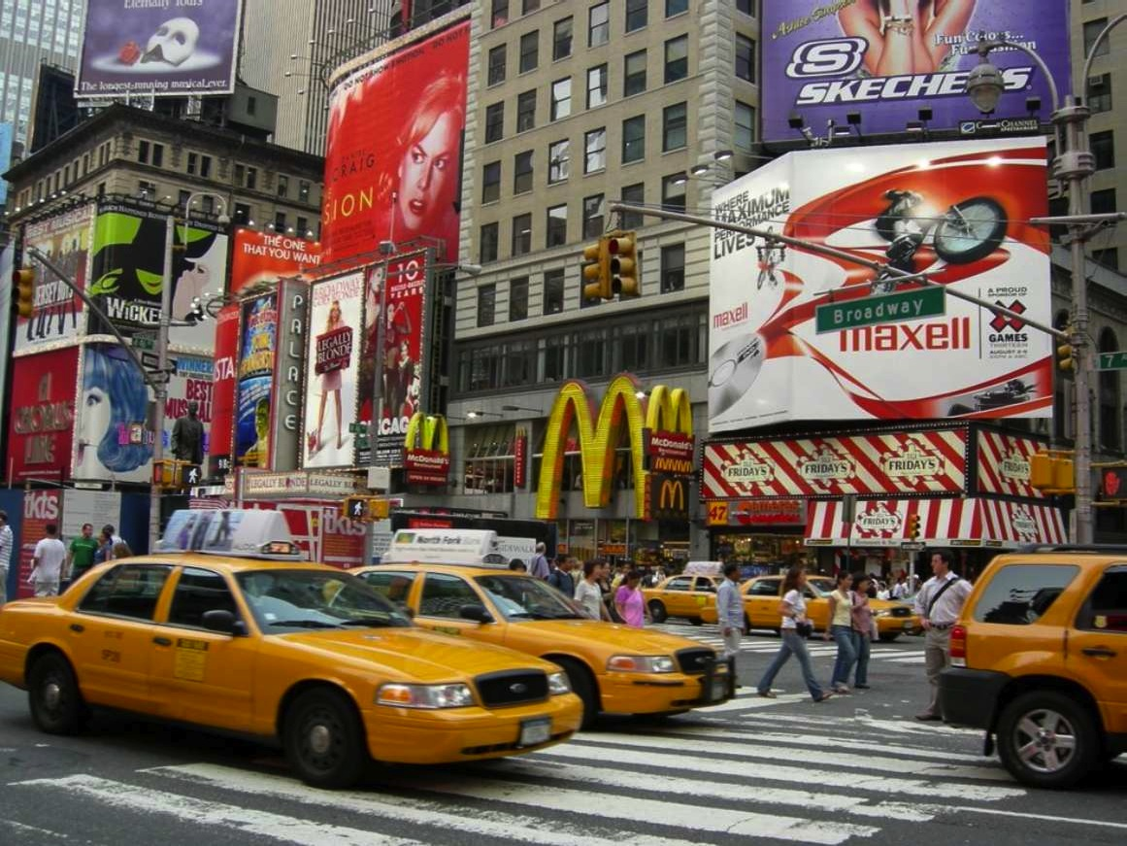

Slide 3
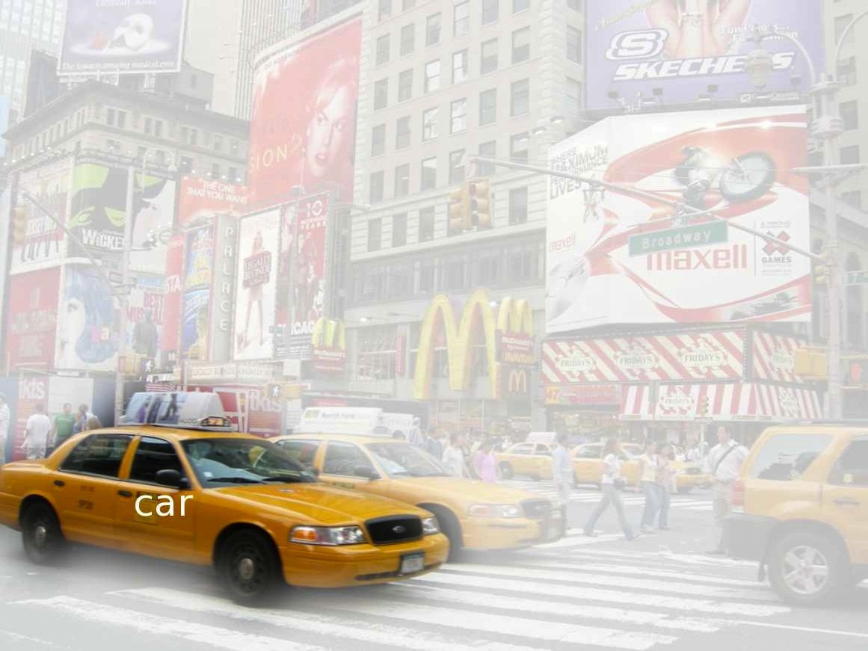
Classification

Slide 4
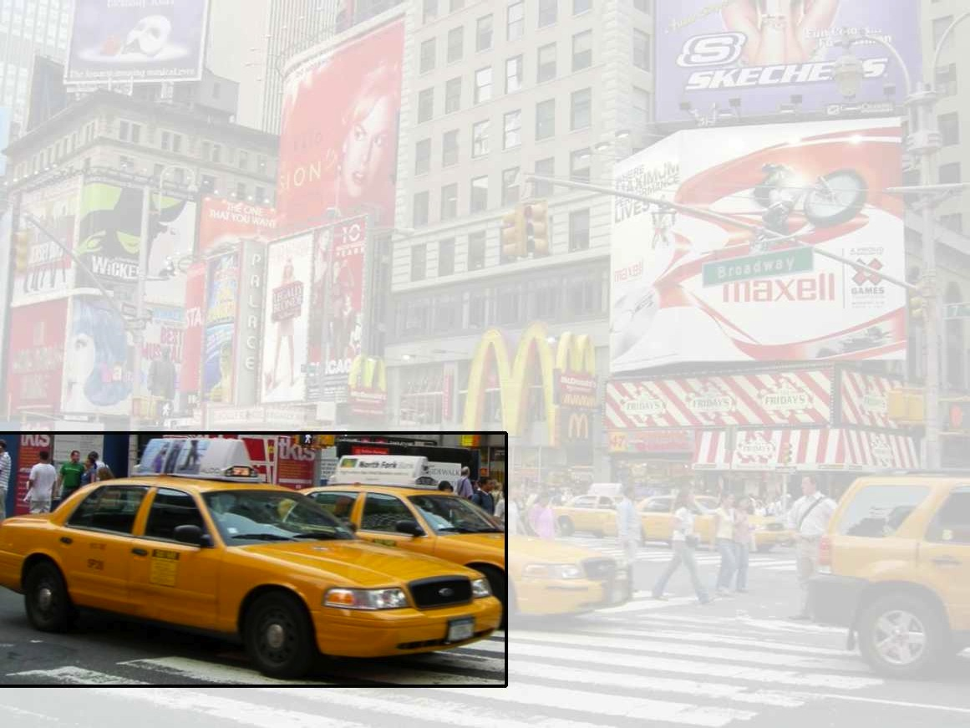
Localization

Slide 5
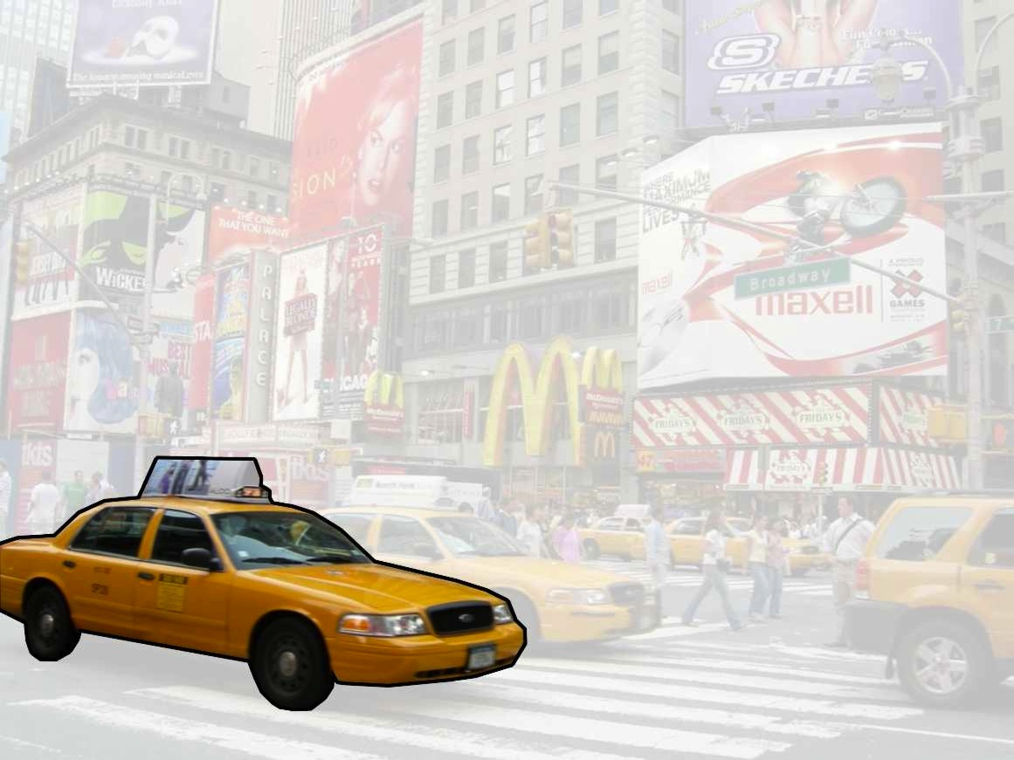
Foreground/Background
Segmentation

Slide 6
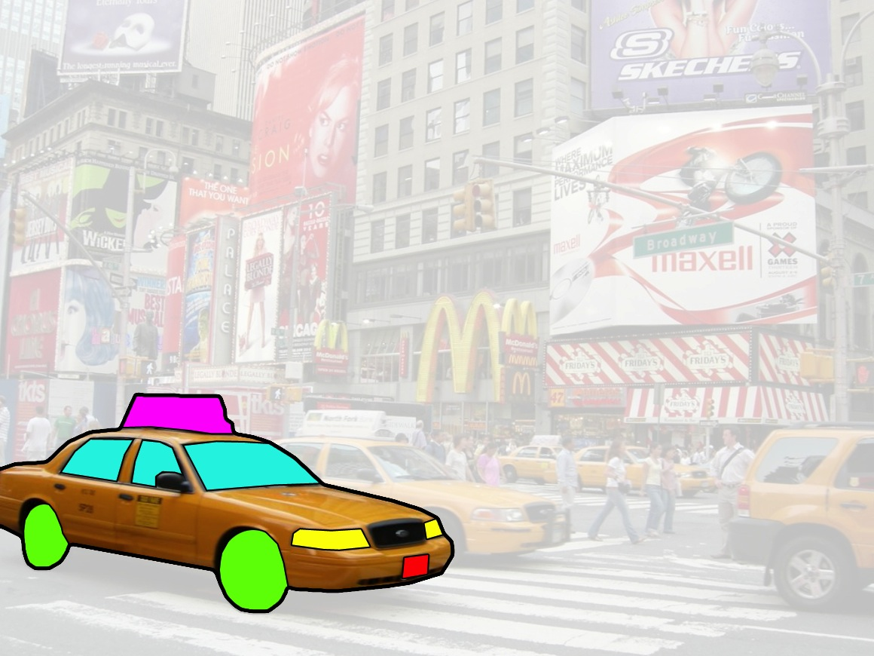
Parts-based Object
Segmentation

Slide 7
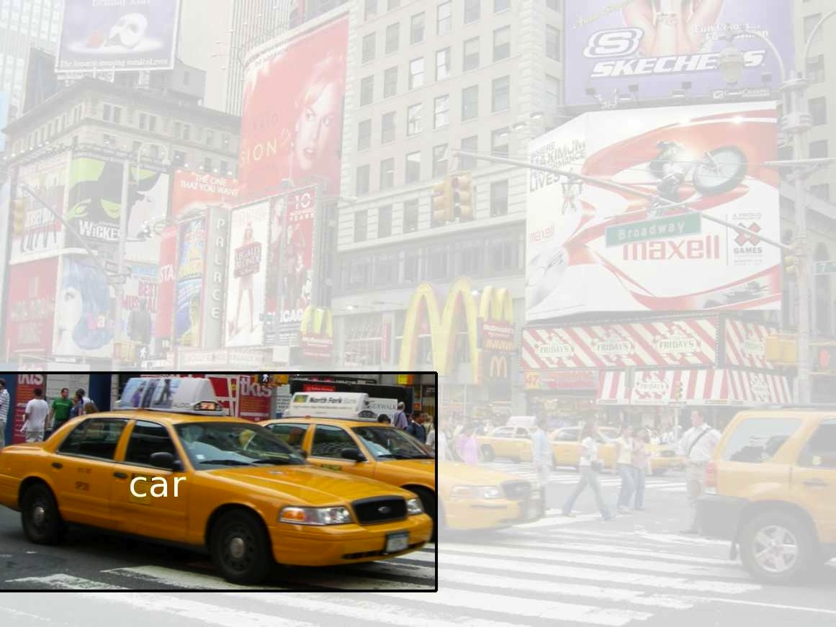
Segment this
This talk’s focus

Slide 8
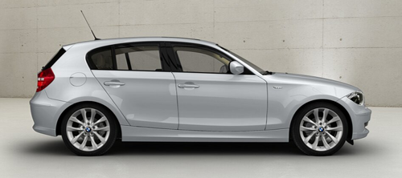
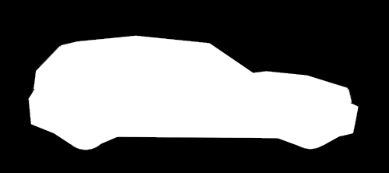

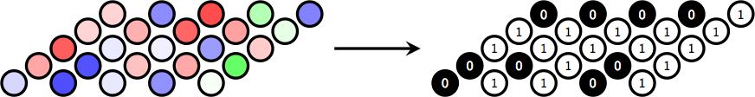
The segmentation task
The image
The segmentation

Slide 9
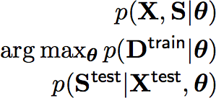
The segmentation task
The generative approach
Construct joint model of image and segmentation
Learn parameters given dataset
Return probable segmentation at test time
Some benefits of this approach
Flexible with regards to data:
  Unsupervised training,
  Semi-supervised training.
Can inspect quality of model by sampling from it

Slide 10
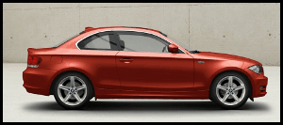
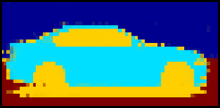
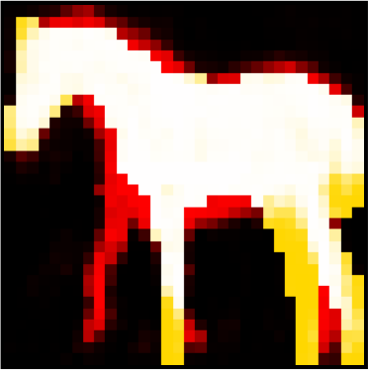
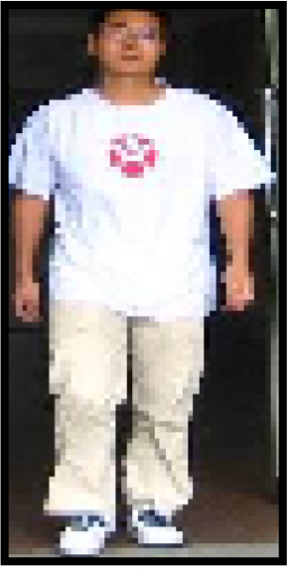
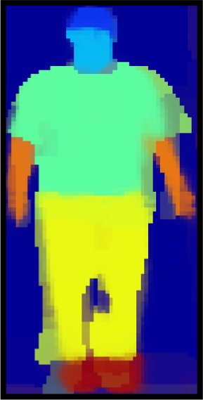
Outline
FSA – Factoring shapes and appearances
  Unsupervised learning of parts (BMVC 2011)
ShapeBM – A strong model of FG/BG shape
  Realism, generalization capability (CVPR 2012)
MSBM – Parts-based object segmentation
  Supervised learning of parts for challenging datasets

Slide 11
Factored Shapes and Appearances
For Parts-based Object Understanding (BMVC 2011)

Slide 12
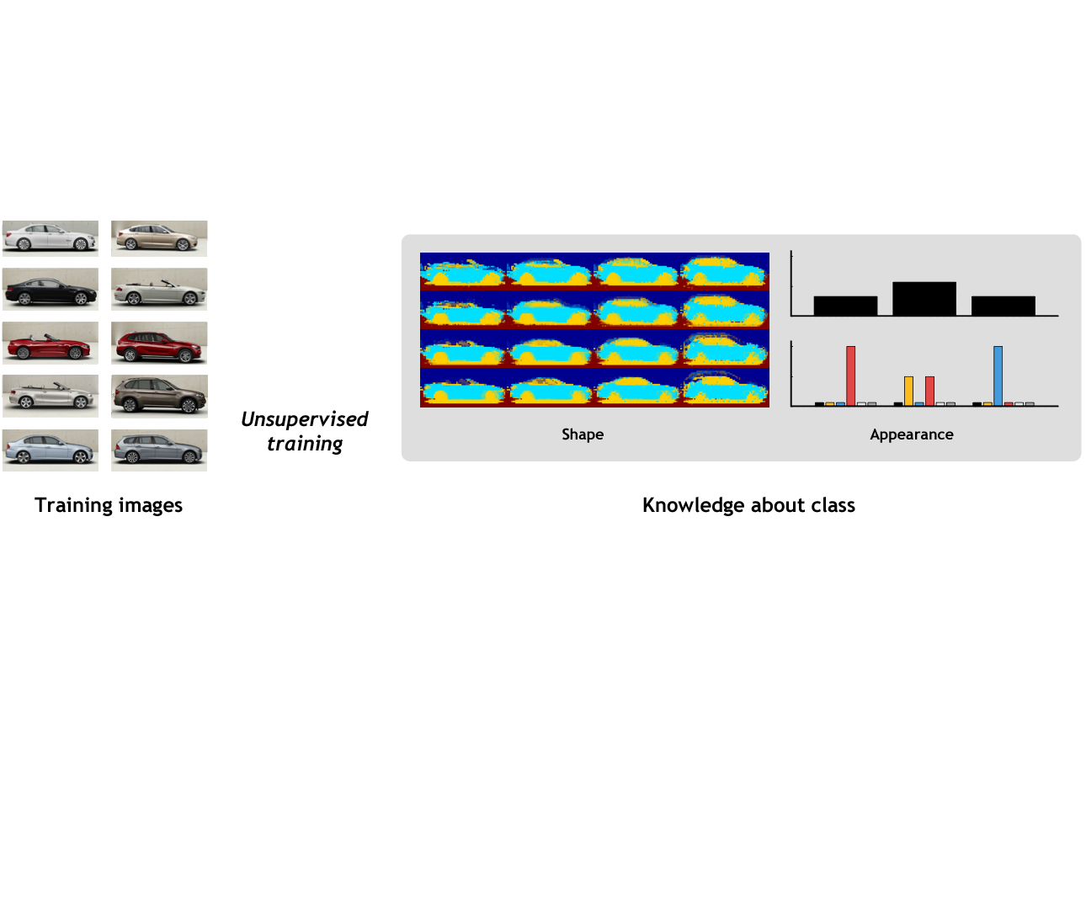

Slide 13
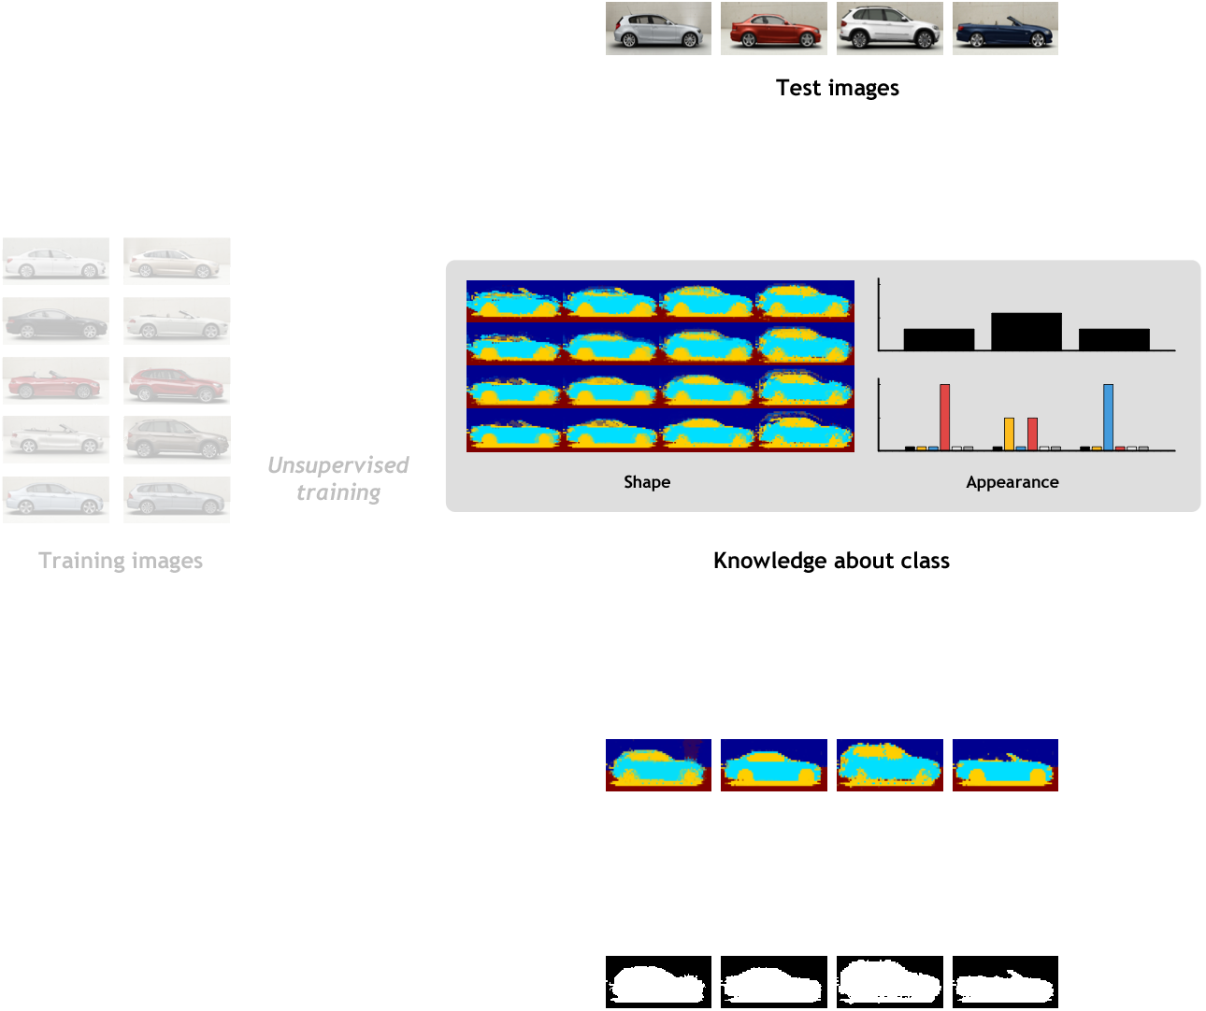

Slide 14
Factored Shapes and Appearances
Goal
  Construct joint model of image and segmentation.
Factor appearances
  Reason about shape independently of its appearance.
Factor shapes
  Represent objects as collections of parts.
  Systematic combination of parts generates objects’ complete shapes.
Learn everything
  Explicitly model variation of appearances and shapes.

Slide 15
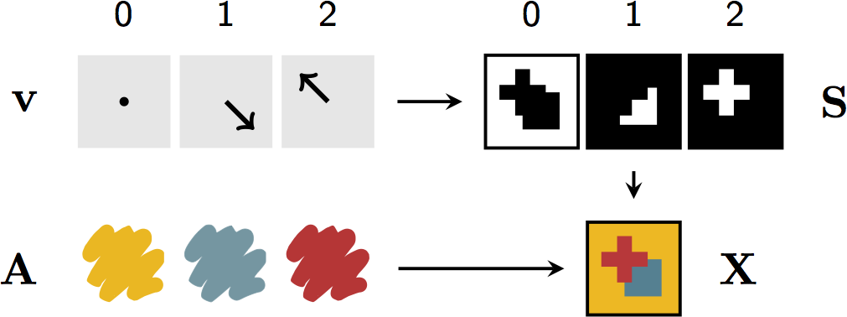
Factored Shapes and Appearances
Schematic diagram

Slide 16
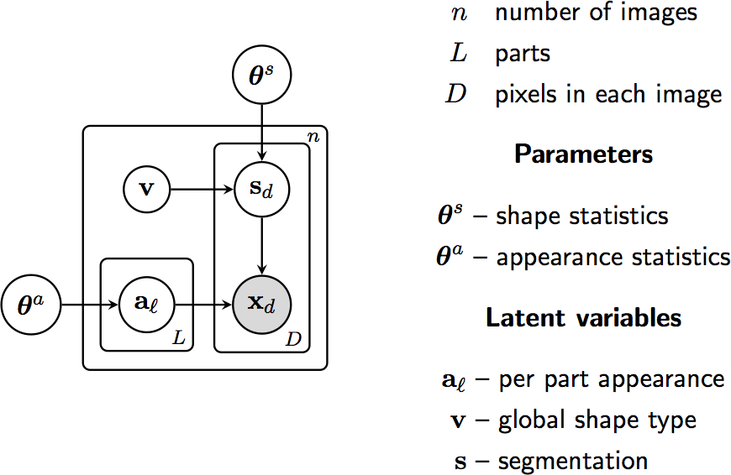
Factored Shapes and Appearances
Graphical model

Slide 17
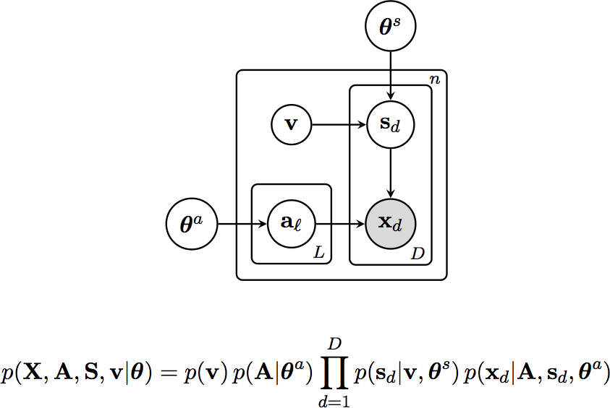
Factored Shapes and Appearances
Shape model

Slide 18
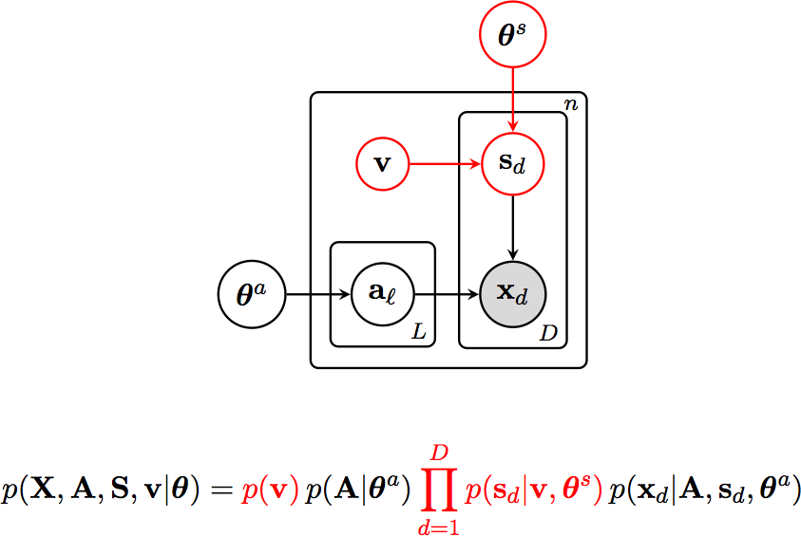
Factored Shapes and Appearances
Shape model

Slide 19
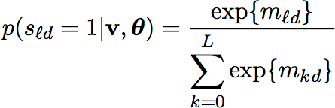
Factored Shapes and Appearances
Shape model
Continuous parameterization
Factor appearances
  Finds probable assignment of pixels to parts without having to enumerate all part depth orderings.
  Resolves ambiguities by exploiting knowledge about appearances.

Slide 20
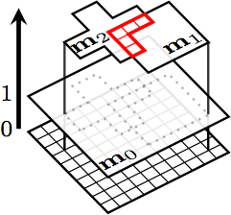
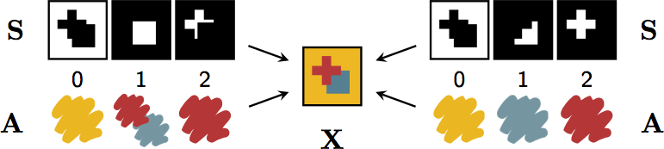
Factored Shapes and Appearances
Handling occlusion

Slide 21

Factored Shapes and Appearances
Learning shape variability
Goal
Instead of learning just a template for each part, learn a distribution over such templates.
Linear latent variable model
Part l ’s mask is governed by a Factor Analysis-like distribution:
where is a low-dimensional latent variable, is the factor loading matrix and is the mean mask.

Slide 22
Factored Shapes and Appearances
Appearance model

Slide 23
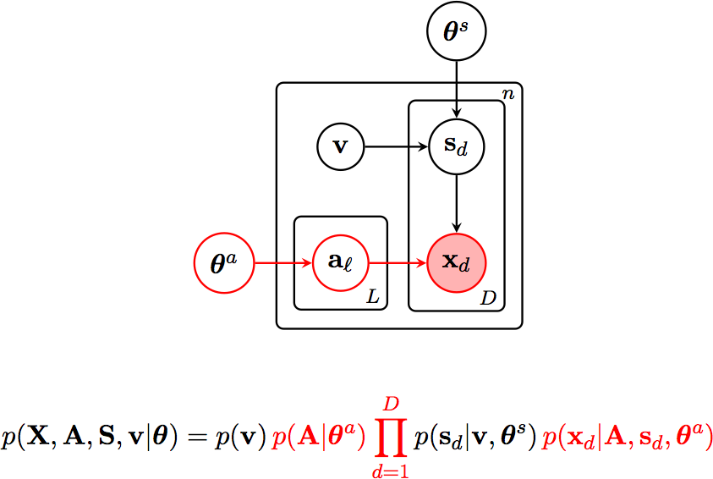
Factored Shapes and Appearances
Appearance model

Slide 24
Factored Shapes and Appearances
Appearance model
Goal
Learn a model of each part’s RGB values that is as informative as possible about its extent in the image.
Position-agnostic appearance model
Learn about distribution of colors across images,
Learn about distribution of colors within images.
Sampling process
For each part:
Sample an appearance ‘class’ for each part,
Samples the parts’ pixels from the current class’ feature histogram.

Slide 25
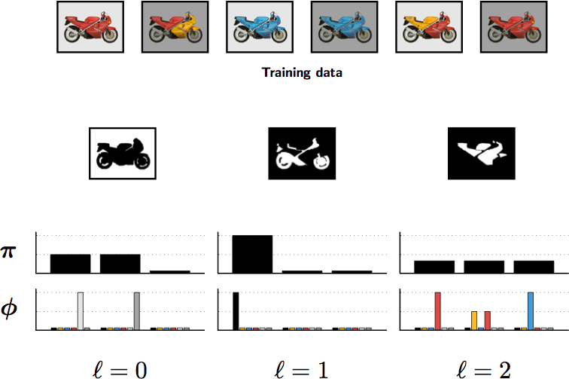
Factored Shapes and Appearances
Appearance model

Slide 26




Factored Shapes and Appearances
Learning
Use EM to find a setting of the shape and appearance parameters that approximately maximizes :
Expectation: Block Gibbs and elliptical slice sampling (Murray et al., 2010) to approximate ,
Maximization: Gradient descent optimization to find
where

Slide 27
Existing generative models
A comparison
 | Factored parts | Factored shape and appearance | Shape variability | Appearance variability
LSM Frey et al. | ✓ (layers) |  | ✓ (FA) | ✓ (FA)
Sprites Williams and Titsias | ✓ (layers)
LOCUS Winn and Jojic |  | ✓ | ✓ (deformation) | ✓ (colors)
MCVQ Ross and Zemel |  | ✓ |  | ✓ (templates)
SCA Jojic et al. |  | ✓ | ✓ (convex) | ✓ (histograms)
FSA | ✓ (softmax) | ✓ | ✓ (FA) | ✓ (histograms)

Slide 28
Results

Slide 29
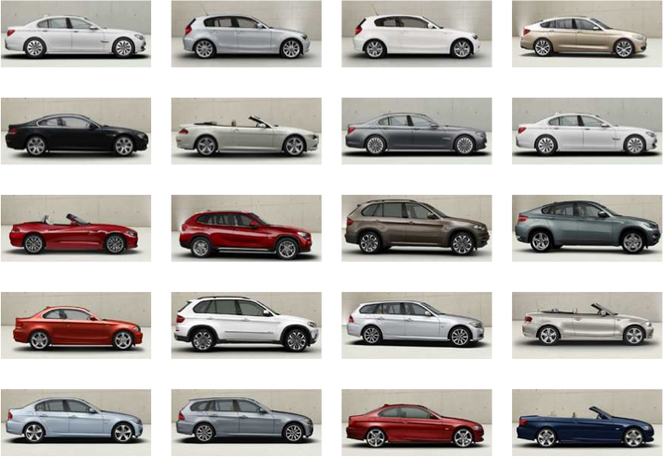
Learning a model of cars
Training images

Slide 30
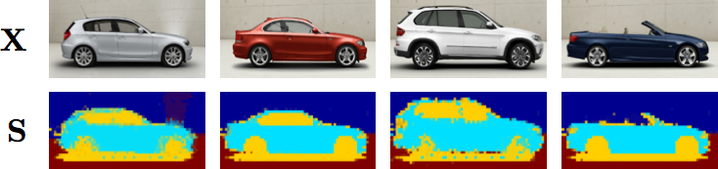
Learning a model of cars
Model details
Number of parts: 3
Number of latent shape dimensions: 2
Number of appearance classes: 5

Slide 31
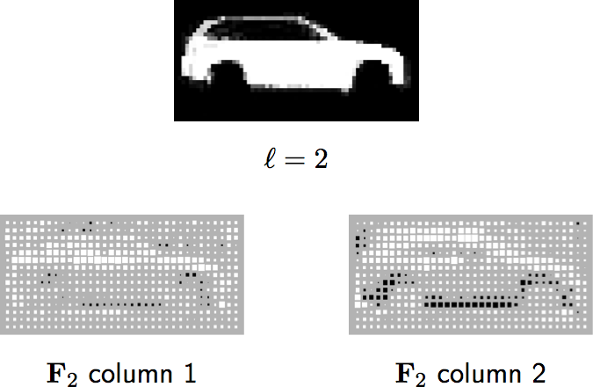
Learning a model of cars
Shape model weights
Convertible – Coupe
Low – High

Slide 32
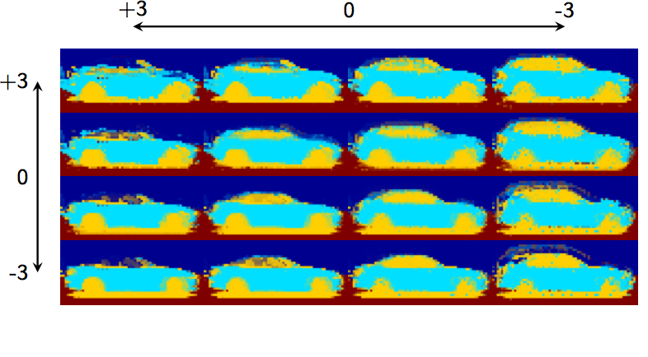
Learning a model of cars
Latent shape space

Slide 33
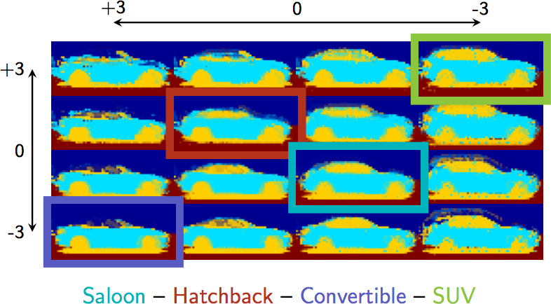
Learning a model of cars
Latent shape space

Slide 34
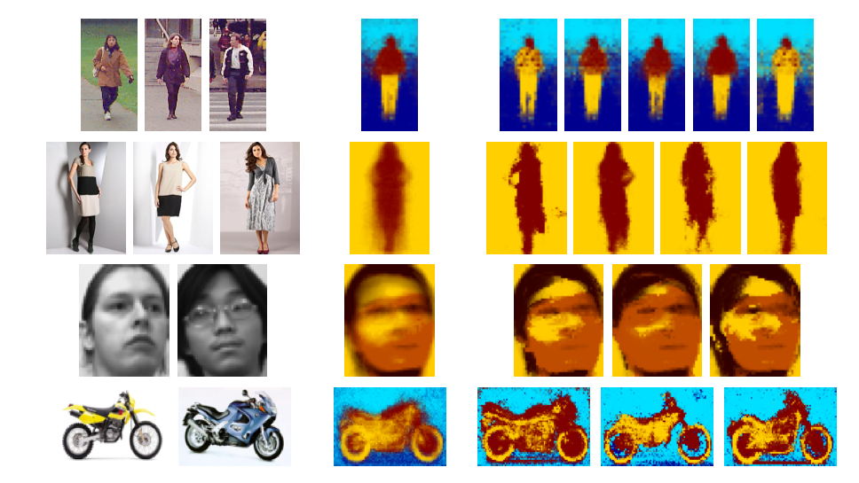
Other datasets
Training data
Mean model
FSA samples

Slide 35
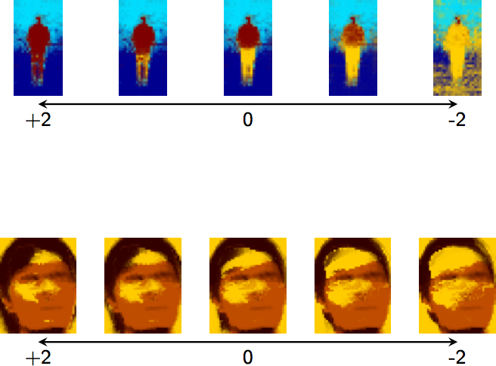
Other datasets

Slide 36
Segmentation benchmarks
Datasets
Weizmann horses: 127 train – 200 test.
Caltech4:
  Cars: 63 train – 60 test,
  Faces: 335 train – 100 test,
  Motorbikes: 698 train – 100 test,
  Airplanes: 700 train – 100 test.
Two variants
Unsupervised FSA: Train given only RGB images.
Supervised FSA: Train using RGB images + their binary masks.

Slide 37
Segmentation benchmarks
 | Horses | Cars | Faces | Motorbikes | Airplanes
GrabCut Rother et al. | 83.9% | 45.1% | 83.7% | 82.4% | 84.5%
Borenstein et al. | 93.6%
LOCUS Winn and Jojic | 93.1% | 91.4%
Arora et al. |  | 95.1% | 92.4% | 83.1% | 93.1%
ClassCut Alexe et al. | 86.2% | 93.1% | 89.0% | 90.3% | 89.8%
Unsupervised FSA | 87.3% | 82.9% | 88.3% | 85.7% | 88.7%
Supervised FSA | 88.0% | 93.6% | 93.3% | 92.1% | 90.9%

Slide 38
The Shape Boltzmann Machine
A Strong Model of Object Shape (CVPR 2012)

Slide 39
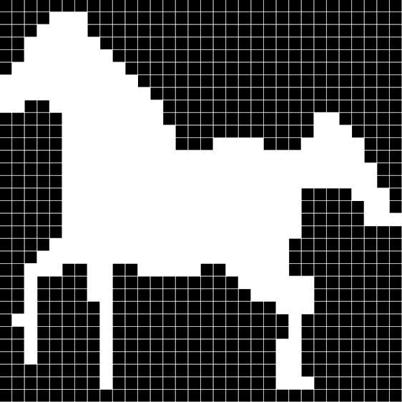
What do we mean by a model of shape?
A probabilistic distribution:
  Defined on binary images
  Of objects not patches
  Trained using limited training data

Slide 40
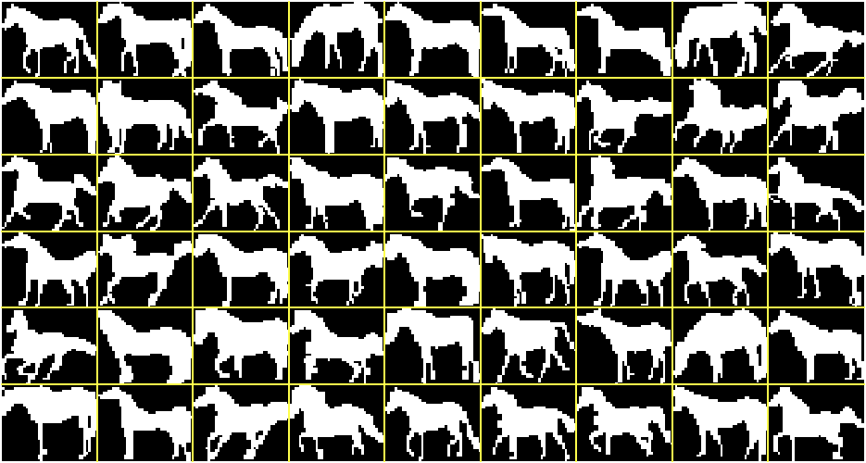
Weizmann horse dataset
Sample training images
327 images

Slide 41
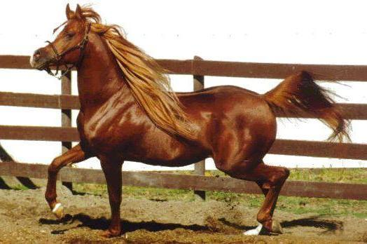
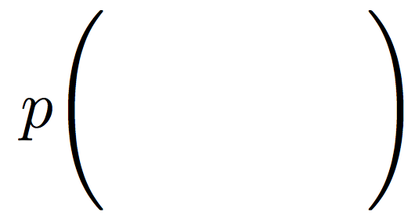



What can one do with an ideal shape model?
Segmentation

Slide 42

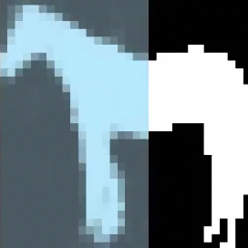
What can one do with an ideal shape model?
Image completion

Slide 43

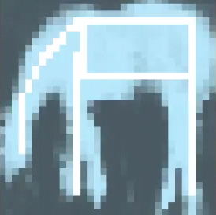
What can one do with an ideal shape model?
Computer graphics

Slide 44


What is a strong model of shape?
We define a strong model of object shape as one which meets two requirements:
Realism
Generalization
Generates samples
that look realistic
Can generate samples that
differ from training images
Training images
Real distribution
Learned distribution

Slide 45
Existing shape models
A comparison
 | Realism |  | Generalization
 | Globally | Locally
Mean | ✓
Factor Analysis | ✓ |  | ✓
Fragments |  | ✓ | ✓
Grid MRFs/CRFs |  | ✓ | ✓
High-order potentials | ~ | ✓ | ✓
Database | ✓ | ✓
ShapeBM | ✓ | ✓ | ✓

Slide 46
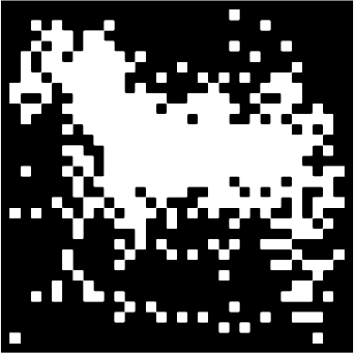
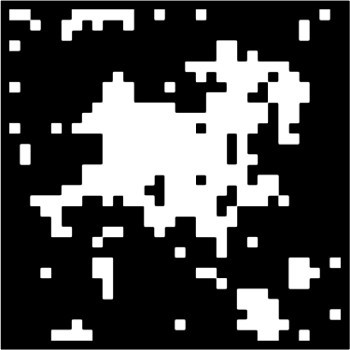
Existing shape models
Most commonly used architectures
Mean
MRF
sample from the model
sample from the model

Slide 47

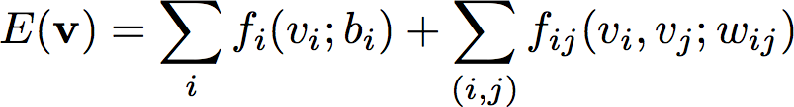
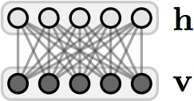
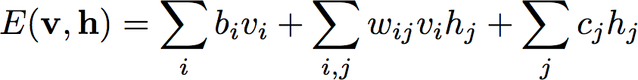
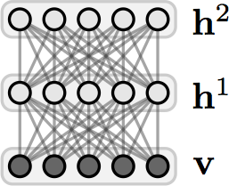
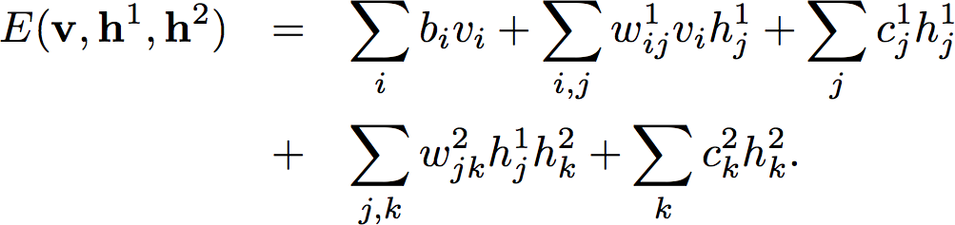
Shallow and Deep architectures
Modeling high-order and long-range interactions
MRF
RBM
DBM

Slide 48
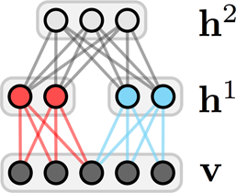
From the DBM to the ShapeBM
Restricted connectivity and sharing of weights
DBM
ShapeBM
Limited training data. Reduce the number of parameters:
  Restrict connectivity,
  Restrict capacity,
  Tie parameters.

Slide 49
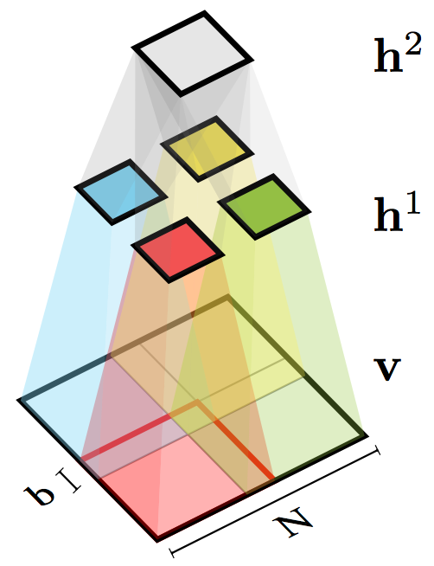
Shape Boltzmann Machine
Architecture in 2D
Top hidden units capture object pose
Given the top units, middle hidden units capture local (part) variability
Overlap helps prevent discontinuities at patch boundaries

Slide 50
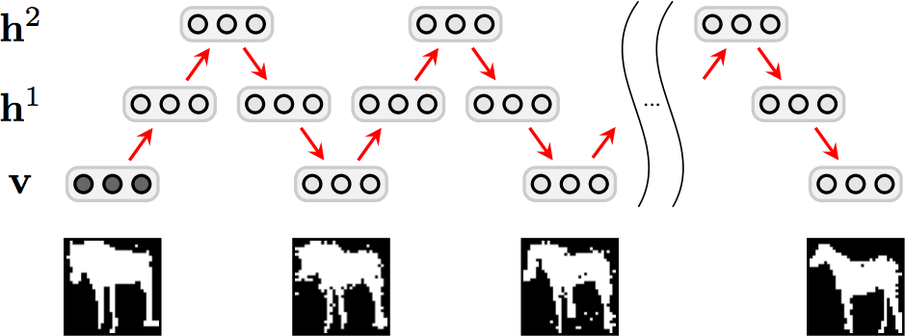
ShapeBM inference
Block-Gibbs MCMC
image
reconstruction
sample 1
sample n
~500 samples per second

Slide 51


ShapeBM learning
Stochastic gradient descent
Maximize with respect to
Pre-training
  Greedy, layer-by-layer, bottom-up,
  ‘Persistent CD’ MCMC approximation to the gradients.
Joint training
  Variational + persistent chain approximations to the gradients,
  Separates learning of local and global shape properties.
~2-6 hours on the small datasets that we consider

Slide 52
Results

Slide 53



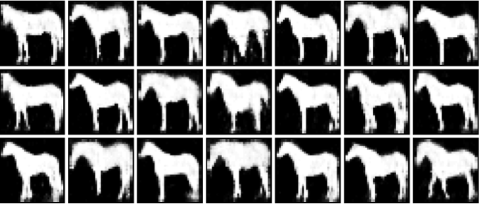
Sampled shapes
Evaluating the Realism criterion
Weizmann horses – 327 images – 2000+100 hidden units
Weizmann horses – 327 images
Data
FA
Incorrect generalization
RBM
Failure to learn variability
Natural shapes
Variety of poses
Sharply defined details
Correct number of legs (!)
ShapeBM

Slide 54
Sampled shapes
Evaluating the Realism criterion
Weizmann horses – 327 images – 2000+100 hidden units
Weizmann horses – 327 images

Slide 55


Sampled shapes
Evaluating the Generalization criterion
Weizmann horses – 327 images – 2000+100 hidden units
Sample from the ShapeBM
Closest image in training dataset
Difference between the two images

Slide 56
Interactive GUI
Evaluating Realism and Generalization
Weizmann horses – 327 images – 2000+100 hidden units

Slide 57

Imputation scores
Quantitative comparison
Weizmann horses – 327 images – 2000+100 hidden units
Collect 25 unseen horse silhouettes,
Divide each into 9 segments,
Estimate the conditional log probability of a segment under the model given the rest of the image,
Average over images and segments.
 | Mean | RBM | FA | ShapeBM
Score | -50.72 | -47.00 | -40.82 | -28.85

Slide 58






Multiple object categories
Simultaneous detection and completion
Caltech-101 objects – 531 images – 2000+400 hidden units
Train jointly on 4 categories without knowledge of class:
Shape
completion
Sampled
shapes

Slide 59


What does h² do?
Weizmann horses
Pose information
Multiple categories
Class label information
Accuracy
Number of training images

Slide 60
A Generative Model of Objects
For Parts-based Object Segmentation (under review)

Slide 61

Joint Model

Slide 62

Joint model
Schematic diagram

Slide 63


Multinomial Shape Boltzmann Machine
Learning a model of pedestrians

Slide 64



Multinomial Shape Boltzmann Machine
Learning a shape model for pedestrians

Slide 65
Inference in the joint model
Practical considerations
Seeding
Initialize inference chains at multiple seeds.
Choose the segmentation which (approximately) maximizes likelihood of the image.
Capacity
Resize inferences in the shape model at run-time.
Superpixels
User image superpixels to refine segmentations.

Slide 66


Slide 67


Slide 68
Quantitative results
Pedestrians | FG | BG | Upper | Lower | Head | Average
Bo and Fowlkes | 73.3% | 81.1% | 73.6% | 71.6% | 51.8% | 69.5%
MSBM | 71.6% | 73.8% | 69.9% | 68.5% | 54.1% | 66.6%
Top Seed | 61.6% | 67.3% | 60.8% | 54.1% | 43.5% | 56.4%
Cars | BG | Body | Wheel | Window | Bumper | Average
ISM | 93.2% | 72.2% | 63.6% | 80.5% | 73.8% | 86.8%
MSBM | 94.6% | 72.7% | 36.8% | 74.4% | 64.9% | 86.0%
Top Seed | 92.2% | 68.4% | 28.3% | 63.8% | 45.4% | 81.8%

Slide 69
Summary
Generative models of images by factoring shapes and appearances.
The Shape Boltzmann Machine as a strong model of object shape.
The Multinomial Shape Boltzmann Machine as a strong model of parts-based object shape.
Inference in generative models for parts-based object segmentation.

Slide 70
Questions
"Factored Shapes and Appearances for Parts-based Object Understanding"
S. M. Ali Eslami, Christopher K. I. Williams (2011)
British Machine Vision Conference (BMVC), Dundee, UK
"The Shape Boltzmann Machine: a Strong Model of Object Shape"
S. M. Ali Eslami, Nicolas Heess and John Winn (2012)
Computer Vision and Pattern Recognition (CVPR), Providence, USA
MATLAB GUI available at
http://arkitus.com/Ali/

Slide 71

Shape completion
Evaluating Realism and Generalization
Weizmann horses – 327 images – 2000+100 hidden units

Slide 72


Constrained shape completion
Evaluating Realism and Generalization
Weizmann horses – 327 images – 2000+100 hidden units
NN
ShapeBM

Slide 73

Further results
Sampling and completion
Caltech motorbikes – 798 images – 1200+50 hidden units
Training
images
ShapeBM
samples
Sample
generalization
Shape
completion

Slide 74


Further results
Constrained completion
Caltech motorbikes – 798 images – 1200+50 hidden units
NN
ShapeBM

