Slide 1
Artificial Intelligence and
Computer Aided Design
S. M. Ali Eslami
January 2015

Slide 2
Outline

Slide 3
Who am I?

Slide 4
“The development of full AI could spell the end of the human race.”

Slide 5
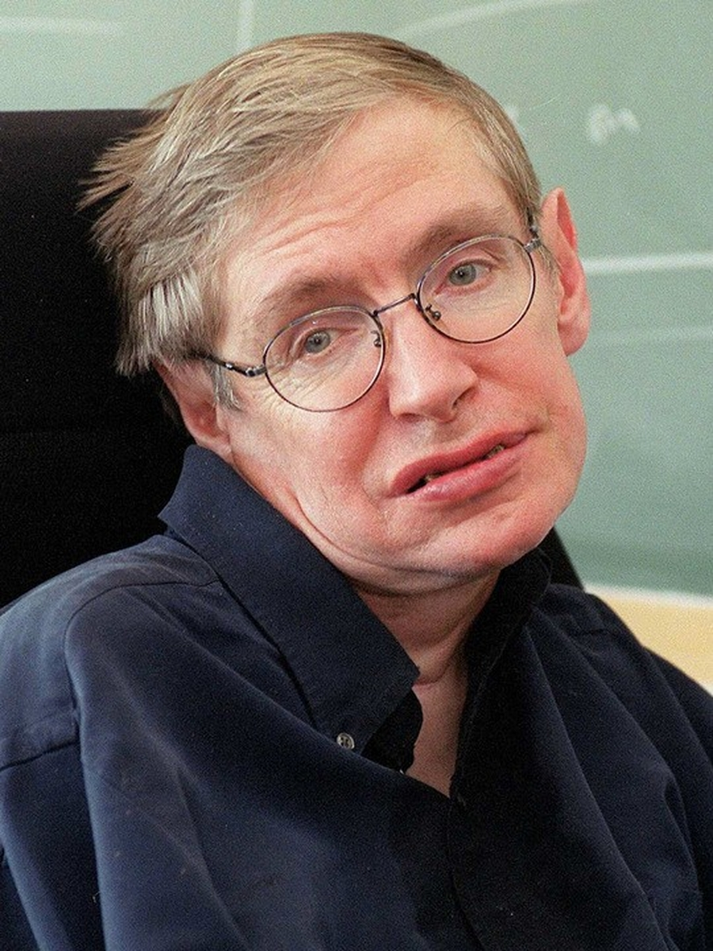
“The development of full AI could spell the end of the human race.”
Stephen Hawking, 2014

Slide 6
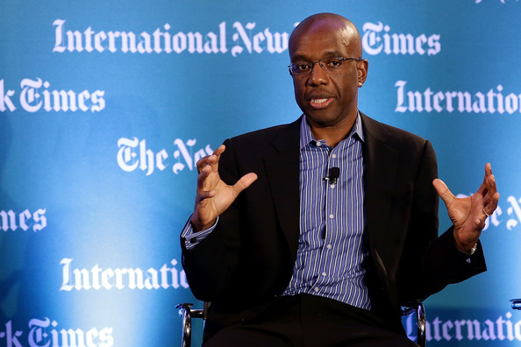
“Machine learning will be the driver of the next big wave of innovation”
James Manyika et al., McKinsey Global Institute, 2011

Slide 7
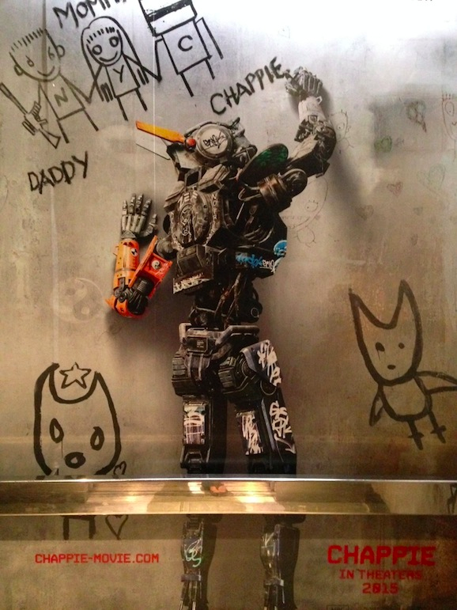
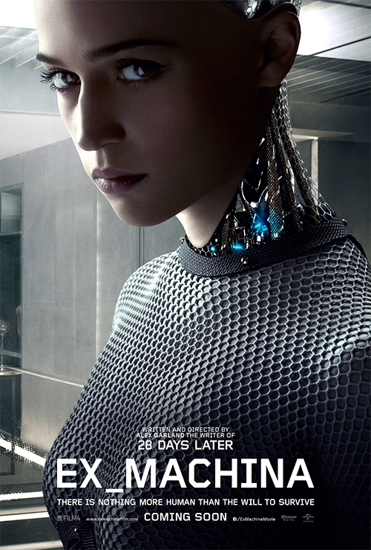
Chappie (2015)
Ex Machina (2015)

Slide 8
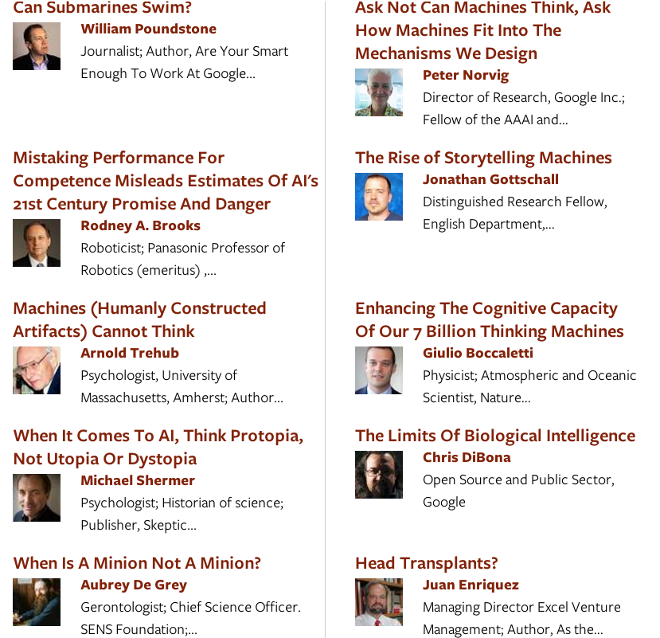
“What do you think about machines that think?” http://edge.org/annual-questions

Slide 9
What is Artificial Intelligence?

Slide 10
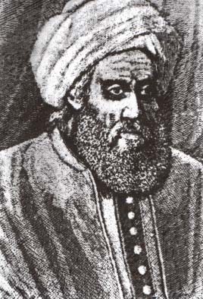
Al-Khwārizmī – محمد بن موسی خوارزمی (c. 780 – c. 850)

Slide 11
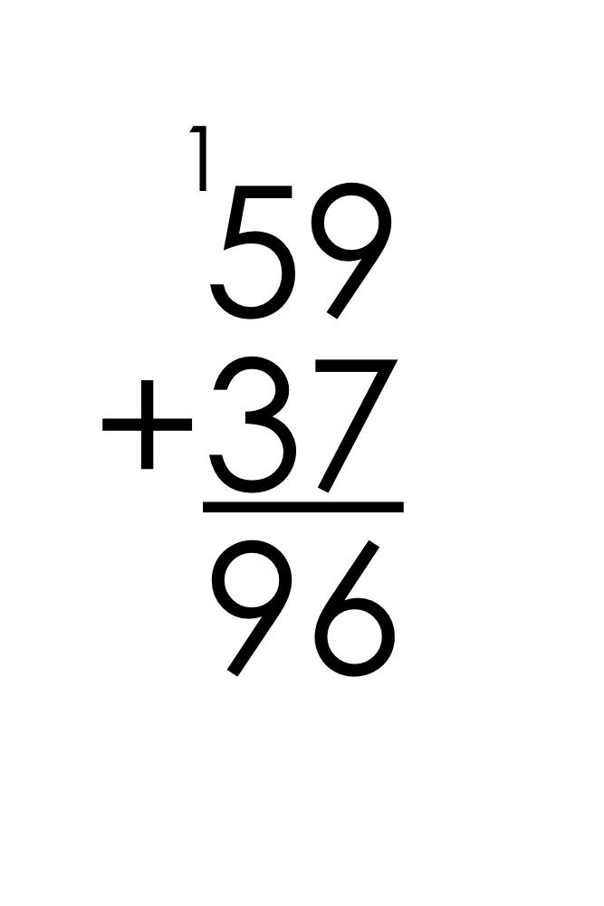
Algorithms

Slide 12
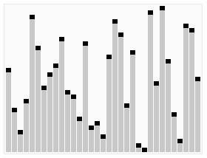
Algorithms

Slide 13
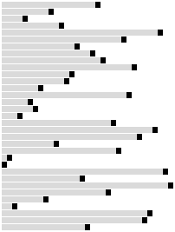
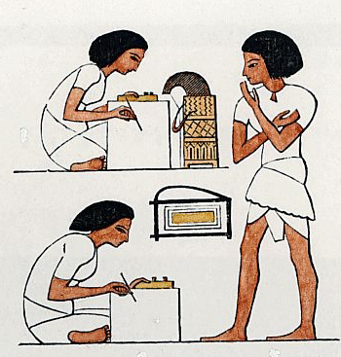

Algorithm
Input
Humans
Output

Slide 14

Computer science
Bubble
Selection
Insertion
Shell
Quick

Slide 15
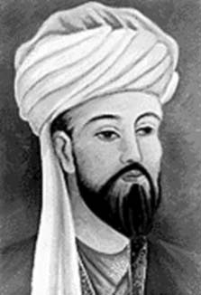
Nasīr al-Dīn Tūsī – نصیر الدین طوسی‎ (1201– 1274)

Slide 16
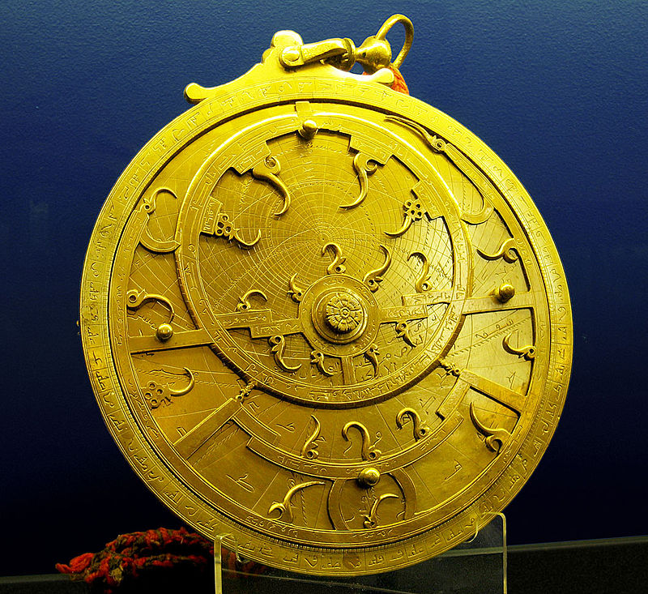
Astrolabe (18th century)

Slide 17
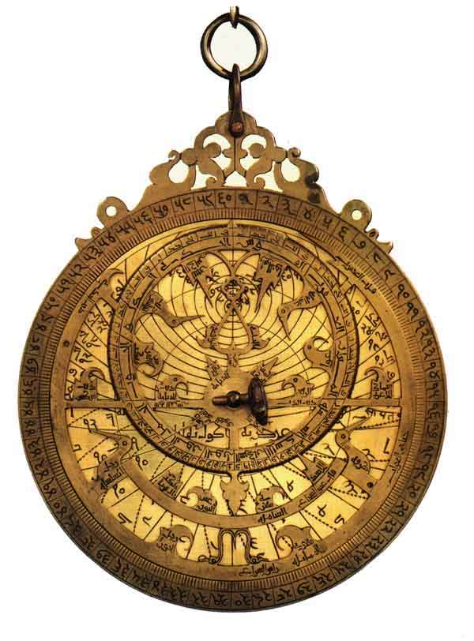
Altitude of sun
Sun’s position
Time of day
Input
Computer
Output

Slide 18
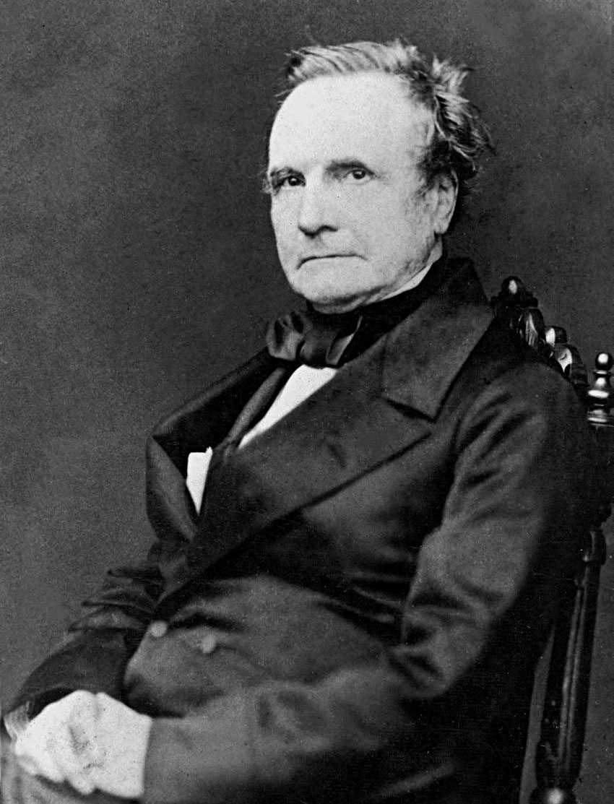
Charles Babbage (1791 – 1871)

Slide 19
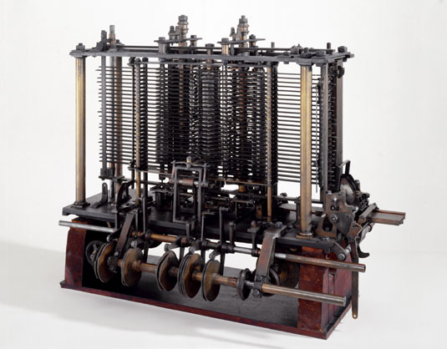
The Analytical Engine (1837)

Slide 20
Sorting
Algorithm
Input
Programmable
Computer
Output

Slide 21

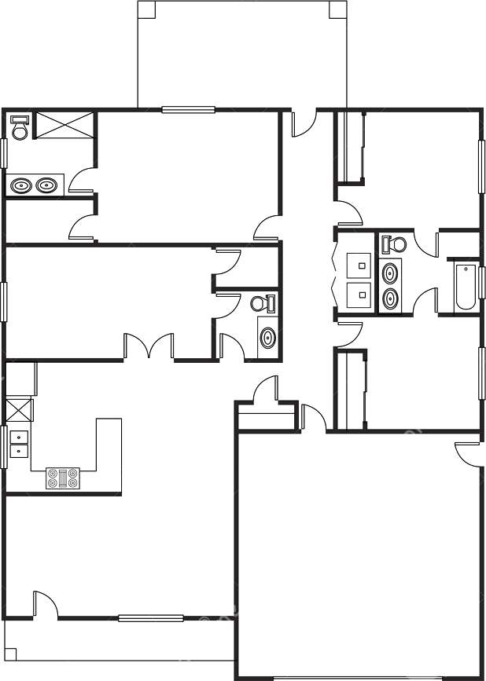

Rendering
Algorithm
Input
Programmable
Computer
Output

Slide 22

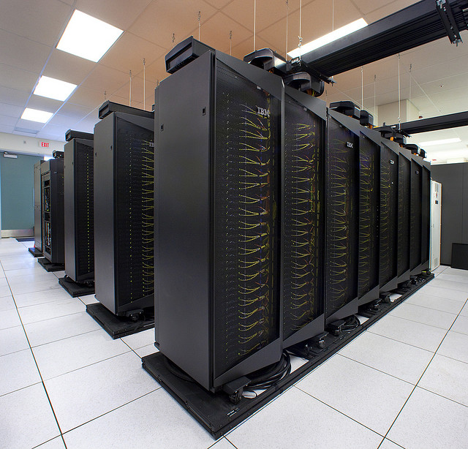
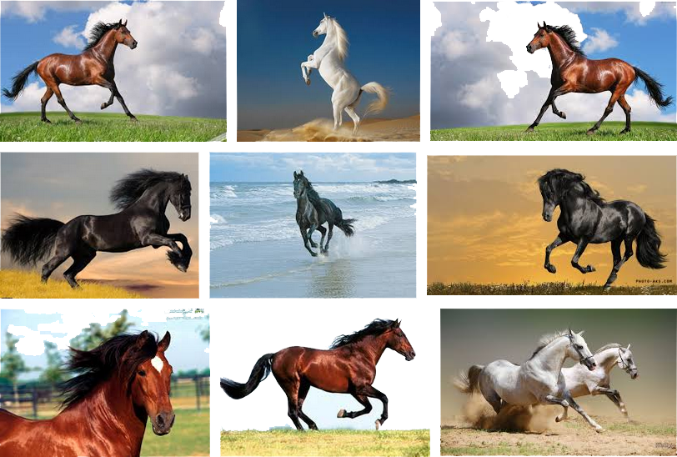
Search
Algorithm
“Horse”
Input
Programmable
Computer
Output

Slide 23
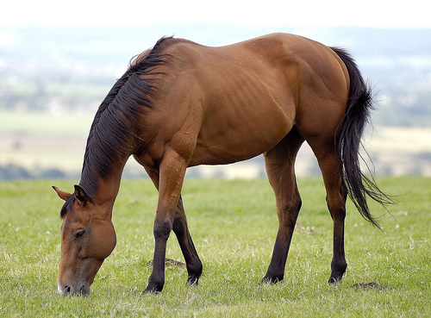
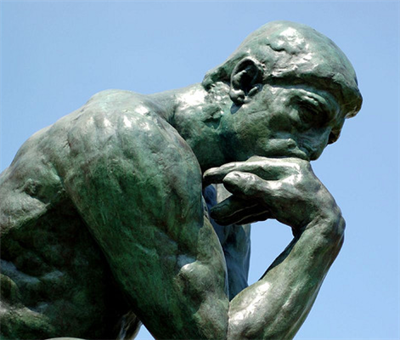
Image Classification
?
Algorithm
Horse
Input
Human
Computer
Output

Slide 24
Tasks thought to require intelligence
Image understanding,
Natural language processing,
Knowledge acquisition,
And many others.

Slide 25
Artificial intelligence is
the study and design of
intelligent computers.

Slide 26
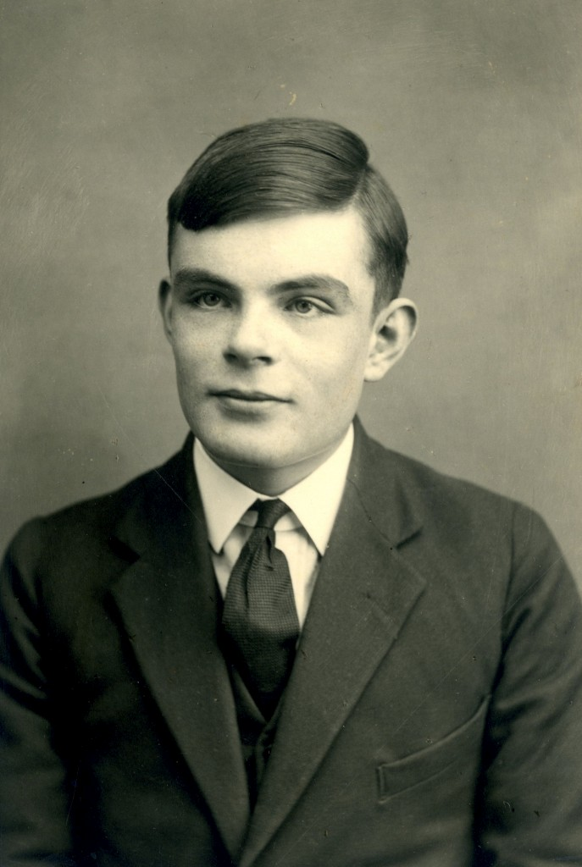
Alan Turing (1912 – 1954)

Slide 27
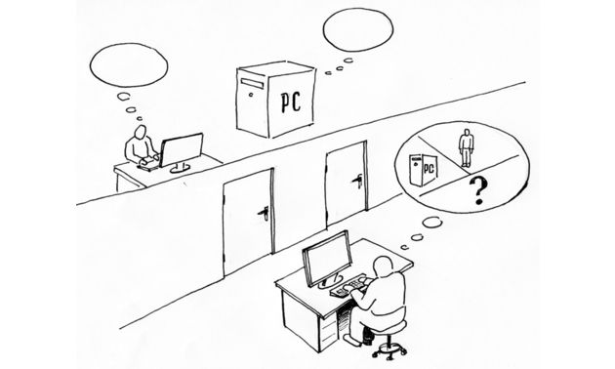

Slide 28
?
Algorithm
Horse
Input
Computer
Output

Slide 29
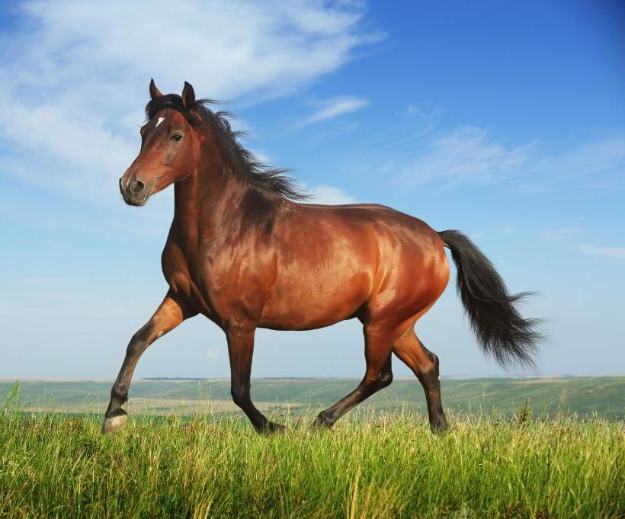
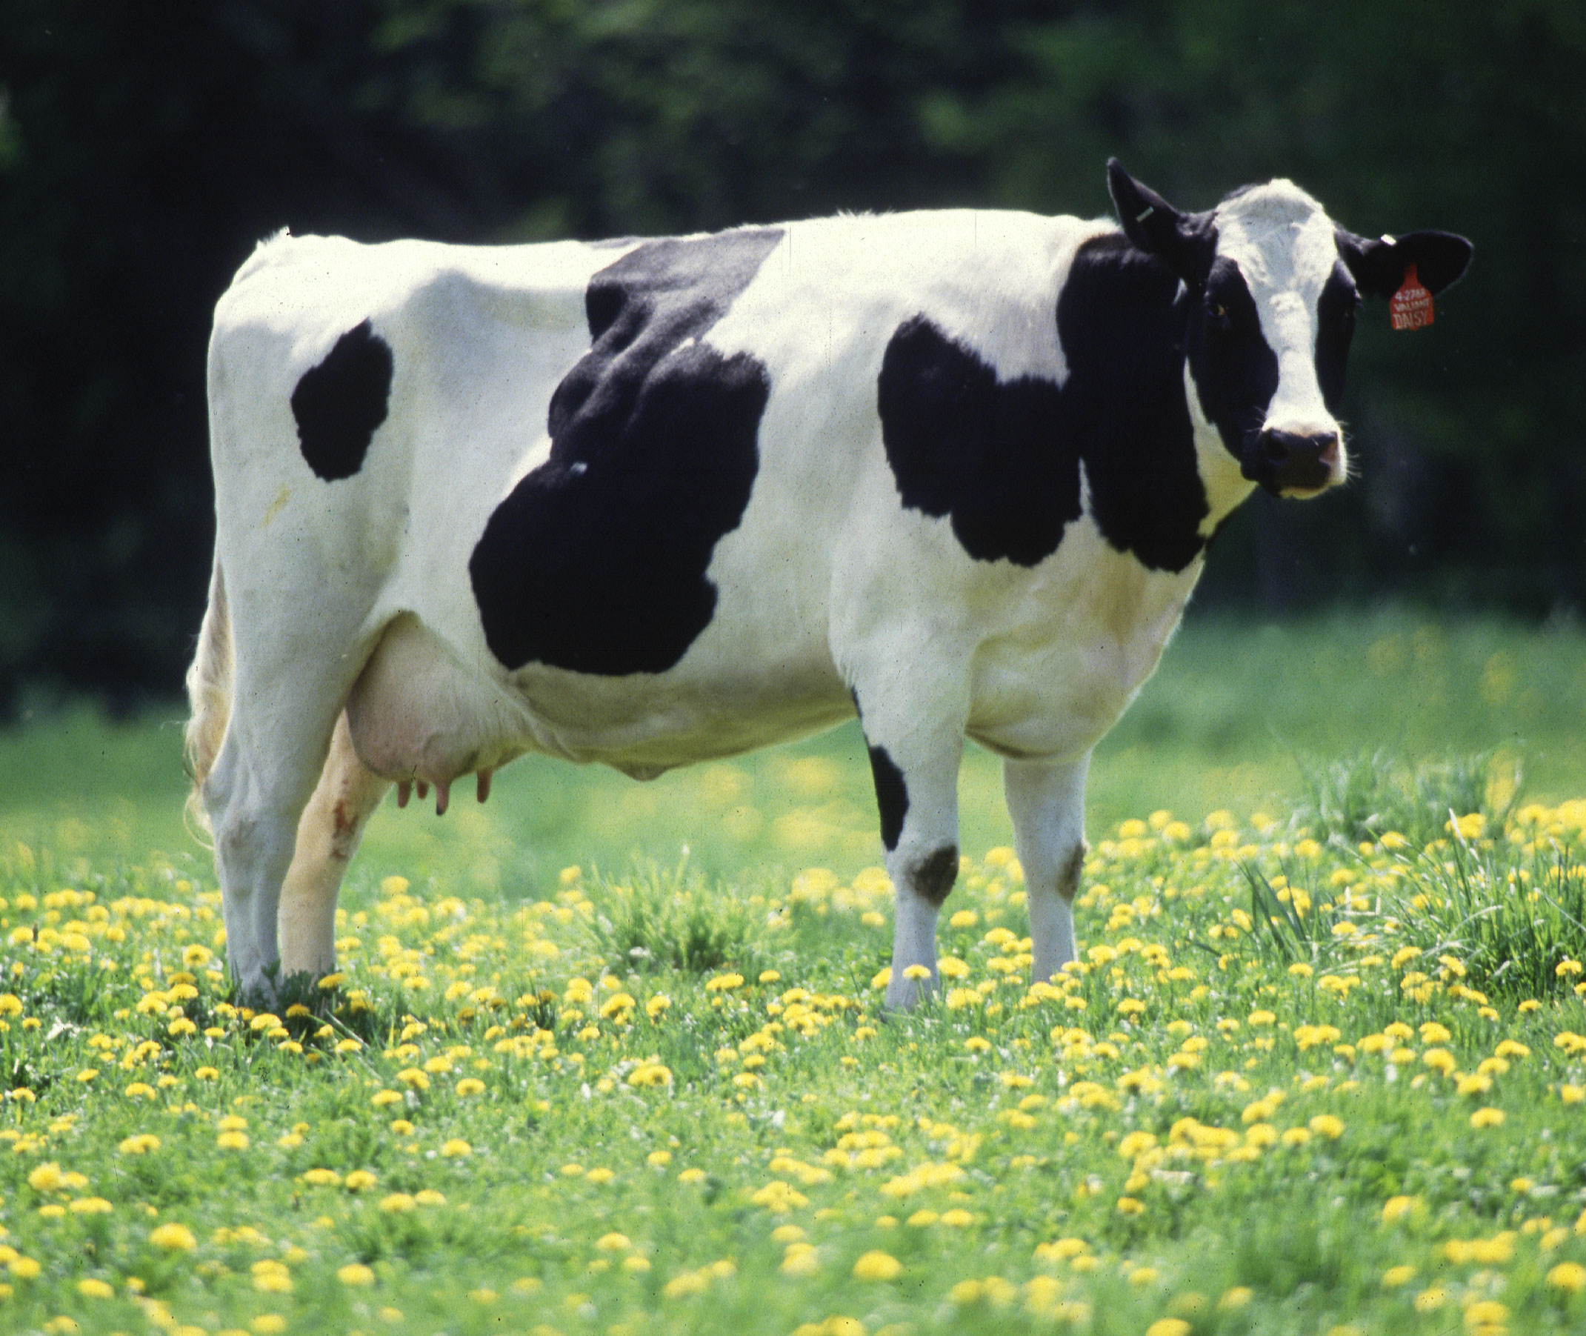
★
?
Horse
Algorithm
Cow
Horse
Input
Computer
Output

Slide 30
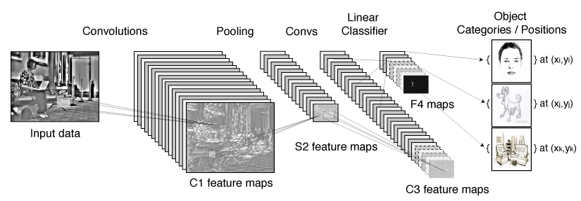
Convolutional Neural Networks
60 million parameters – 650,000 neurons – 6 days of training

Slide 31
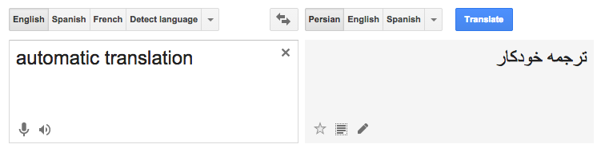
Applications of machine learning

Slide 32
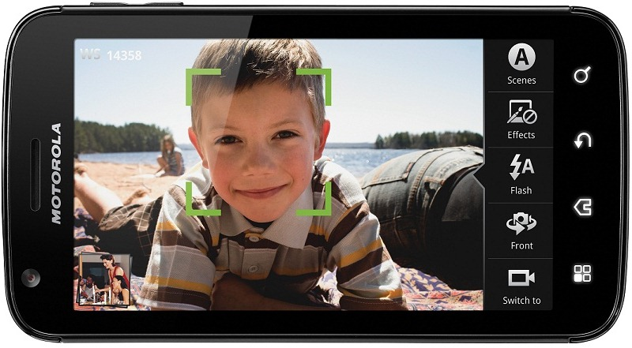
Applications of machine learning
Face recognition

Slide 33
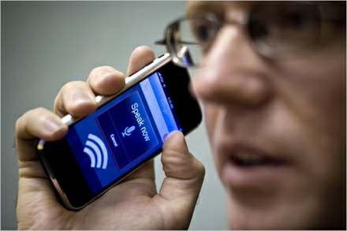
Applications of machine learning
Speech recognition

Slide 34
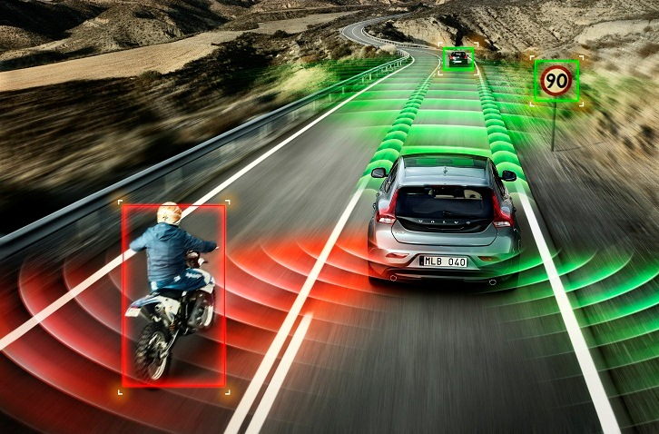
Applications of machine learning
Autonomous vehicles

Slide 35
Applications of machine learning
Machine perception
Computer vision
Natural language processing
Search engines
Medical diagnosis
Bioinformatics
Brain-machine interfaces
Cheminformatics
Detecting credit card fraud
Stock market analysis
Classifying DNA sequences
Handwriting recognition
Software engineering
Adaptive websites
Robot locomotion
Computational advertising
Computational finance
Structural health monitoring
Sentiment analysis
Affective computing
Information retrieval
Recommender systems

Slide 36
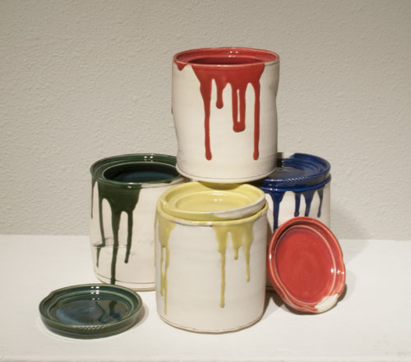
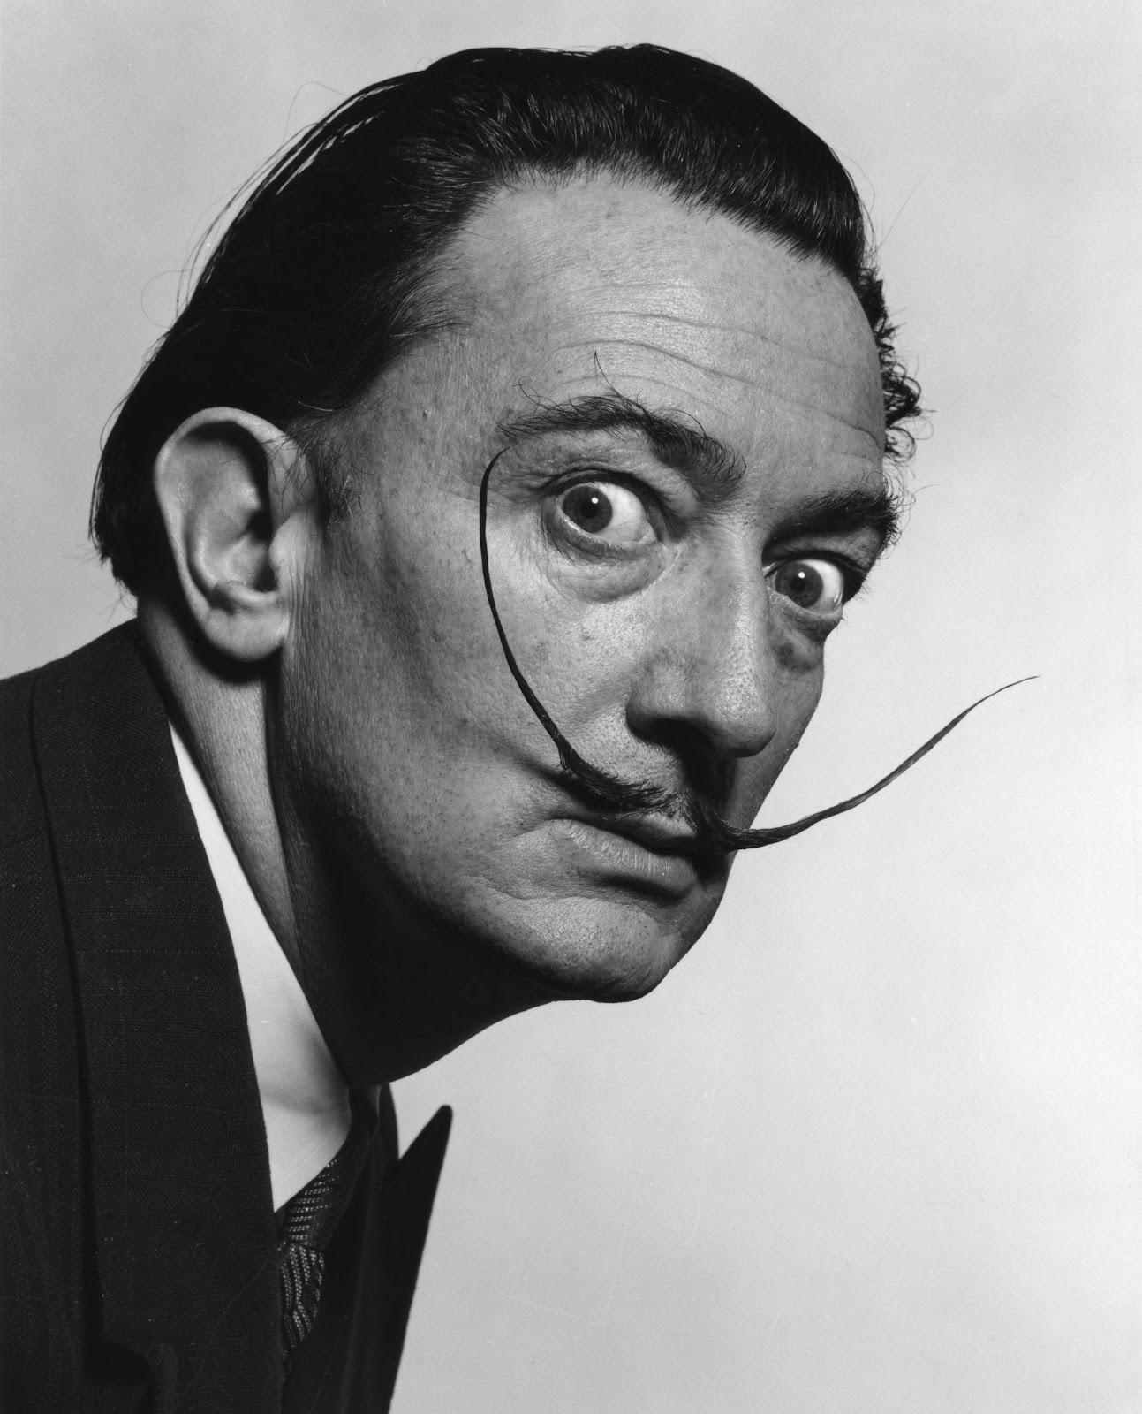
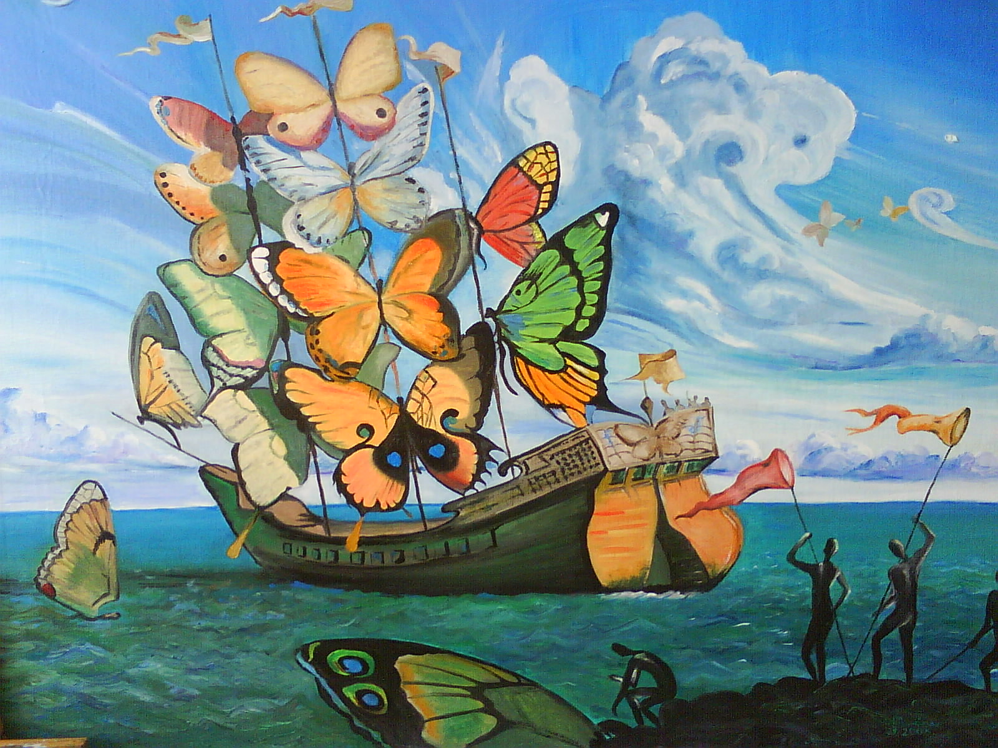
?
Algorithm
Input
Human
Computer
Output

Slide 37
What is modern AI composed of?

Slide 38
Artificial neural networks, Back-propagation, Auto-encoders, Hopfield networks, Boltzmann machines, Restricted Boltzmann machines, Spiking neural networks, Bayesian statistics, Bayesian networks, Bayesian knowledge bases, Decision trees, Inductive logic programming, Gaussian process regression, Gene expression programming, Learning Automata, Learning Vector Quantization, Logistic model trees, Instance-based learning, Nearest neighbors, Analogical modeling, Symbolic machine learning algorithms, Support vector machines, Random forests, Ensembles of classifiers, Bootstrap aggregating, Boosting, Ordinal classification, Conditional random fields, Linear classifiers, Fisher's linear discriminant, Logistic regression, Multinomial logistic regression, Naive Bayes classifiers, Perceptrons, Support vector machines, k-nearest neighbors, Boosting
1. Optimization
2. Sampling

Slide 39
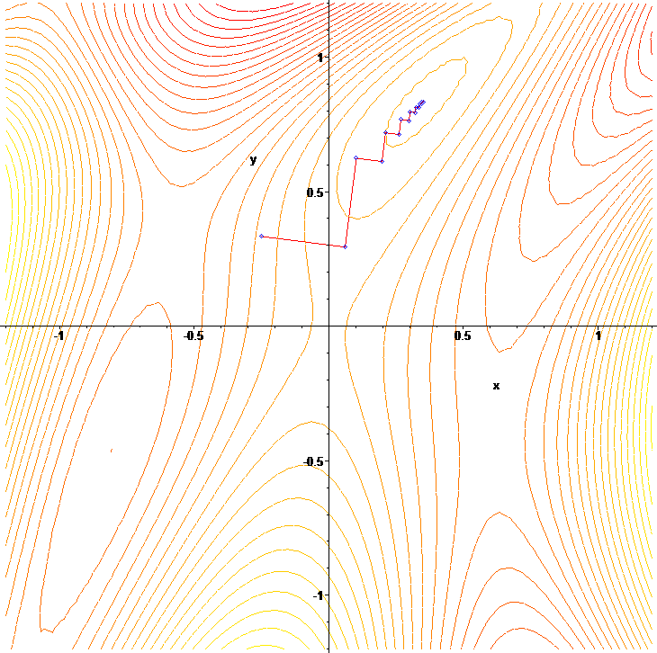
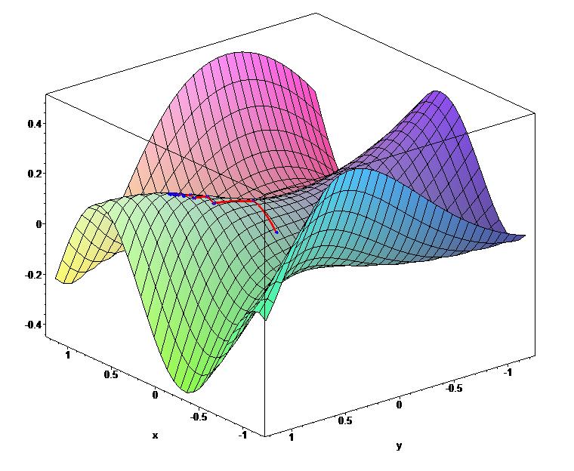
Optimization

Slide 40
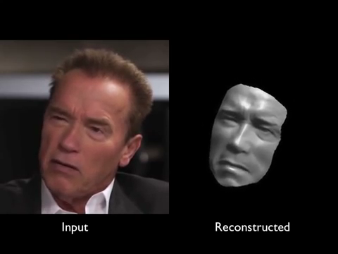
Supasorn Suwajanakorn et al. (2014)

Slide 41
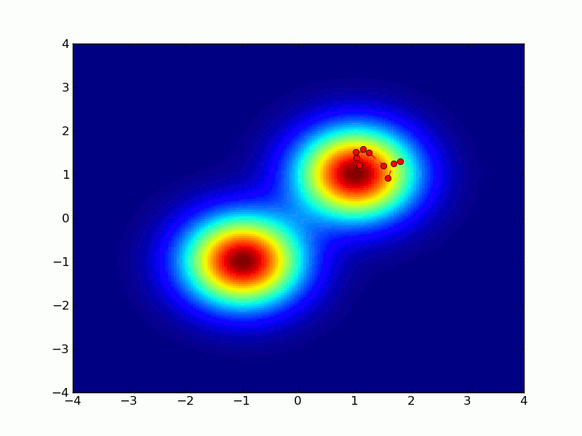
Sampling

Slide 42
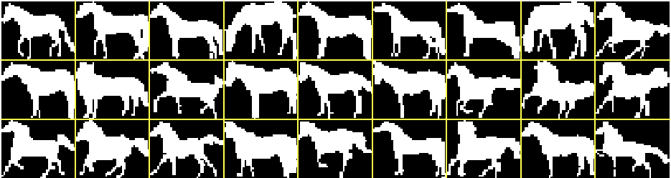
Learning to draw shapes
Learn a model via optimization.
Visualize model via sampling.

Slide 43
Learning to draw shapes

Slide 44
Learning to draw shapes
12 million parameters
4 hours to train
State-of-the-art realism
The Shape Boltzmann Machine: a Strong Model of Object Shape
S. M. Ali Eslami, Nicolas Heess, Christopher K. I. Williams, John Winn
International Journal of Computer Vision, Springer (2013)

Slide 45
How can AI be useful for design?

Slide 46
1. Industrialized variation

Slide 47
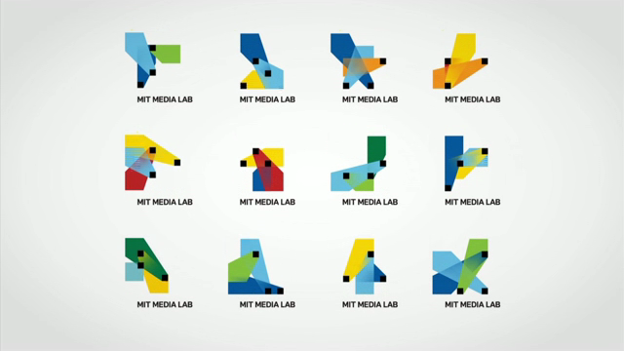
TheGreenEyl (2011)

Slide 48
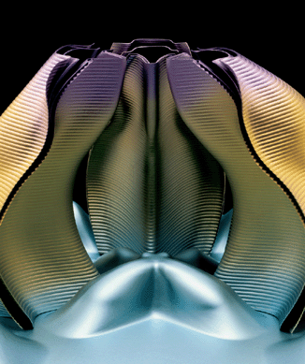
Gregg Lynn (2003)

Slide 49


Slide 50
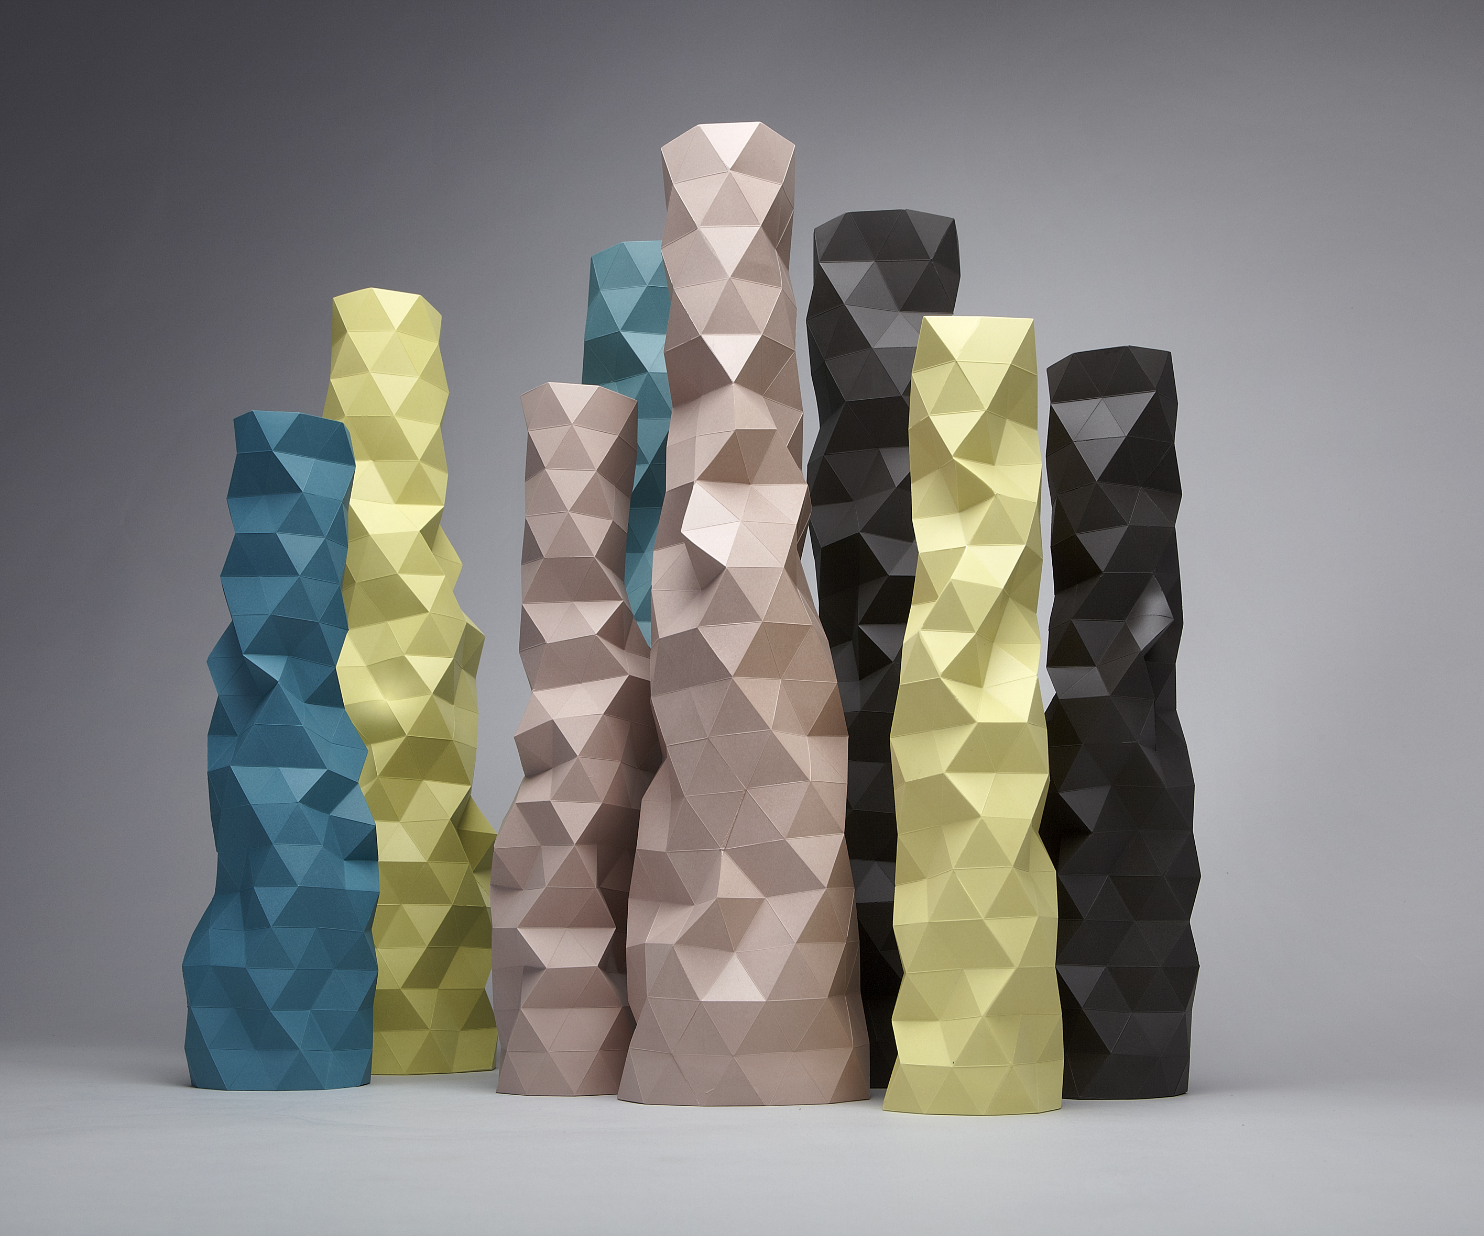
Phil Cuttance (2012)

Slide 51
2. Automated design

Slide 52
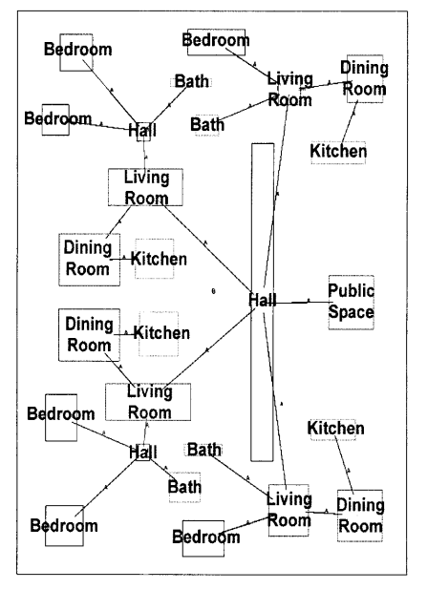
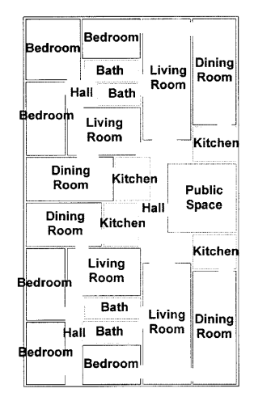
Jeremy Michalek et al. (2002)

Slide 53
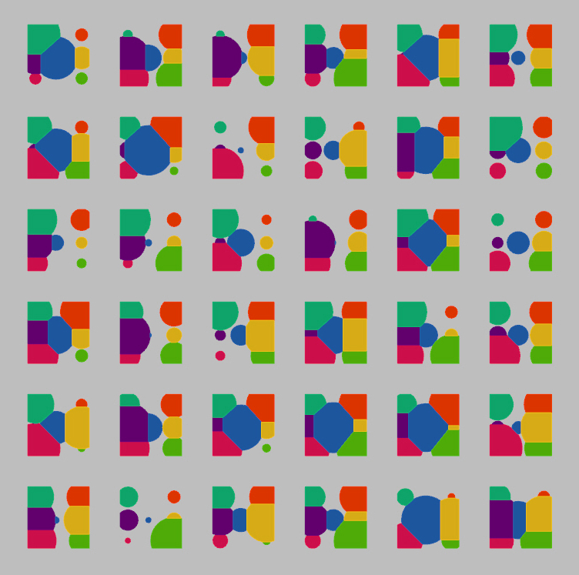
Pirouz Nourian and Samaneh Rezvani (2013)

Slide 54
3. Style learning

Slide 55
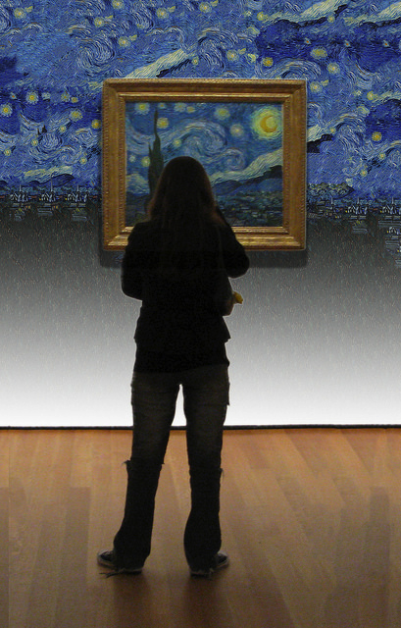
Yarin Gal (2014) extrapolated-art.com

Slide 56
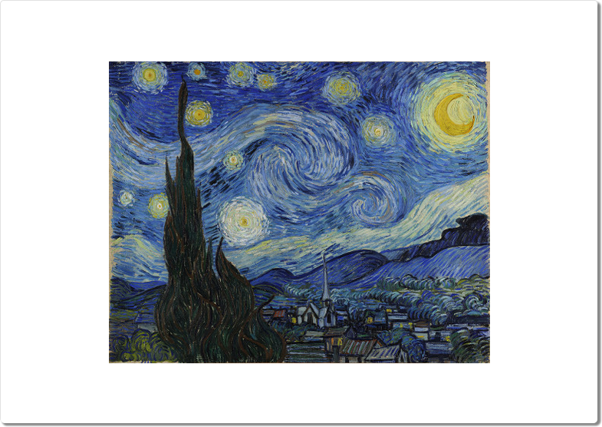
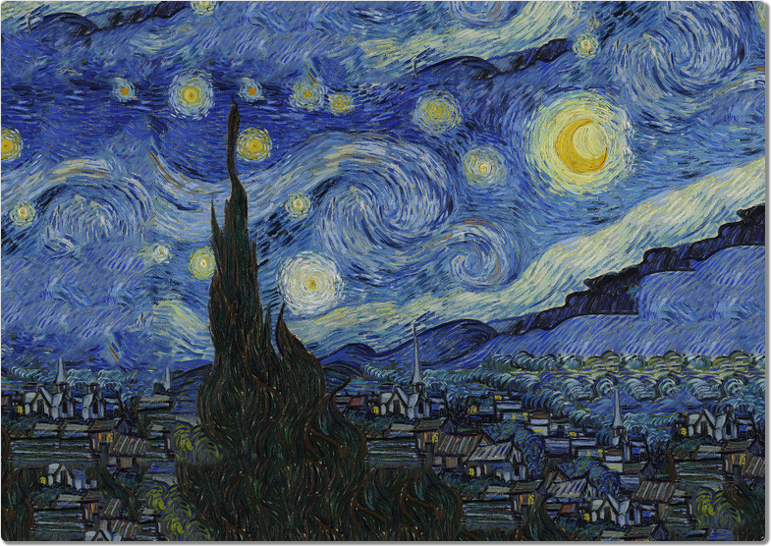

Slide 57
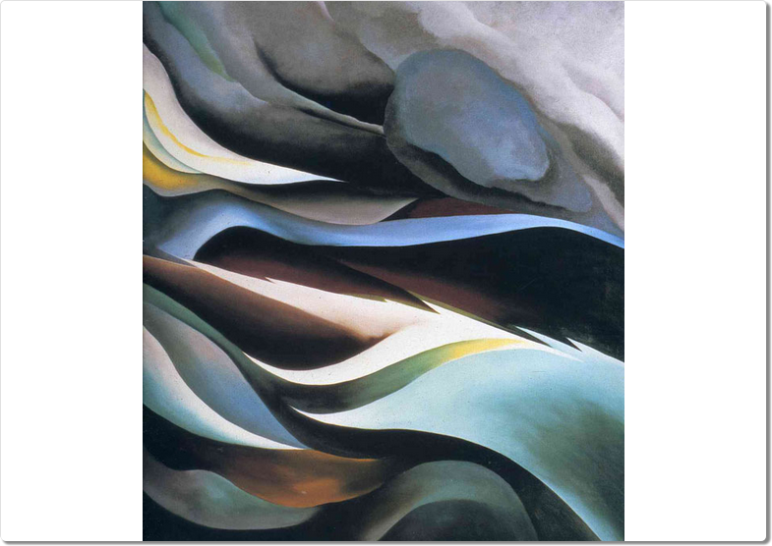


Slide 58
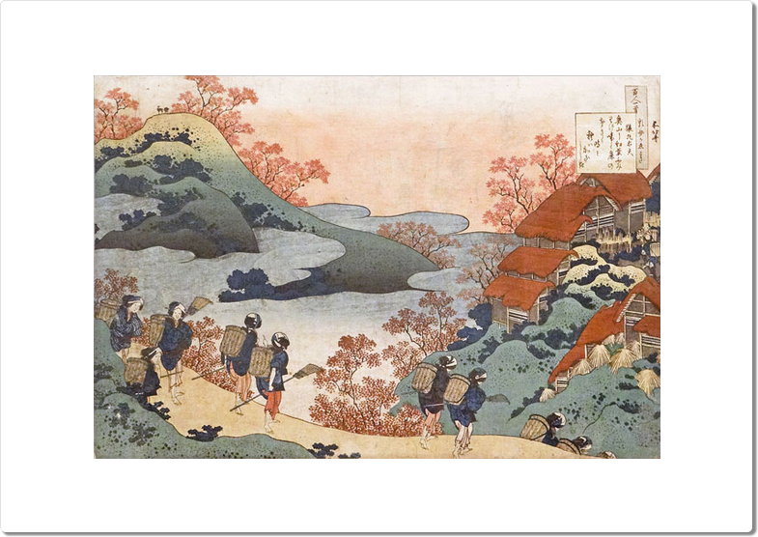
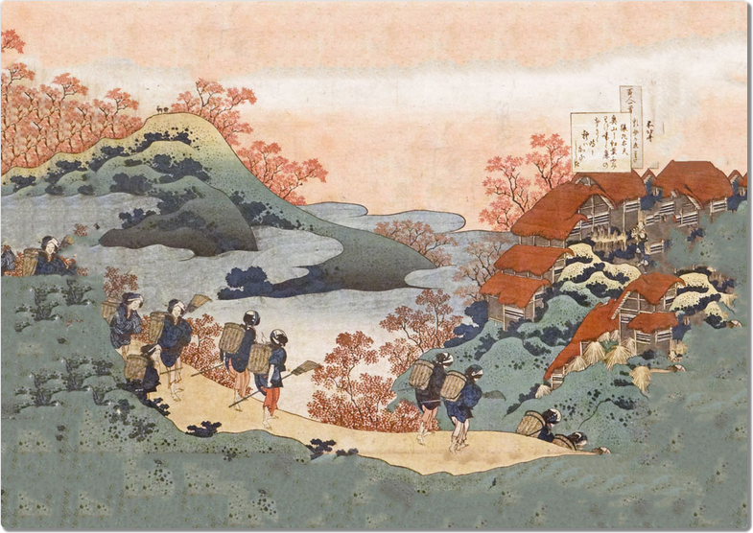

Slide 59
4. History of art

Slide 60
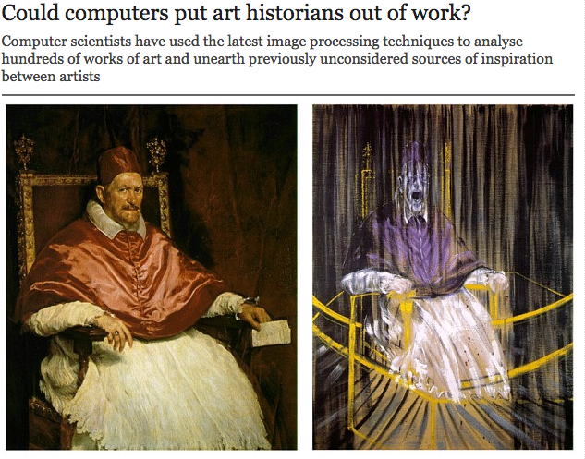
Babak Saleh et al. (2014)

Slide 61

Frederic Bazille (1870)
Norman Rockwell (1950)

Slide 62

Vincent van Gogh (1890)
Joan Miro (1922)

Slide 63
5. Human-in-the-loop design

Slide 64

digitalbottles.com, dardodel.com (2012)

Slide 65







Slide 66
12%

Slide 67

40.6% signup increase, ~$60m in extra donations

Slide 68
“I won’t miss a design philosophy that lives or dies strictly by the sword of data.”
Douglas Bowman, “Goodbye Google” (2009)

Slide 69
Will AI end the human race?

Slide 70

“[We’ve] built a better ladder; but a better ladder doesn’t necessarily get you to the moon...”
Gary Marcus (2012)

Slide 71
★
Algorithm
?
Input
Human
Output

Slide 72
http://arkitus.com

