Slide 1
Extensions to message-passing inference
S. M. Ali Eslami
September 2014

Slide 2
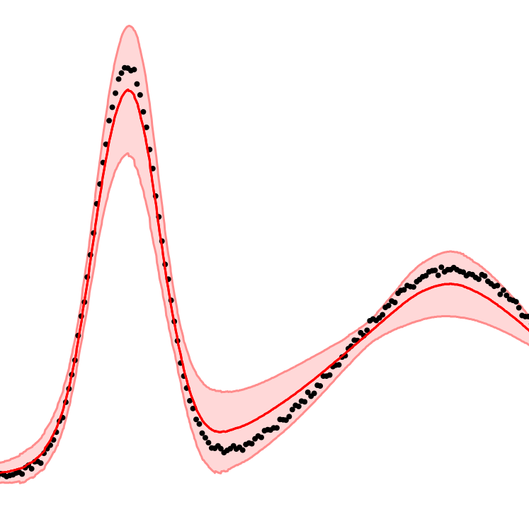

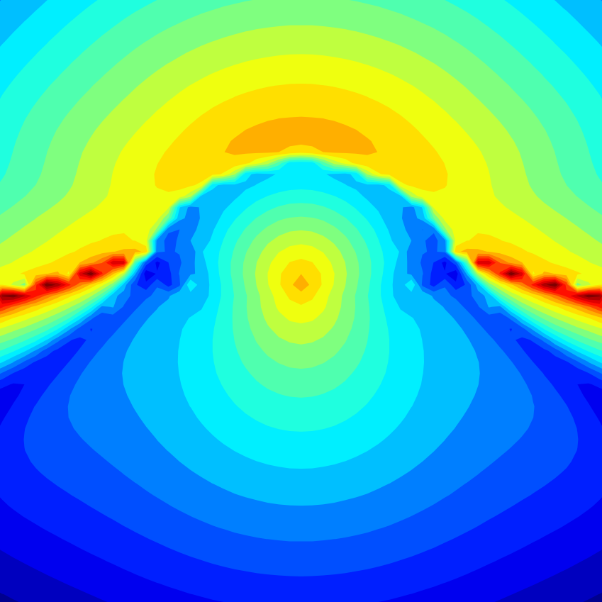


Outline
Just-in-time learning for message-passing
with Daniel Tarlow, Pushmeet Kohli, John Winn
Deep RL for ATARI games
with Arthur Guez, Thore Graepel
Contextual initialisation for message-passing
with Varun Jampani, Daniel Tarlow, Pushmeet Kohli, John Winn
Hierarchical RL for automated driving
with Diana Borsa, Yoram Bachrach, Pushmeet Kohli and Thore Graepel
Team modelling for learning of traits
with Matej Balog, James Lucas, Daniel Tarlow, Pushmeet Kohli and Thore Graepel

Slide 3
Probabilistic programming
Programmer specifies a generative model
Compiler automatically creates code for inference in the model

Slide 4
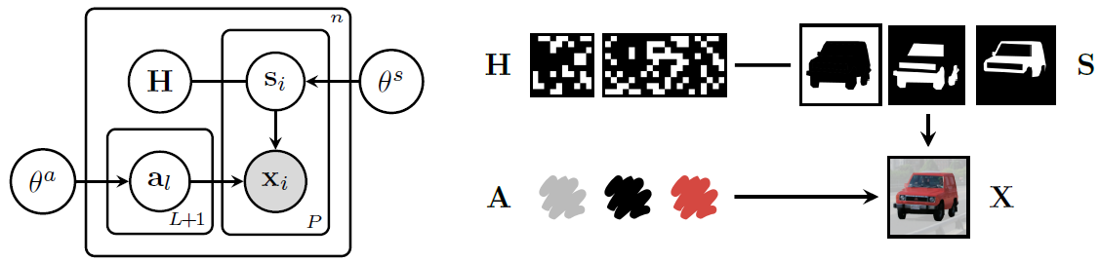
Probabilistic graphics programming?

Slide 5
Challenges
Specifying a generative model that is accurate and useful
Compiling an inference algorithm for it that is efficient

Slide 6


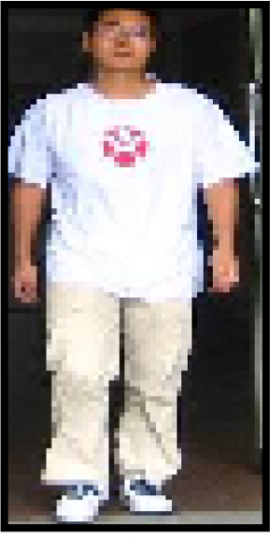
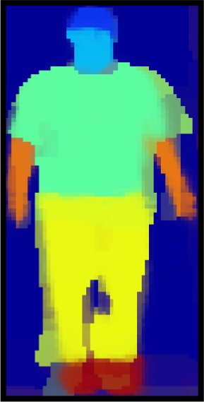
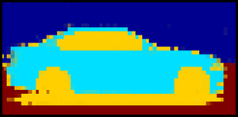
Generative probabilistic models for vision
Manually designed inference
FSA
BMVC 2011
SBM
CVPR 2012
MSBM
NIPS 2013

Slide 7
Why is inference hard?
Sampling
Inference can mix slowly
Active area of research
Message-passing
Computation of messages can be slow (e.g. if using quadrature or sampling)
Just-in-time learning (part 1)
Inference can require many iterations and may converge to bad fixed points
Contextual initialisation (part 2)

Slide 8
Just-In-Time Learning for Inference
with Daniel Tarlow, Pushmeet Kohli, John Winn
NIPS 2014

Slide 9
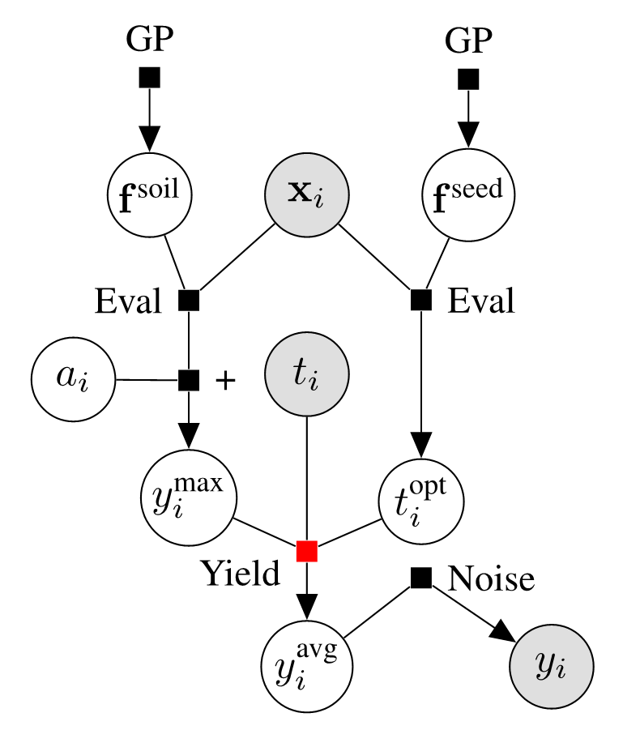
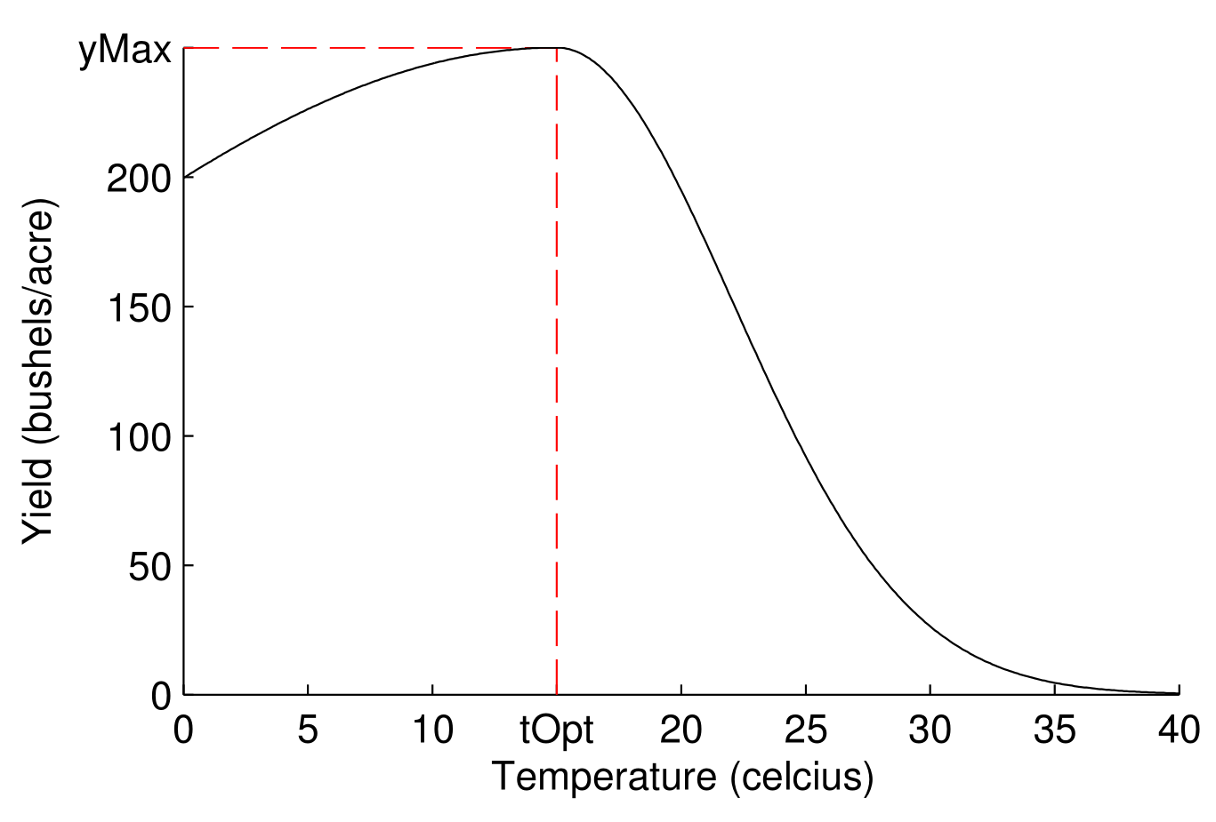
Motivating example
Ecologists have strong empirical beliefs about the form of the relationship between temperature and yield.
It is important for them that the relationship is modelled faithfully.
We do not have a fast implementation of the Yield factor in Infer.NET.

Slide 10
Problem overview
Implementing a fast and robust factor is not always trivial.
Approach
Use general algorithms (e.g. Monte Carlo sampling or quadrature) to compute message integrals.
Gradually learn to increase the speed of computations by regressing from incoming to outgoing messages at run-time.

Slide 11





Message-passing
Incoming
message
group
Outgoing
message

Slide 12
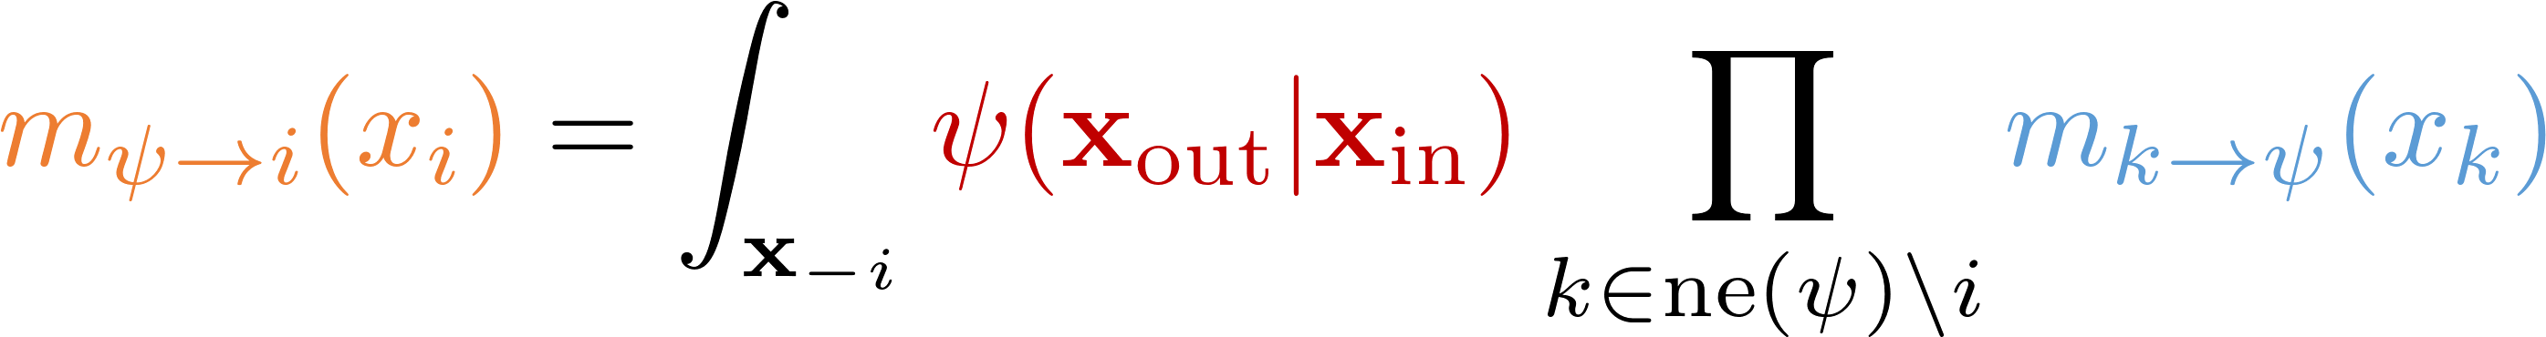
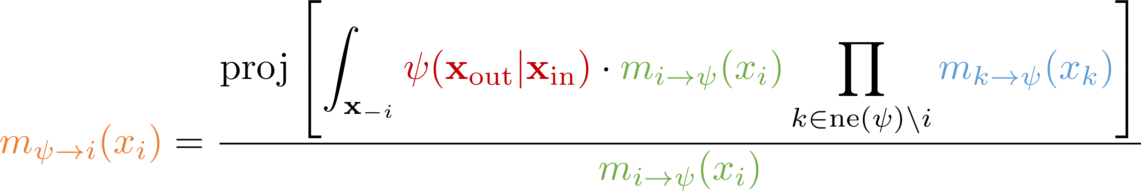
Belief and expectation propagation

Slide 13
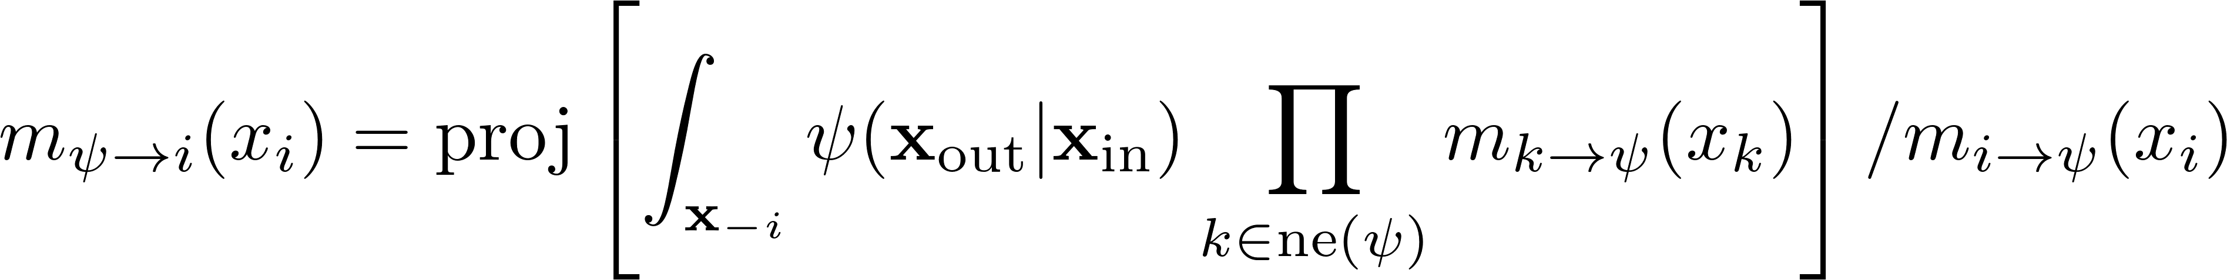
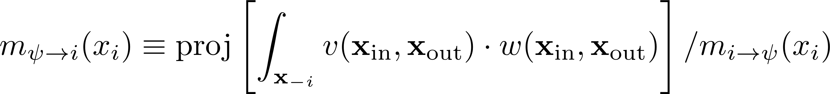
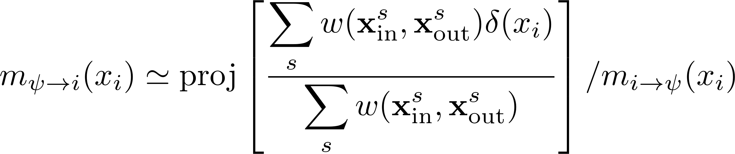
How to compute messages for any $ψ$

Slide 14

Learning to pass messages
Heess, Tarlow and Winn (2013)
Oracle allows us to compute all messages for any factor of interest:
However, sampling can be very slow. Instead, learn a direct mapping, parameterized by $Θ$, from incoming to outgoing messages:

Slide 15
Learning to pass messages
Heess, Tarlow and Winn (2013)
Before inference
Create a dataset of plausible incoming message groups.
Compute outgoing messages for each group using oracle.
Employ regressor to learn the mapping.
During inference
Given a group of incoming messages:
Use regressor to predict parameters of outgoing message.

Slide 16
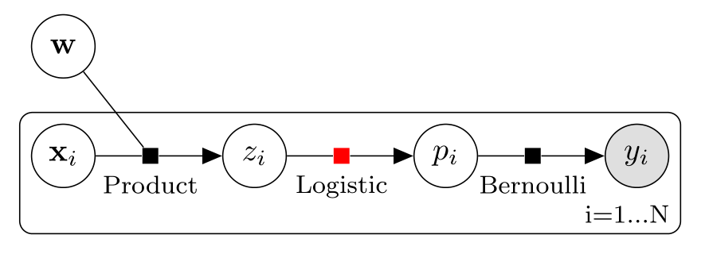
Logistic regression

Slide 17
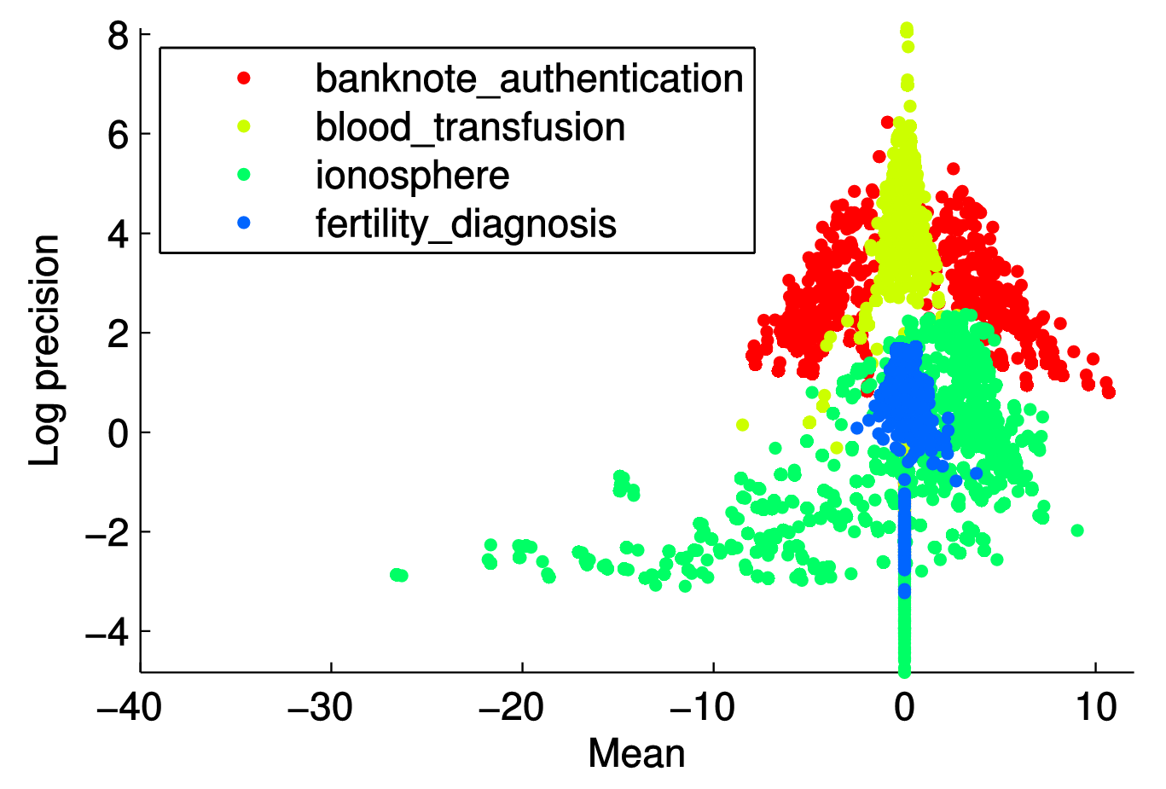
Logistic regression
4 random UCI datasets

Slide 18
Learning to pass messages – an alternative approach
Just-in-time learning
Before inference
Do nothing.
During inference
Given a group of incoming messages:
If unsure:
  Consult oracle for answer and update regressor.
Otherwise:
  Use regressor to predict parameters of outgoing message.

Slide 19
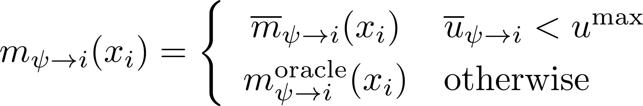
Learning to pass messages
Just-in-time learning
Need an uncertainty aware regressor:
Then:

Slide 20
Random decision forests for JIT learning
Tree 1
Tree 2
Tree T

Slide 21
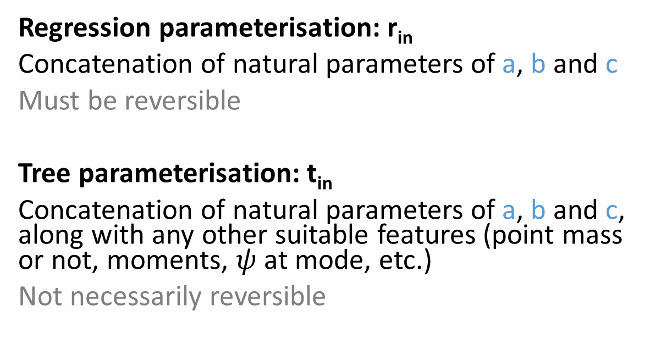
Random decision forests for JIT learning
Parameterisation
Regression parameterisation: r_{in}
Concatenation of natural parameters of a, b and c
Must be reversible
Tree parameterisation: t_{in}
Concatenation of natural parameters of a, b and c, along with any other suitable features (point mass or not, moments, $ψ$ at mode, etc.)
Not necessarily reversible

Slide 22
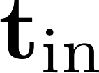
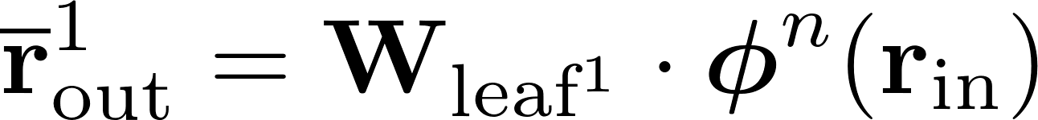
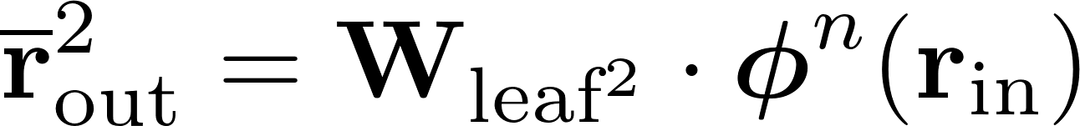
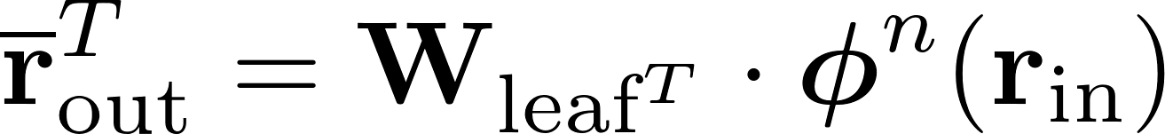
Random decision forests for JIT learning
Prediction model
Tree 1
Tree 2
Tree T

Slide 23
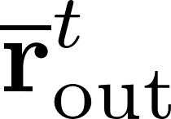
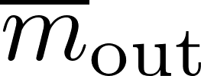
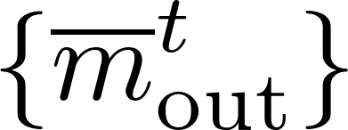
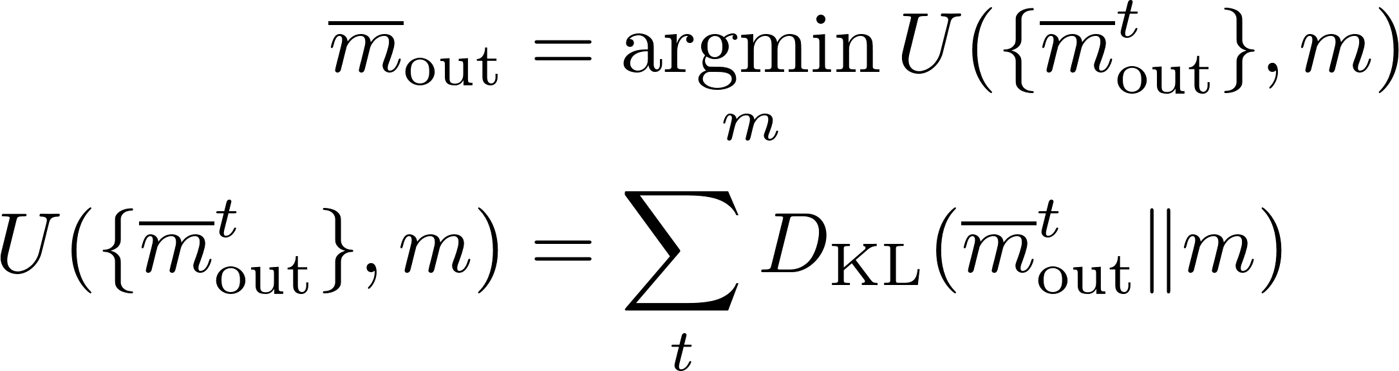
Random decision forests for JIT learning
Ensemble model
Could take the element-wise average of the parameters and reverse to obtain outgoing message .
  Sensitive to chosen parameterisation.
  Instead, compute the moment average of the distributions .

Slide 24
Random decision forests for JIT learning
Uncertainty model
  Use degree of agreement in predictions as a proxy for uncertainty.
  If all trees predict the same output, it means that their knowledge about the mapping is similar despite the randomness in their structure.
  Conversely, if there is large disagreement between the predictions, then the forest has high uncertainty.

Slide 25
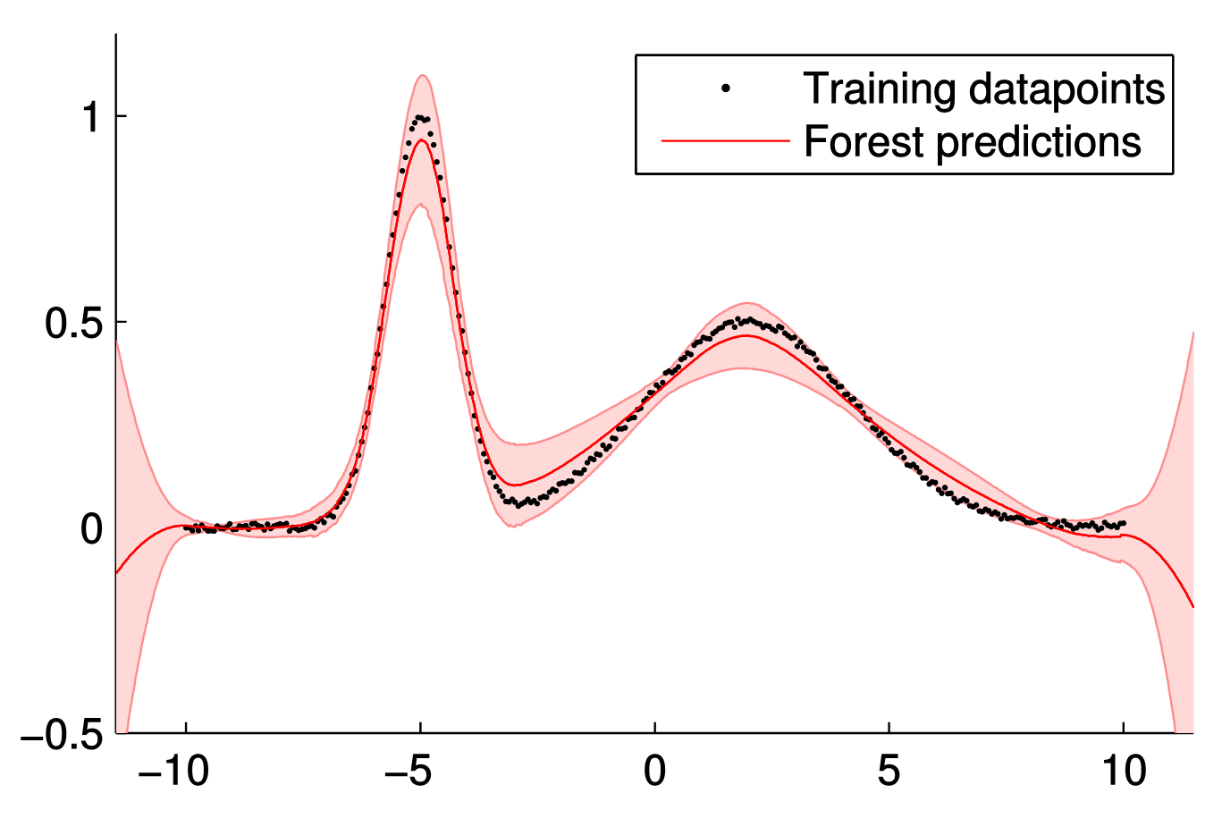
Random decision forests for JIT learning
2 feature samples per node – maximum depth 4 – regressor degree 2 – 1,000 trees

Slide 26
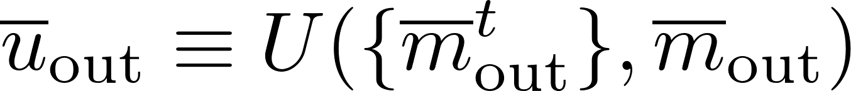
Random decision forests for JIT learning
Ensemble model
  Compute the moment average of the distributions .
  Use degree of agreement in predictions as a proxy for uncertainty:

Slide 27
Random decision forests for JIT learning
Training objective function
How good is a prediction? Consider effect on induced belief on target random variable:
Focus on the quantity of interest: accuracy of posterior marginals.
Train trees to partition training data in a way that the relationship between incoming and outgoing messages is well captured by regression, as measured by symmetrised marginal KL.

Slide 28
Results

Slide 29
Logistic regression

Slide 30
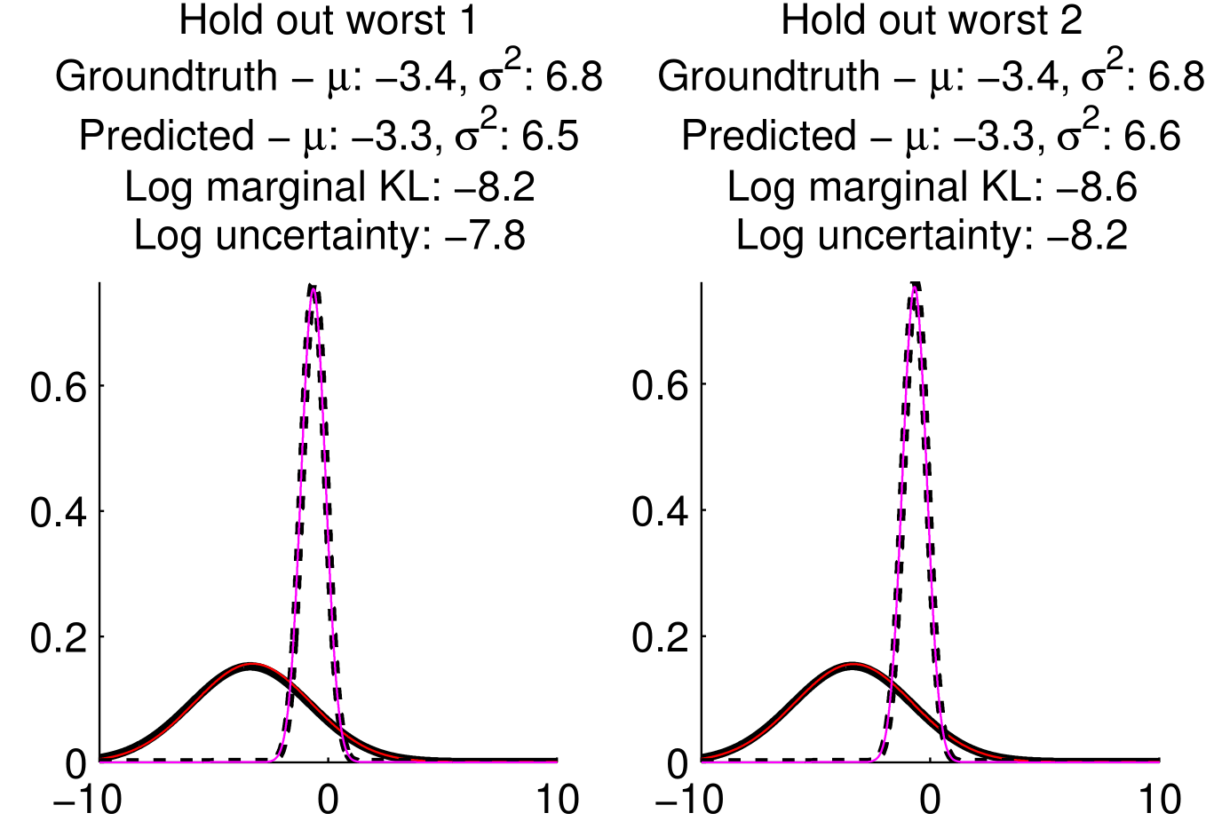
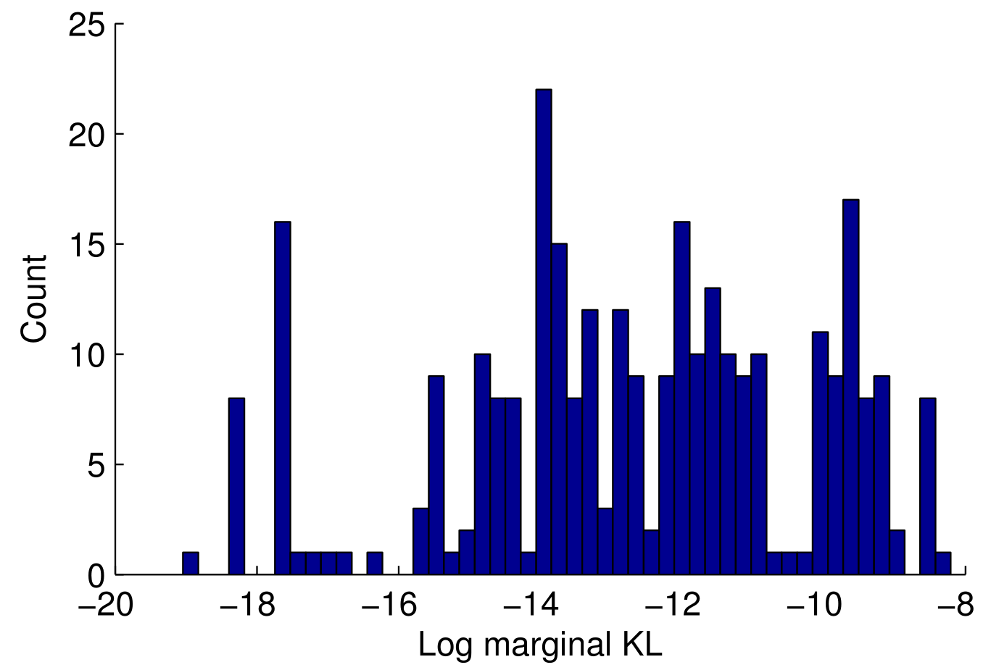
Uncertainty aware regression of a logistic factor
Are the forests accurate?

Slide 31
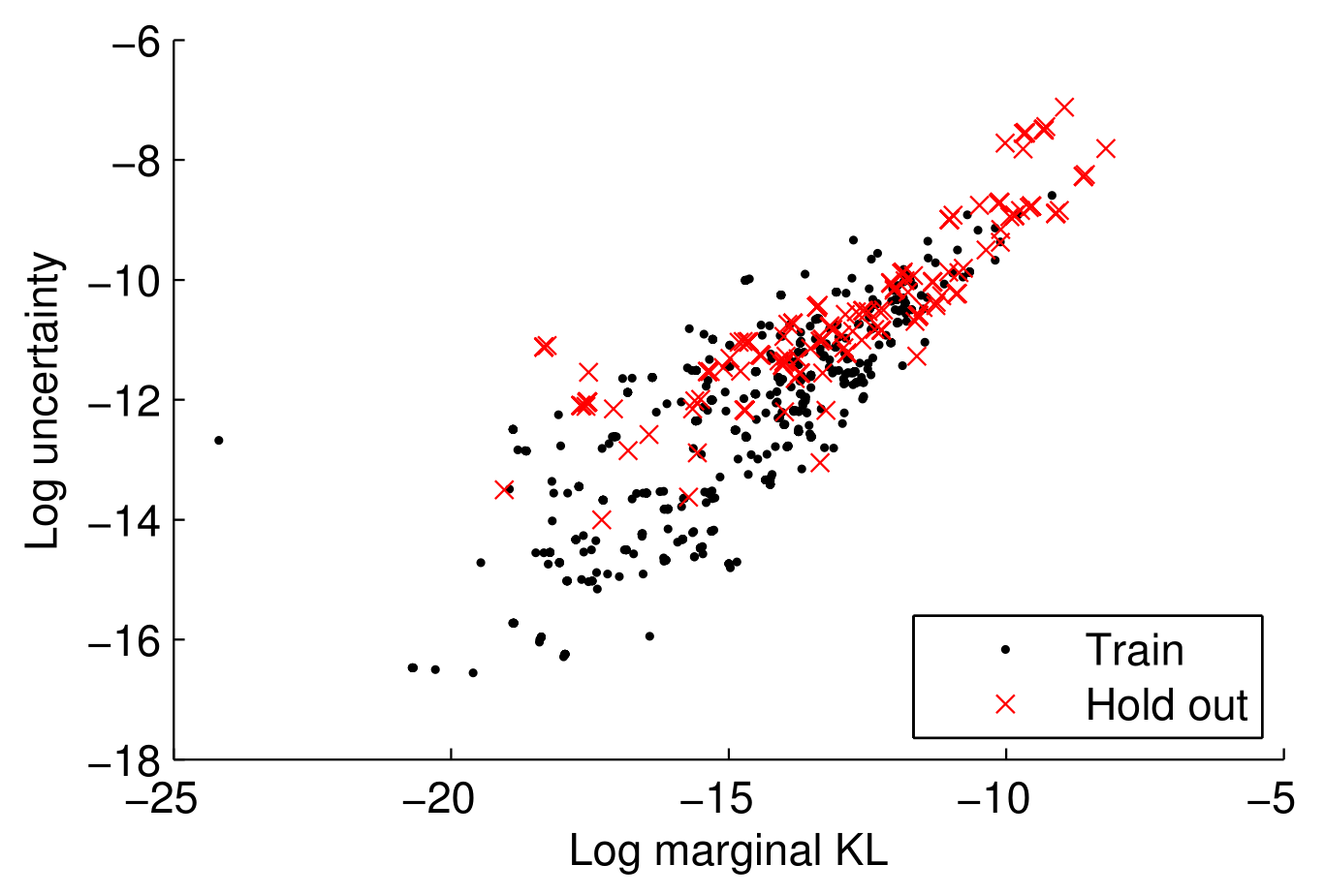
Uncertainty aware regression of a logistic factor
Are the forests uncertain when they should be?

Slide 32
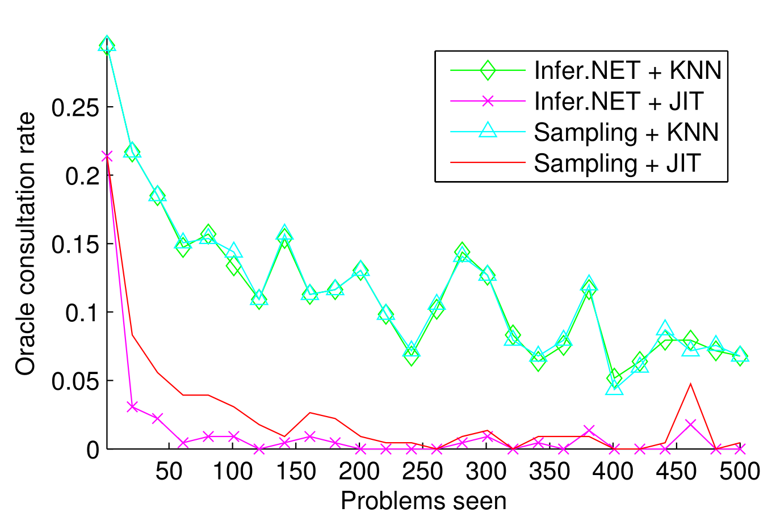
Just-in-time learning of a logistic factor
Oracle consultation rate

Slide 33
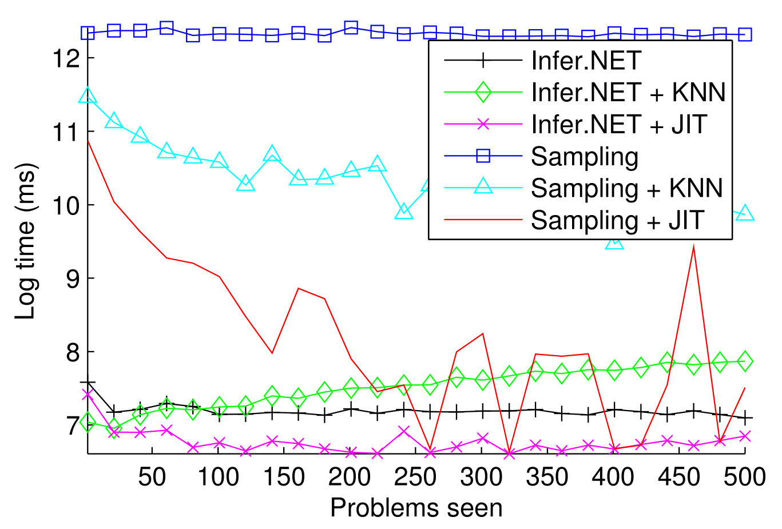
Just-in-time learning of a logistic factor
Inference time

Slide 34
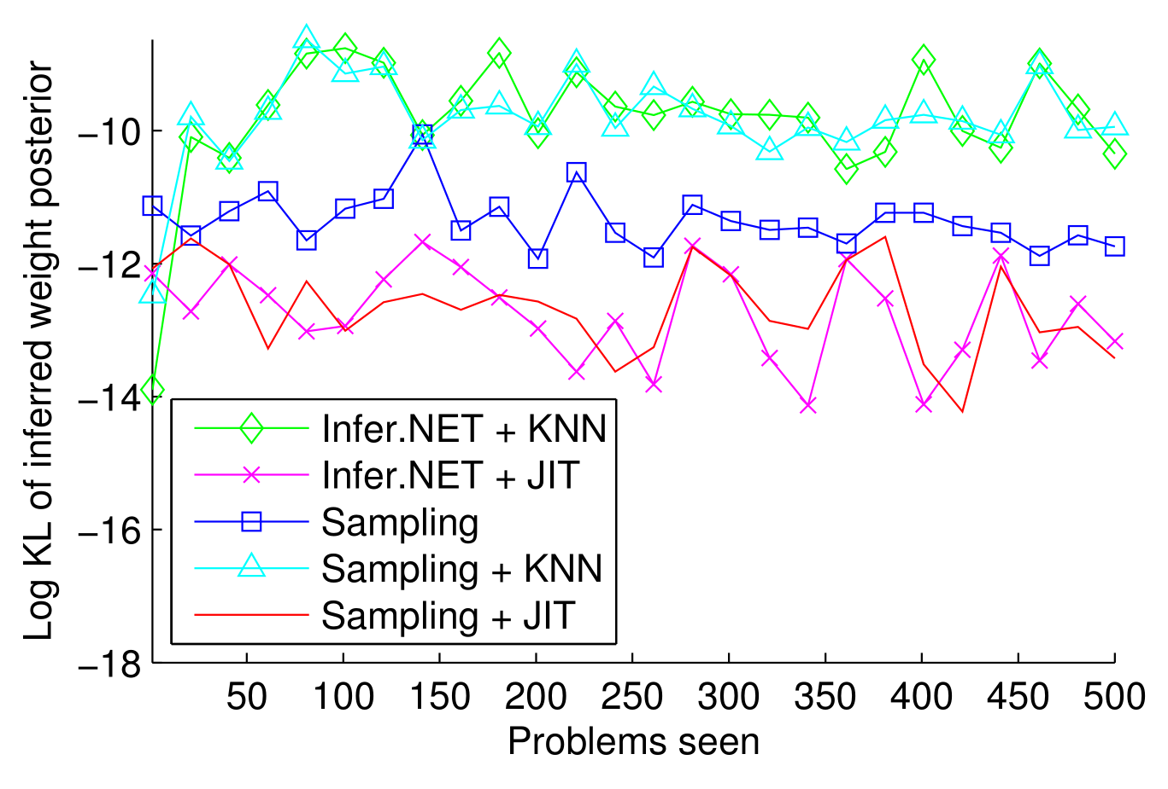
Just-in-time learning of a logistic factor
Inference error

Slide 35
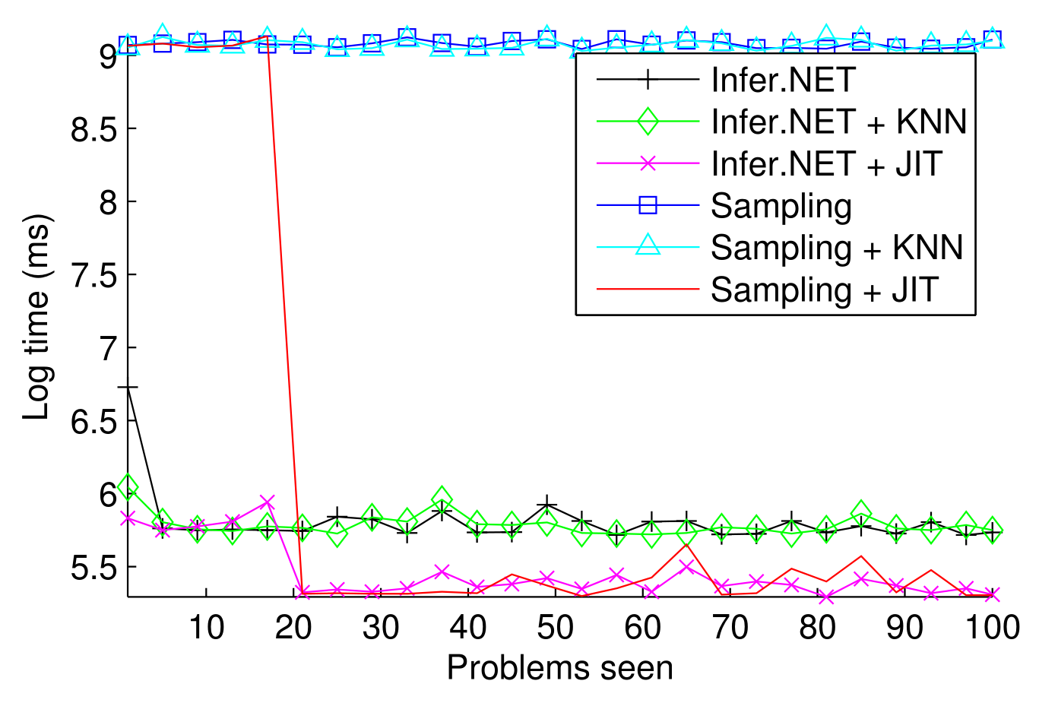
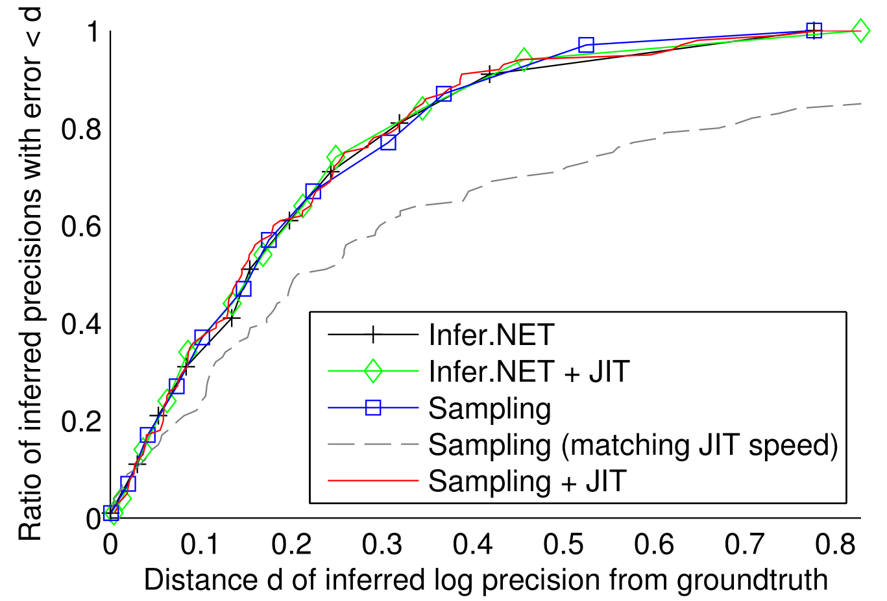
Just-in-time learning of a compound gamma factor

Slide 36
A model of corn yield

Slide 37
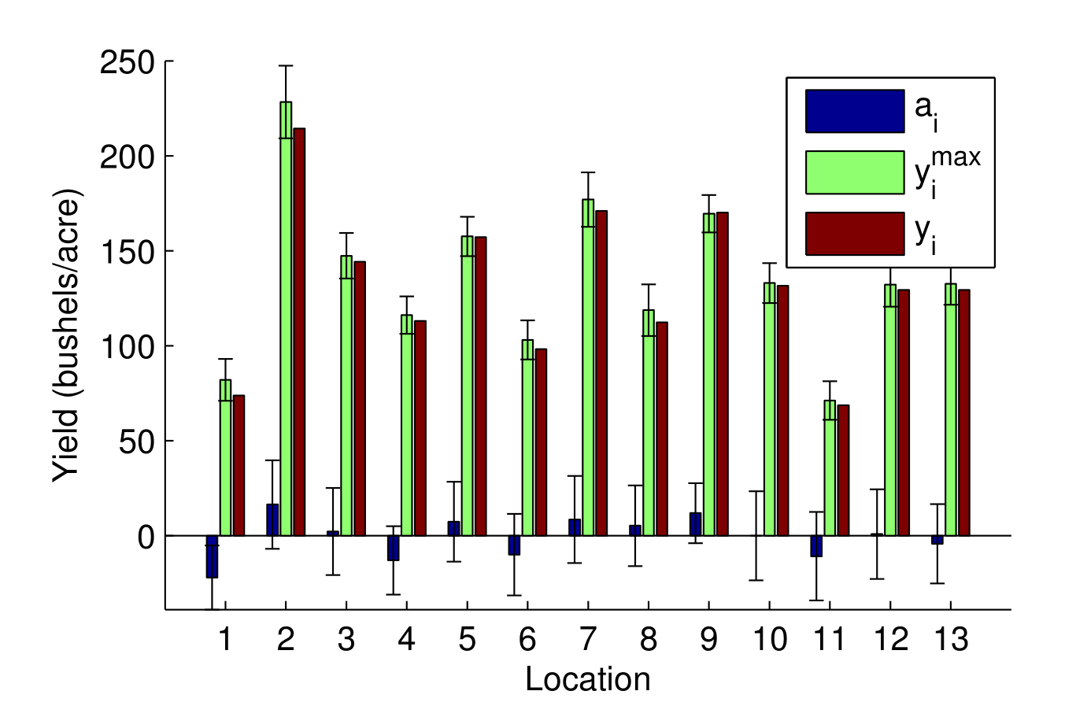
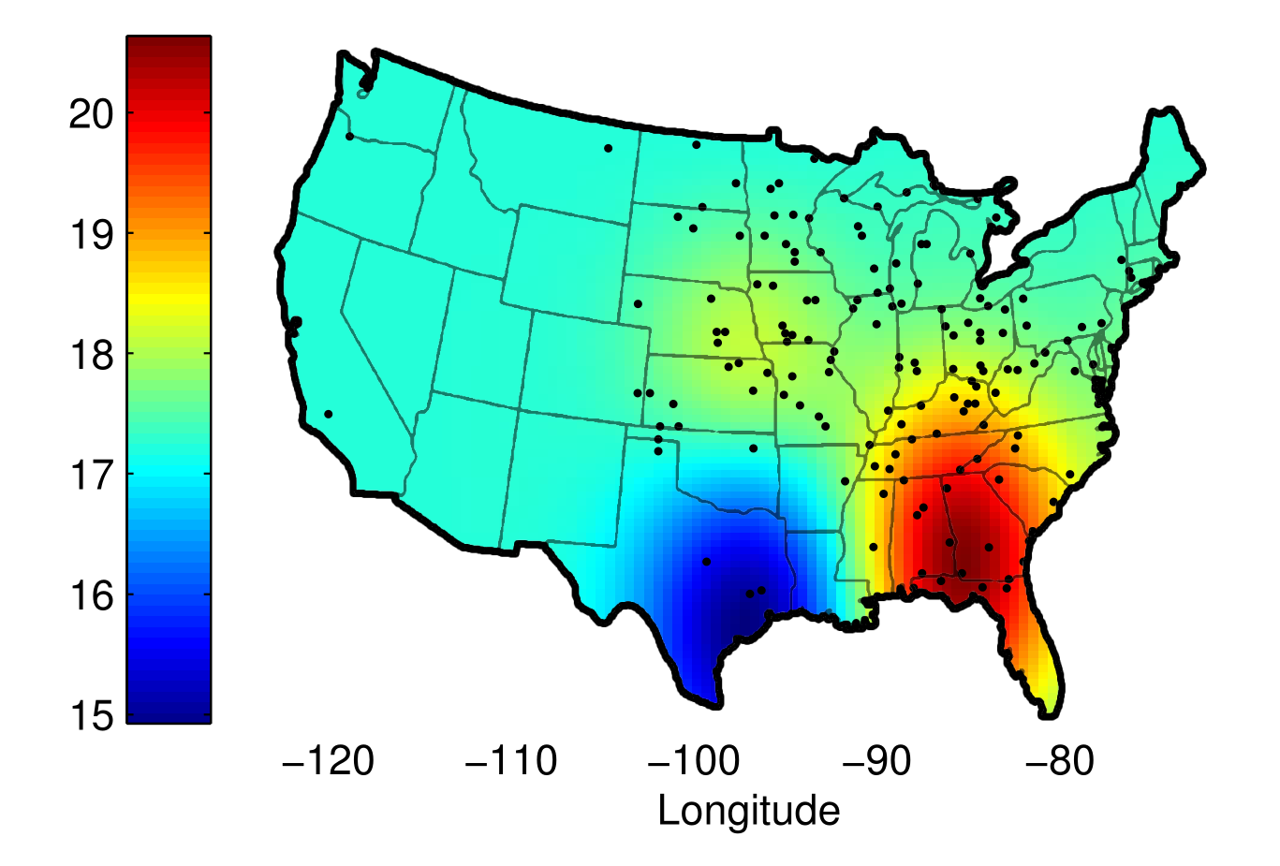
USDA National Agricultural Statistics Service (2011 – 2013)
Inference works

Slide 38
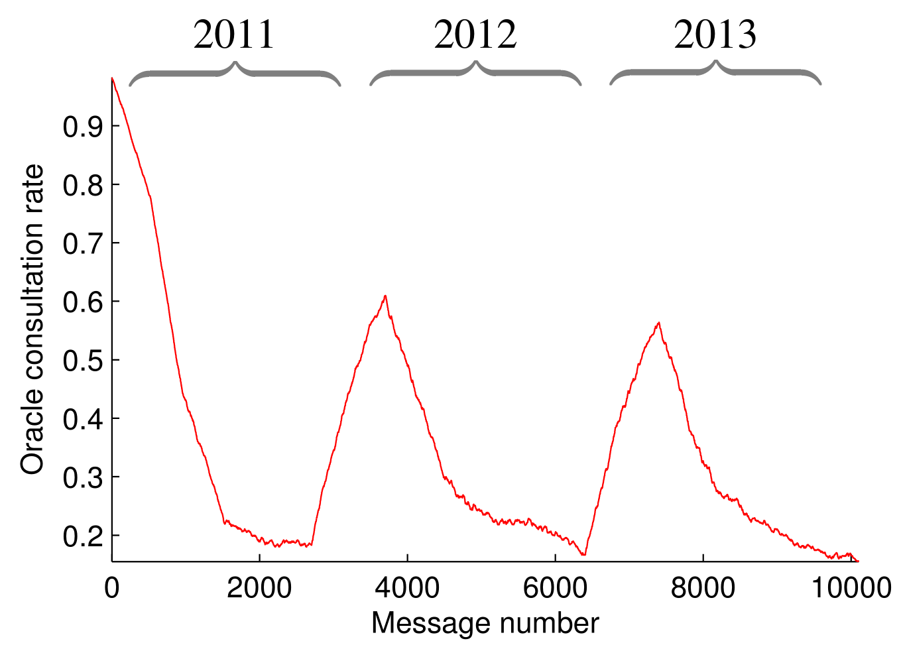
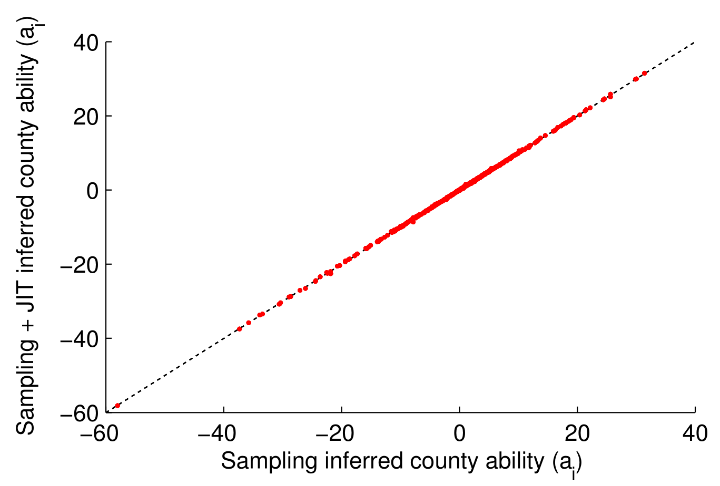
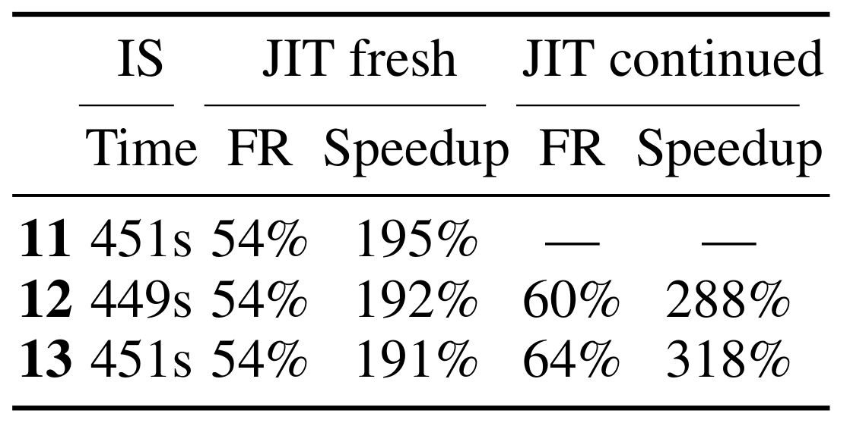
Just-in-time learning of a yield factor

Slide 39
Summary
Speed up message passing inference using JIT learning:
  Savings in human time (no need to implement factor operators).
  Savings in computer time (reduce the amount of computation).
JIT can even accelerate hand-coded message operators.
Open questions
Better measure of uncertainty?
Better methods for choosing u^{max}?

Slide 40


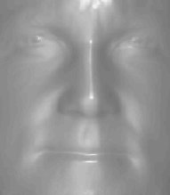
Contextual Initialisation Machines
With Varun Jampani, Daniel Tarlow, Pushmeet Kohli, John Winn

Slide 41
Gauss and Ceres
A deceptively simple problem

Slide 42
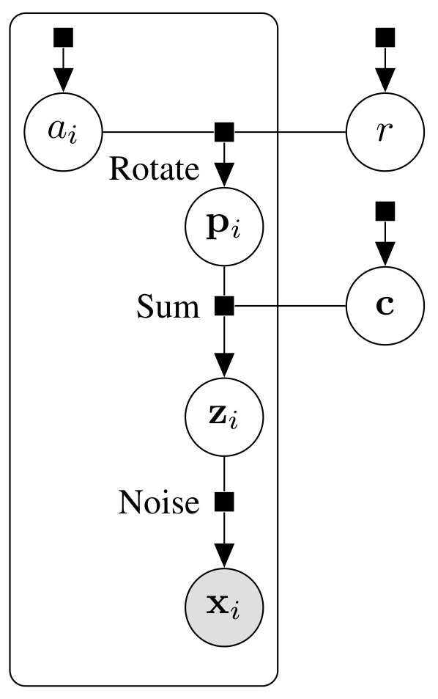
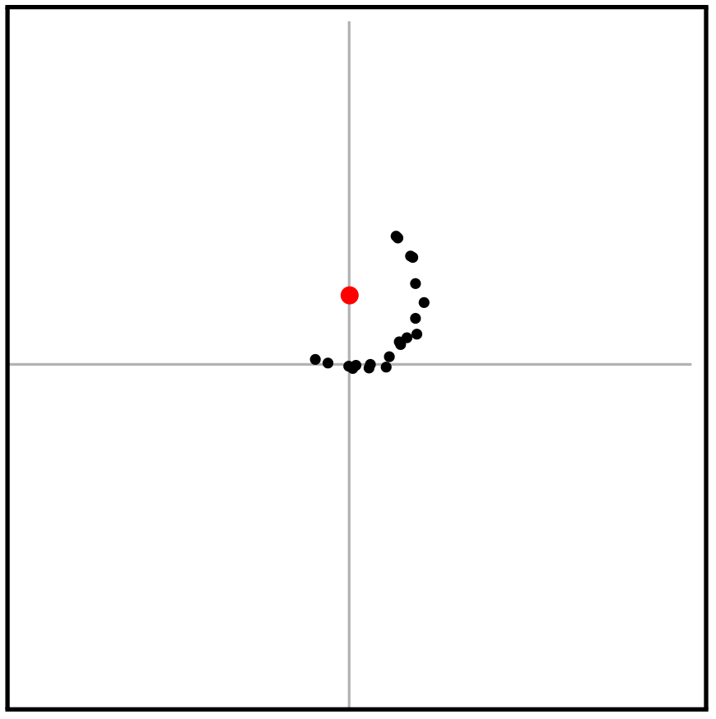
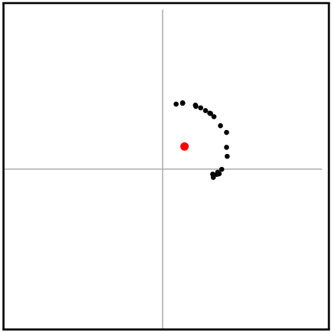
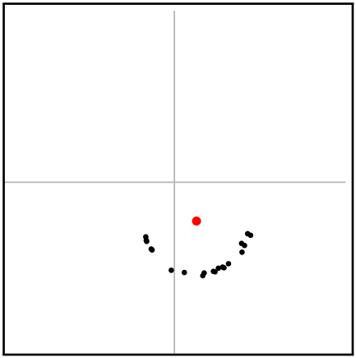
A point model of circles

Slide 43
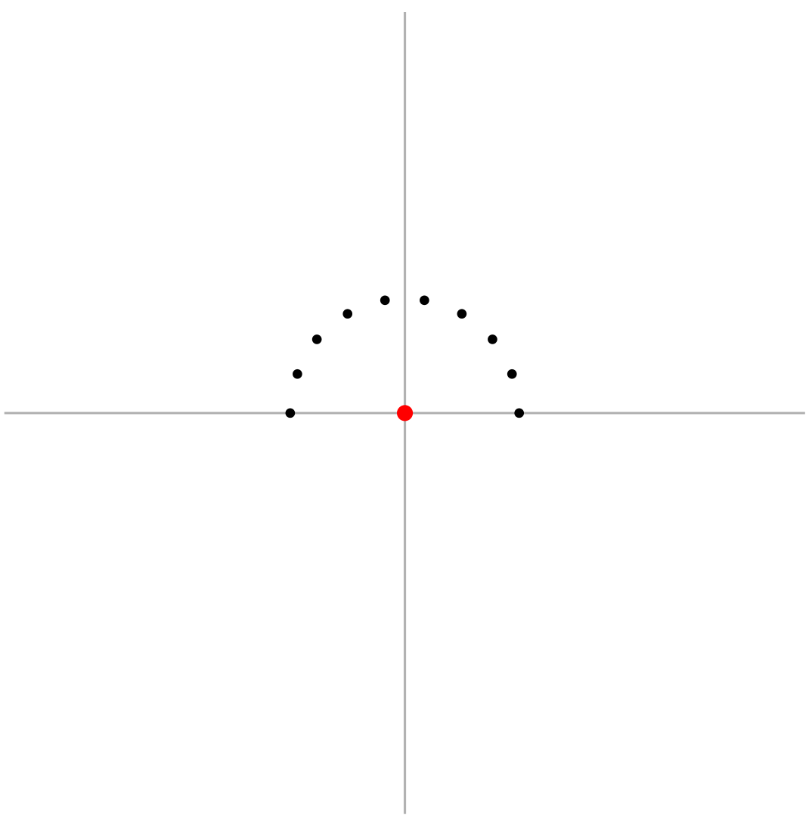

Slide 44
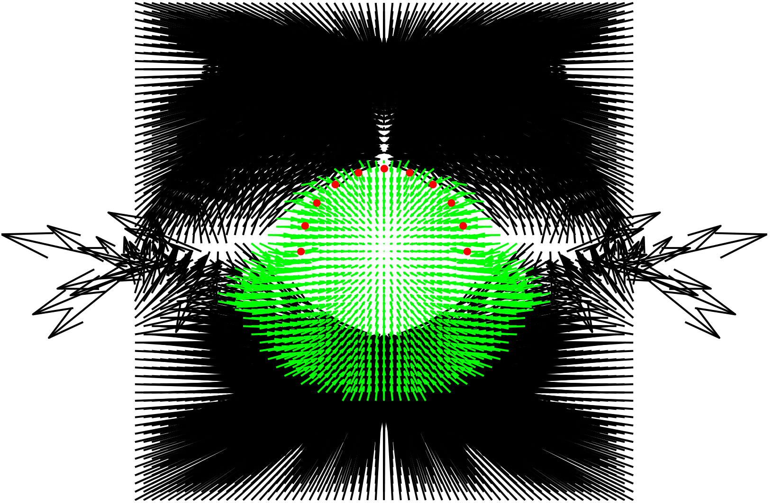

Slide 45
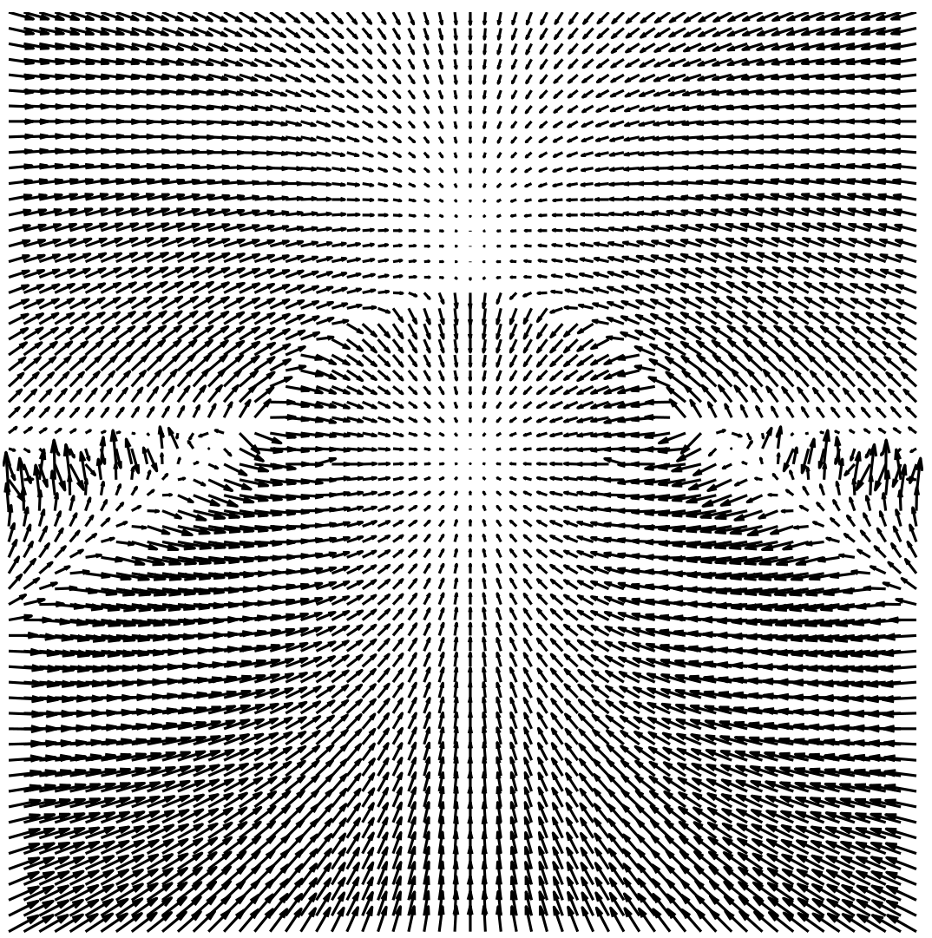

Slide 46
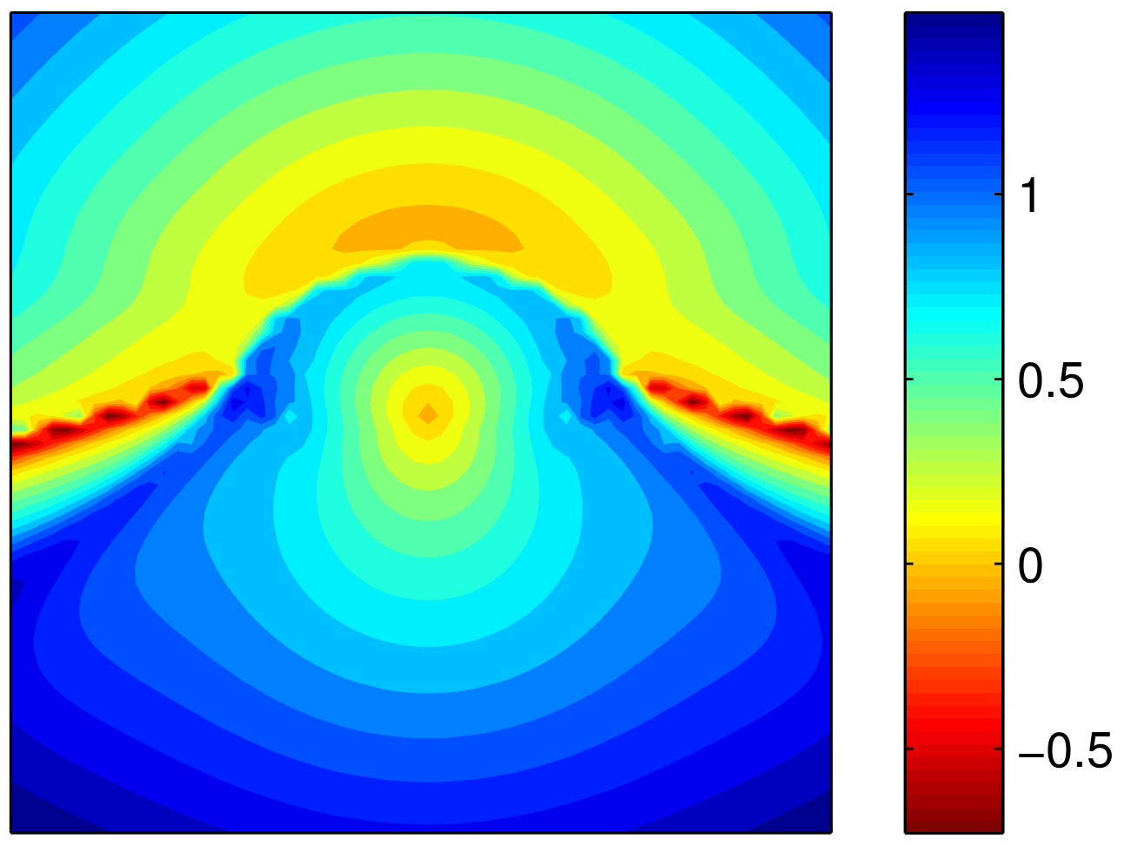

Slide 47
A point model of circles
Initialisation makes a big difference

Slide 48

What’s going on?
A common motif in vision models
Global variables
in each layer
Multiple layers
Many variables per layer

Slide 49


Possible solutions
Structured inference
Messages easy to compute
Fully-factorised representation
Lots of loops
No loops (within layers)
Lots of loops (across layers)
Messages difficult to compute
No loops
Messages difficult to compute
Complex messages between layers

Slide 50

Contextual initialisation
Structured accuracy without structured cost
Observations
Beliefs about global variables are approximately predictable from layer below.
Stronger beliefs about global variables leads to increased quality of messages to layer above.
Strategy
Learn to send global messages in first iteration.
Keep using fully factorised model for layer messages.

Slide 51

A point model of circles

Slide 52


A point model of circles
Accelerated inference using contextual initialisation
Centre
Radius

Slide 53













A pixel model of squares

Slide 54






A pixel model of squares
Robustified inference using contextual initialisation

Slide 55

A pixel model of squares
Robustified inference using contextual initialisation

Slide 56

A pixel model of squares
Robustified inference using contextual initialisation
Side length
Center

Slide 57

A pixel model of squares
Robustified inference using contextual initialisation
FG Color
BG Color

Slide 58











A generative model of shading
With Varun Jampani
Image X
Reflectance R
Shading S
Normal N
Light L

Slide 59

A generative model of shading
Inference progress with and without context

Slide 60

A generative model of shading
Fast and accurate inference using contextual initialisation

Slide 61
Summary
Bridging the gap between Infer.NET and generative computer vision.
Initialisation makes a big difference.
The inference algorithm can learn to initialise itself.
Open questions
What is the best formulation of this approach?
What are the trade-offs between inference and prediction?

Slide 62
Questions

