Slide 1


The Shape Boltzmann Machine
A Strong Model of Object Shape
S. M. Ali Eslami
Nicolas Heess
John Winn
CVPR 2012
Providence, Rhode Island

Slide 2
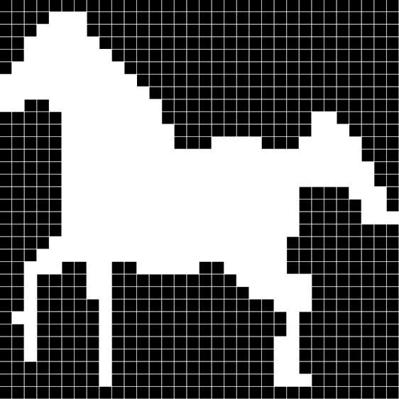
What do we mean by a model of shape?
A probabilistic distribution:
  Defined on binary images
  Of objects not patches
  Trained using limited training data

Slide 3
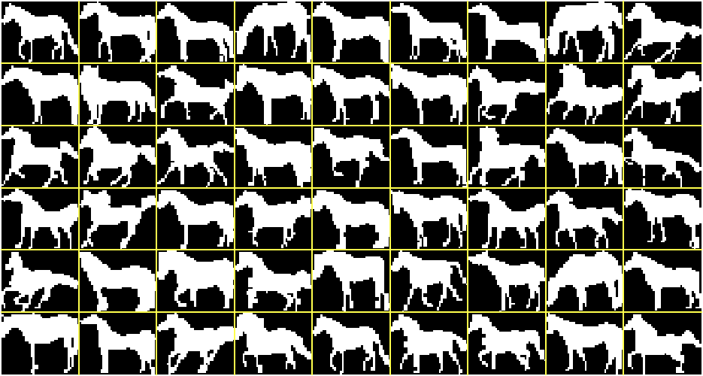
Weizmann horse dataset
Sample training images
327 images

Slide 4
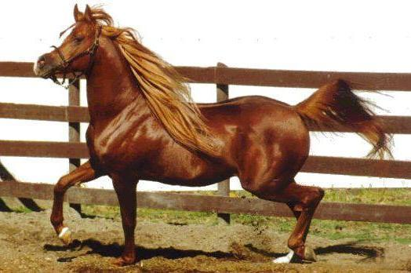
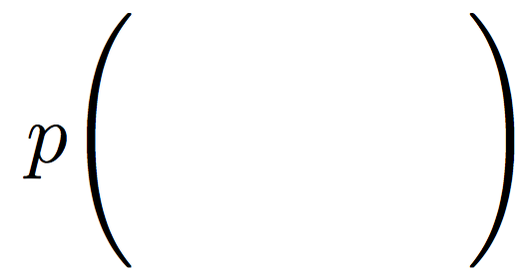
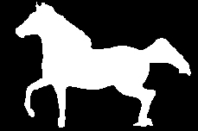
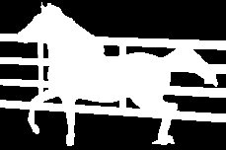

What can one do with an ideal shape model?
Segmentation (due to probabilistic nature)

Slide 5

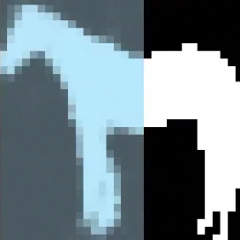
What can one do with an ideal shape model?
Image completion (due to generative nature)

Slide 6

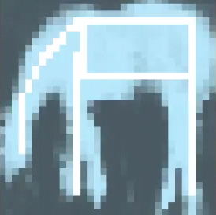
What can one do with an ideal shape model?
Computer graphics (due to generative nature)

Slide 7


What is a strong model of shape?
We define a strong model of object shape as one which meets two requirements:
Realism
Generalization
Generates samples
that look realistic
Can generate samples that
differ from training images
Training images
Real distribution
Learned distribution

Slide 8
Existing shape models
A comparison
 | Realism |  | Generalization
 | Globally | Locally
Mean | ✓
Factor Analysis | ✓ |  | ✓
Fragments |  | ✓ | ✓
Grid MRFs/CRFs |  | ✓ | ✓
High-order potentials | ~ | ✓ | ✓
Database | ✓ | ✓
ShapeBM | ✓ | ✓ | ✓

Slide 9
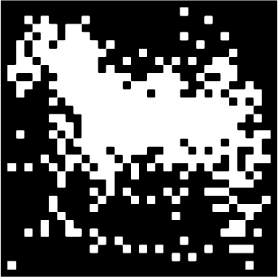
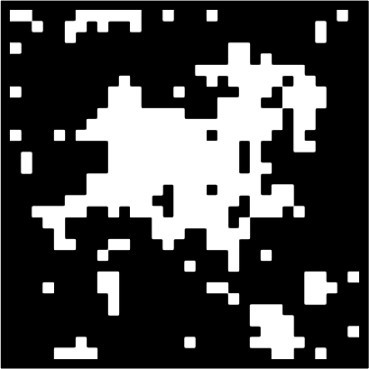
Existing shape models
Most commonly used architectures
Mean
MRF
sample from the model
sample from the model

Slide 10

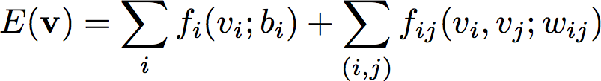
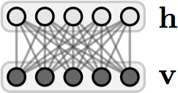
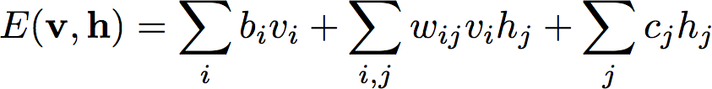
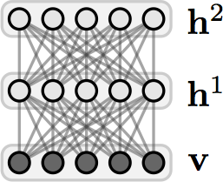
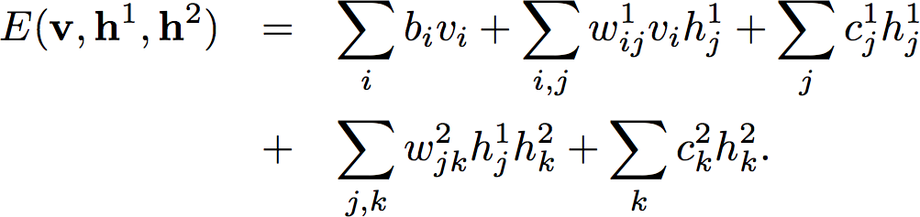
Shallow and Deep architectures
Modeling high-order and long-range interactions
MRF
RBM
DBM

Slide 11
Deep Boltzmann Machines
DBM
Probabilistic
Generative
Powerful
Typically trained with many examples.
We only have datasets with few training examples.

Slide 12
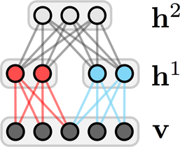
From the DBM to the ShapeBM
Restricted connectivity and sharing of weights
DBM
ShapeBM
Limited training data, therefore reduce the number of parameters:
  Restrict connectivity,
  Tie parameters,
  Restrict capacity.

Slide 13
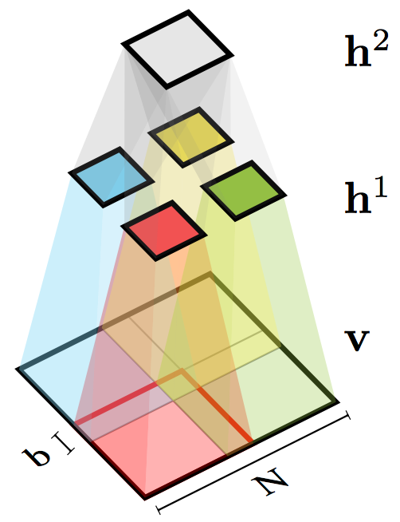
Shape Boltzmann Machine
Architecture in 2D
Top hidden units capture object pose
Given the top units, middle hidden units capture local (part) variability
Overlap helps prevent discontinuities at patch boundaries

Slide 14
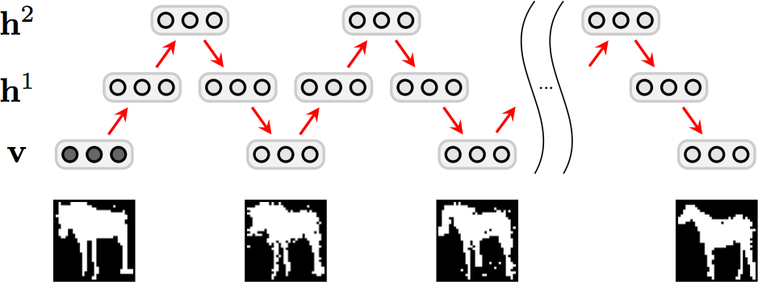
ShapeBM inference
Block-Gibbs MCMC
image
reconstruction
sample 1
sample n
Fast: ~500 samples per second

Slide 15


ShapeBM learning
Stochastic gradient descent
Maximize with respect to
Pre-training
  Greedy, layer-by-layer, bottom-up,
  ‘Persistent CD’ MCMC approximation to the gradients.
Joint training
  Variational + persistent chain approximations to the gradients,
  Separates learning of local and global shape properties.
~2-6 hours on the small datasets that we consider

Slide 16
Results

Slide 17



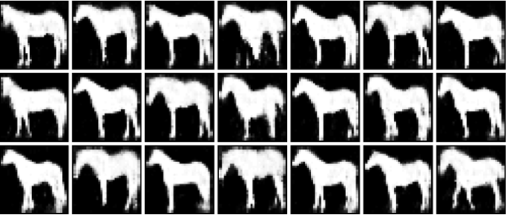
Sampled shapes
Evaluating the Realism criterion
Weizmann horses – 327 images – 2000+100 hidden units
Weizmann horses – 327 images
Data
FA
Incorrect generalization
RBM
Failure to learn variability
Natural shapes
Variety of poses
Sharply defined details
Correct number of legs (!)
ShapeBM

Slide 18
Sampled shapes
Evaluating the Realism criterion
Weizmann horses – 327 images – 2000+100 hidden units
Weizmann horses – 327 images
This is great, but has it just overfit?

Slide 19
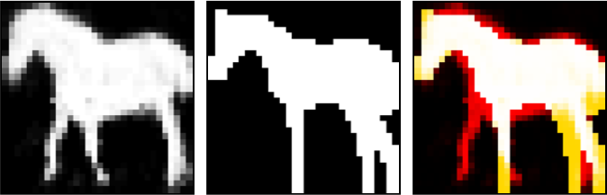
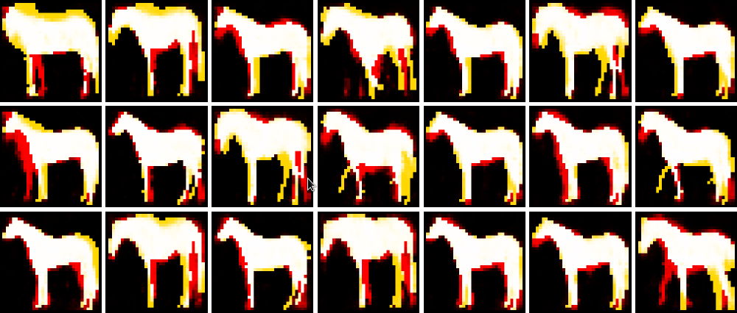
Sampled shapes
Evaluating the Generalization criterion
Weizmann horses – 327 images – 2000+100 hidden units
Sample from the ShapeBM
Closest image in training dataset
Difference between the two images

Slide 20
Interactive GUI
Evaluating Realism and Generalization
Weizmann horses – 327 images – 2000+100 hidden units

Slide 21
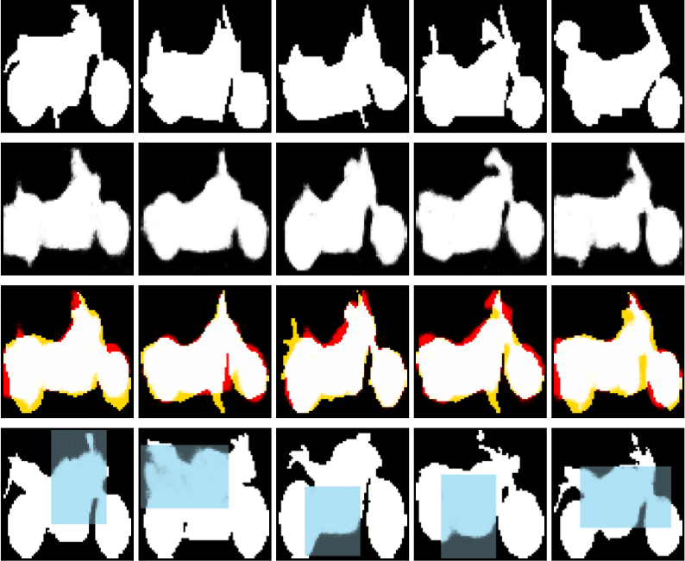
Further results
Sampling and completion
Caltech motorbikes – 798 images – 1200+50 hidden units
Training
images
ShapeBM
samples
Sample
generalization
Shape
completion

Slide 22

Imputation scores
Quantitative comparison
Weizmann horses – 327 images – 2000+100 hidden units
Collect 25 unseen horse silhouettes,
Divide each into 9 segments,
Estimate the conditional log probability of a segment under the model given the rest of the image,
Average over images and segments.
 | Mean | RBM | FA | ShapeBM
Score | -50.72 | -47.00 | -40.82 | -28.85

Slide 23





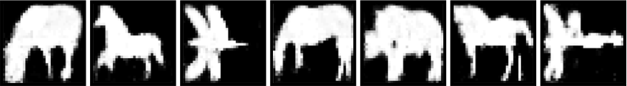
Multiple object categories
Simultaneous detection and completion
Caltech-101 objects – 531 images – 2000+400 hidden units
Train jointly on 4 categories without knowledge of class:
Shape
completion
Sampled
shapes

Slide 24
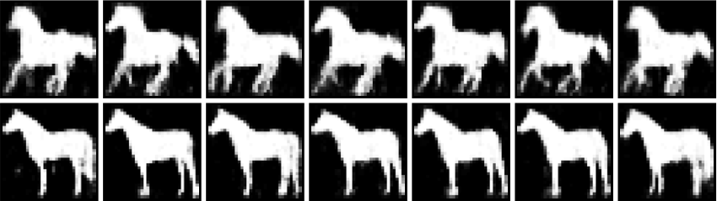


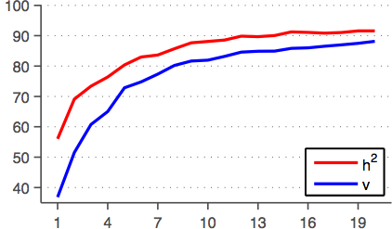
What does h² do?
Weizmann horses
Pose information
Multiple categories
Class label information
Accuracy
Number of training images

Slide 25
Summary
Shape models are essential in applications such as segmentation, detection, in-painting and graphics.
The ShapeBM characterizes a strong model of shape:
  Samples are realistic,
  Samples generalize from training data.
The ShapeBM learns distributions that are qualitatively and quantitatively better than other models for this task.

Slide 26

Questions
MATLAB GUI available at
http://arkitus.com/Ali/

Slide 27
Questions
"The Shape Boltzmann Machine: a Strong Model of Object Shape"
S. M. Ali Eslami, Nicolas Heess and John Winn (2012)
Computer Vision and Pattern Recognition (CVPR), Providence, USA
MATLAB GUI available at
http://arkitus.com/Ali/

Slide 28
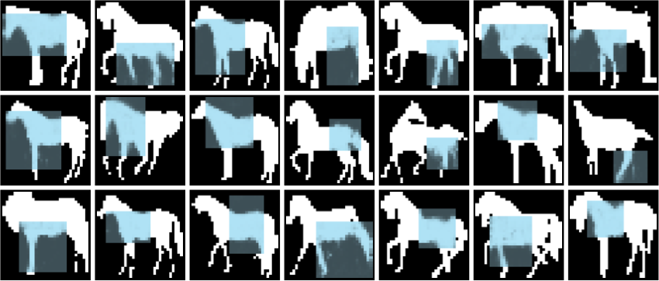
Shape completion
Evaluating Realism and Generalization
Weizmann horses – 327 images – 2000+100 hidden units

Slide 29

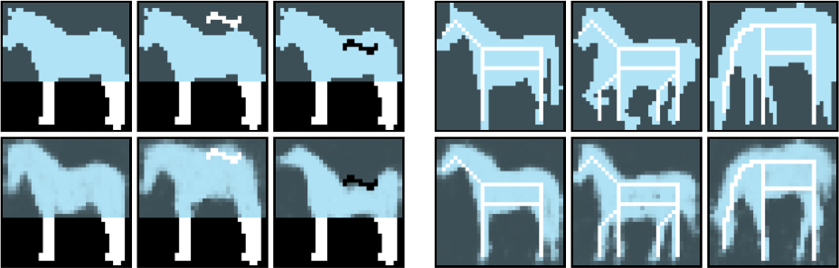
Constrained shape completion
Evaluating Realism and Generalization
Weizmann horses – 327 images – 2000+100 hidden units
NN
ShapeBM

Slide 30

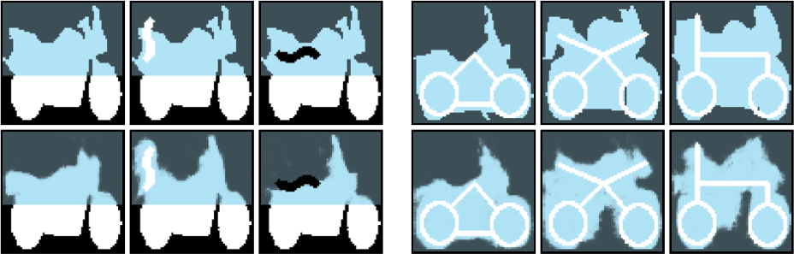
Further results
Constrained completion
Caltech motorbikes – 798 images – 1200+50 hidden units
NN
ShapeBM

