Slide 1


Boltzmann Machines and their Extensions
S. M. Ali Eslami
Nicolas Heess
John Winn
March 2013
Heriott-Watt University

Slide 2
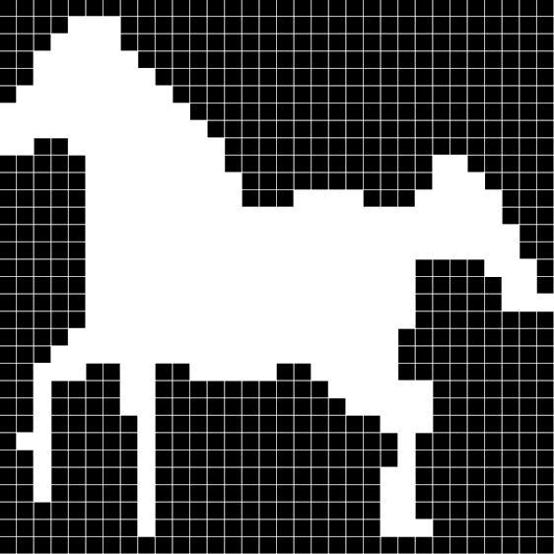
Goal
Define a probabilistic distribution on images like this:

Slide 3
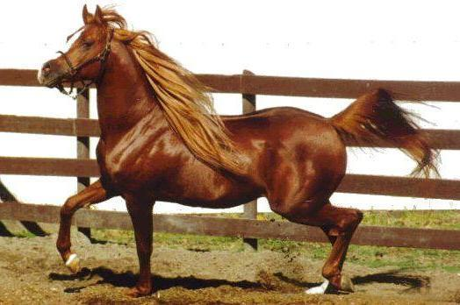
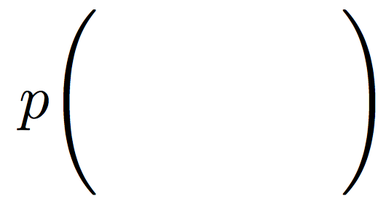
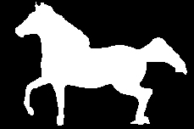
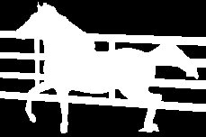

What can one do with an ideal shape model?
Segmentation

Slide 4
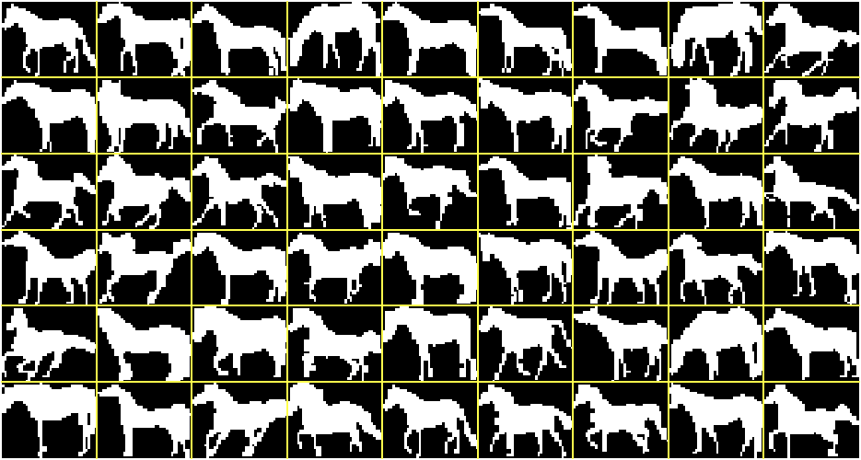
Weizmann horse dataset
Sample training images
327 images

Slide 5

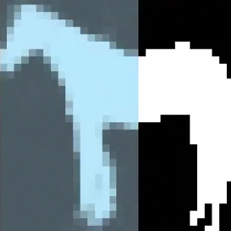
What can one do with an ideal shape model?
Image

Slide 6

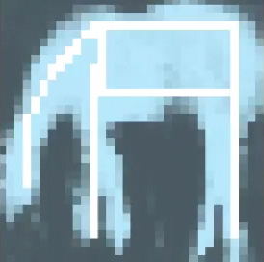
What can one do with an ideal shape model?
Computer graphics

Slide 7

Energy based models
Gibbs distribution

Slide 8

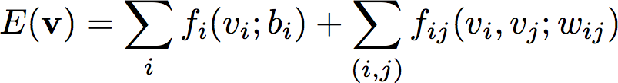
Shallow architectures
Mean

Slide 9

Shallow architectures
MRF

Slide 10
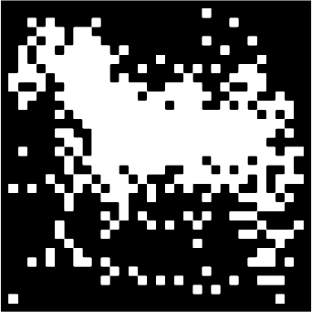
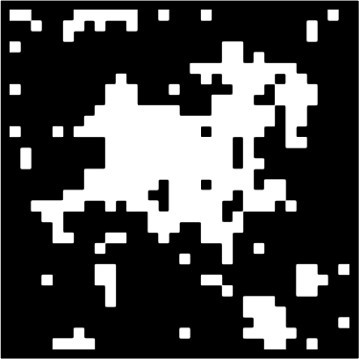
Existing shape models
Most commonly used architectures
Mean
MRF
sample from the model
sample from the model

Slide 11


What is a strong model of shape?
We define a strong model of object shape as one which meets two requirements:
Realism
Generalization
Generates samples
that look realistic
Can generate samples that
differ from training images
Training images
Real distribution
Learned distribution

Slide 12
Shallow architectures
HOP-MRF

Slide 13
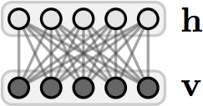
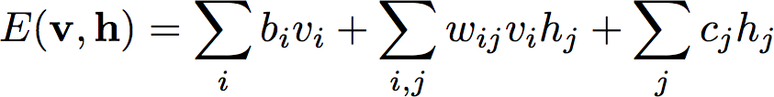
Shallow architectures
RBM

Slide 14

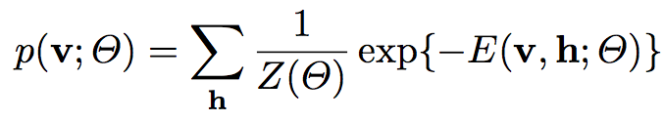
Shallow architectures
Restricted Boltzmann Machines
The effect of the latent variables can be appreciated by considering the marginal distribution over the visible units:

Slide 15
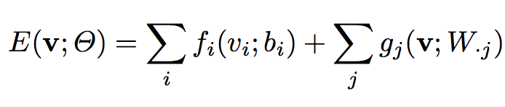

Shallow architectures
Restricted Boltzmann Machines
In fact, the hidden units can be summed out analytically. The energy of this marginal distribution is given by:
where

Slide 16
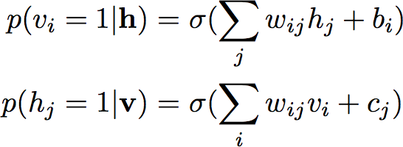
Shallow architectures
Restricted Boltzmann Machines
All hidden units are conditionally independent given the visible units and vice versa.

Slide 17
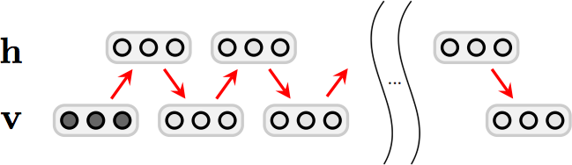
RBM inference
Block-Gibbs MCMC

Slide 18
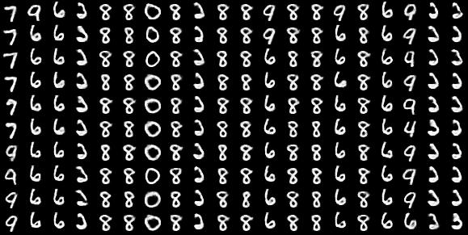
RBM inference
Block-Gibbs MCMC

Slide 19


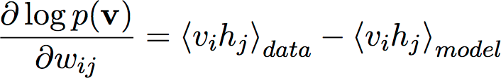
RBM learning
Stochastic gradient descent
Maximize with respect to

Slide 20
RBM learning
Contrastive divergence
Getting an unbiased sample of the second term, however is very difficult. It can be done by starting at any random state of the visible units and performing Gibbs sampling for a very long time. Instead:

Slide 21
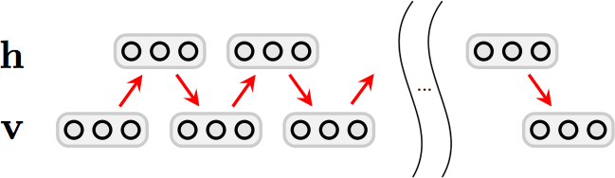
RBM inference
Block-Gibbs MCMC

Slide 22
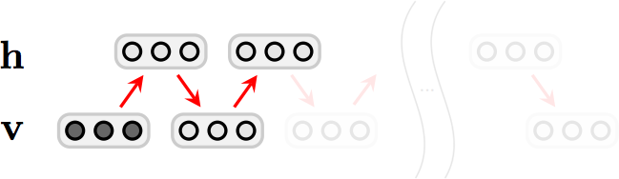
RBM inference
Block-Gibbs MCMC

Slide 23
RBM learning
Contrastive divergence
Crudely approximating the gradient of the log probability of the training data.
More closely approximating the gradient of another objective function called the Contrastive Divergence, but it ignores one tricky term in this objective function so it is not even following that gradient.
Sutskever and Tieleman have shown that it is not following the gradient of any function.
Nevertheless, it works well enough to achieve success in many significant applications.

Slide 24
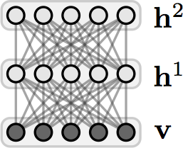
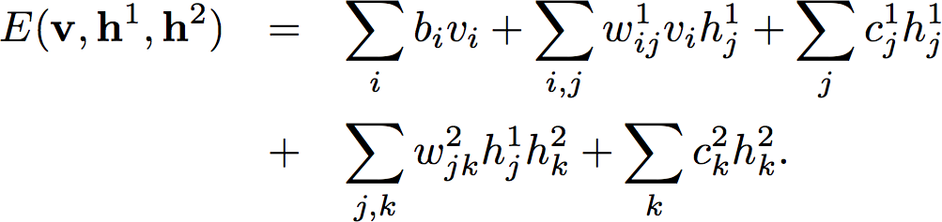
Deep architectures
DBM

Slide 25
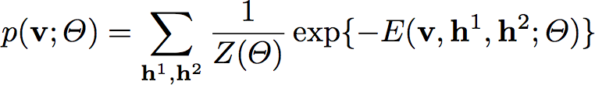
Deep architectures
Deep Boltzmann Machines

Slide 26
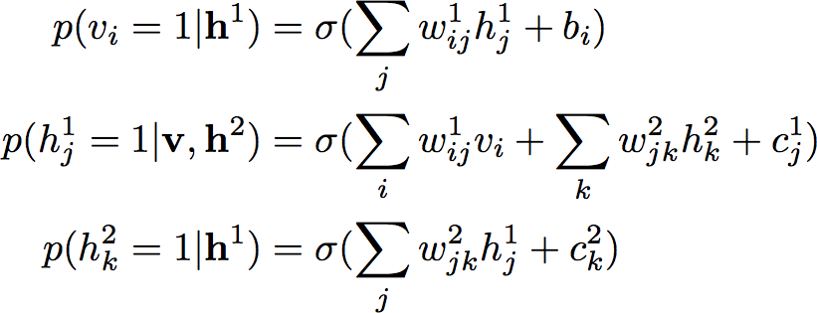
Deep architectures
Deep Boltzmann Machines
Conditional distributions remain factorised due to layering.

Slide 27
Shallow and Deep architectures
Modeling high-order and long-range interactions
MRF
RBM
DBM

Slide 28
Deep Boltzmann Machines
DBM
Probabilistic
Generative
Powerful
Typically trained with many examples.
We only have datasets with few training examples.

Slide 29
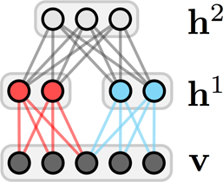
From the DBM to the ShapeBM
Restricted connectivity and sharing of weights
DBM
ShapeBM
Limited training data, therefore reduce the number of parameters:
  Restrict connectivity,
  Tie parameters,
  Restrict capacity.

Slide 30
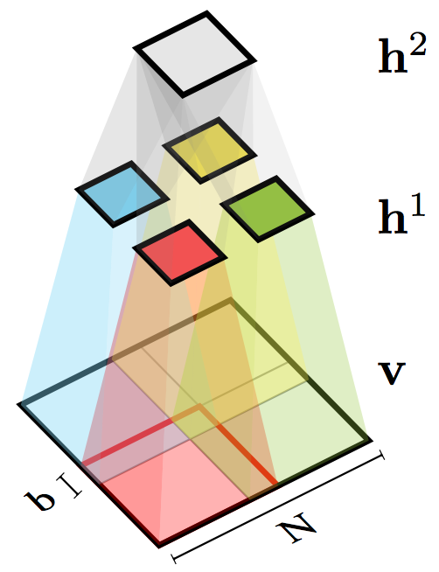
Shape Boltzmann Machine
Architecture in 2D
Top hidden units capture object pose
Given the top units, middle hidden units capture local (part) variability
Overlap helps prevent discontinuities at patch boundaries

Slide 31
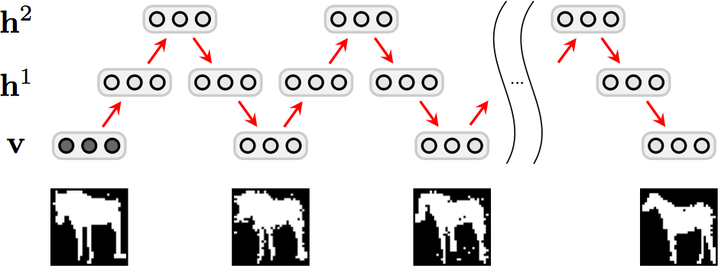
ShapeBM inference
Block-Gibbs MCMC
image
reconstruction
sample 1
sample n
Fast: ~500 samples per second

Slide 32

ShapeBM learning
Stochastic gradient descent
Maximize with respect to
Pre-training
  Greedy, layer-by-layer, bottom-up,
  ‘Persistent CD’ MCMC approximation to the gradients.
Joint training
  Variational + persistent chain approximations to the gradients,
  Separates learning of local and global shape properties.
~2-6 hours on the small datasets that we consider

Slide 33
Results

Slide 34



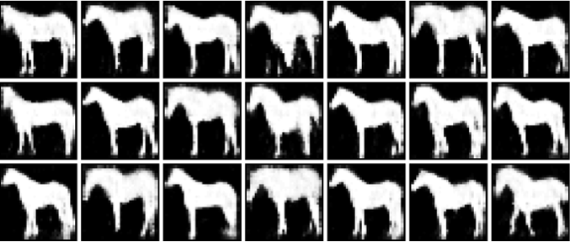
Sampled shapes
Evaluating the Realism criterion
Weizmann horses – 327 images – 2000+100 hidden units
Weizmann horses – 327 images
Data
FA
Incorrect generalization
RBM
Failure to learn variability
Natural shapes
Variety of poses
Sharply defined details
Correct number of legs (!)
ShapeBM

Slide 35
Sampled shapes
Evaluating the Realism criterion
Weizmann horses – 327 images – 2000+100 hidden units
Weizmann horses – 327 images
This is great, but has it just overfit?

Slide 36
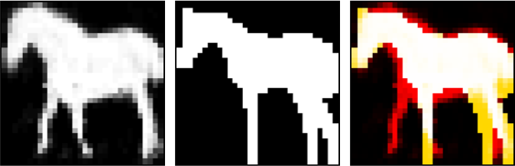
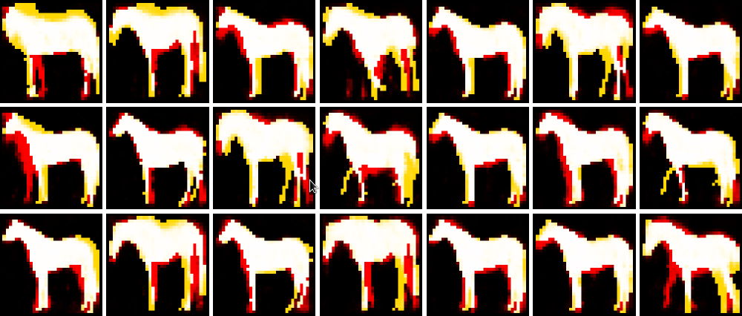
Sampled shapes
Evaluating the Generalization criterion
Weizmann horses – 327 images – 2000+100 hidden units
Sample from the ShapeBM
Closest image in training dataset
Difference between the two images

Slide 37
Interactive GUI
Evaluating Realism and Generalization
Weizmann horses – 327 images – 2000+100 hidden units

Slide 38
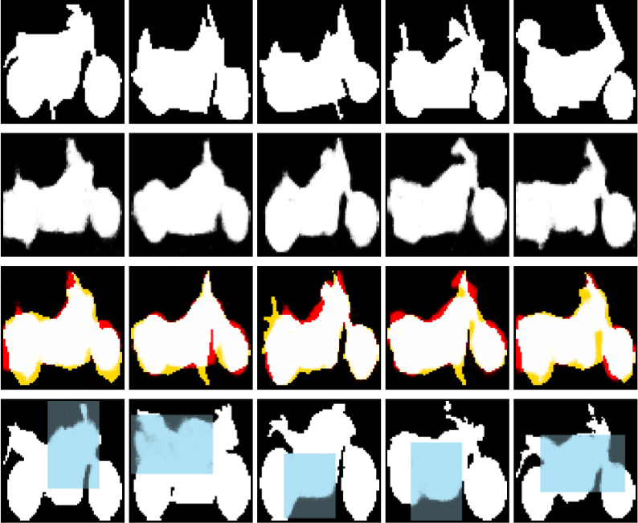
Further results
Sampling and completion
Caltech motorbikes – 798 images – 1200+50 hidden units
Training
images
ShapeBM
samples
Sample
generalization
Shape
completion

Slide 39

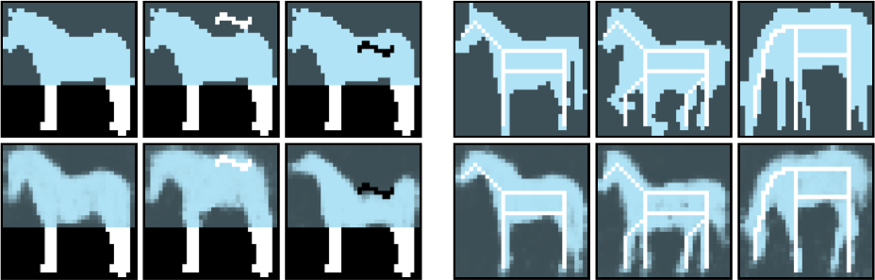
Constrained shape completion
Evaluating Realism and Generalization
Weizmann horses – 327 images – 2000+100 hidden units
NN
ShapeBM

Slide 40

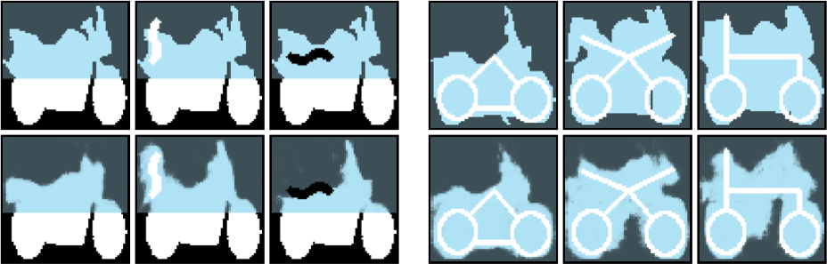
Further results
Constrained completion
Caltech motorbikes – 798 images – 1200+50 hidden units
NN
ShapeBM

Slide 41

Imputation scores
Quantitative comparison
Weizmann horses – 327 images – 2000+100 hidden units
Collect 25 unseen horse silhouettes,
Divide each into 9 segments,
Estimate the conditional log probability of a segment under the model given the rest of the image,
Average over images and segments.
 | Mean | RBM | FA | ShapeBM
Score | -50.72 | -47.00 | -40.82 | -28.85

Slide 42
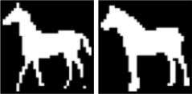




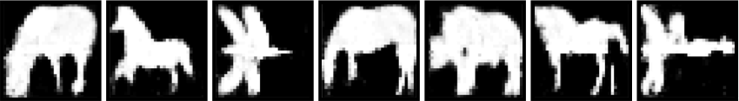
Multiple object categories
Simultaneous detection and completion
Caltech-101 objects – 531 images – 2000+400 hidden units
Train jointly on 4 categories without knowledge of class:
Shape
completion
Sampled
shapes

Slide 43
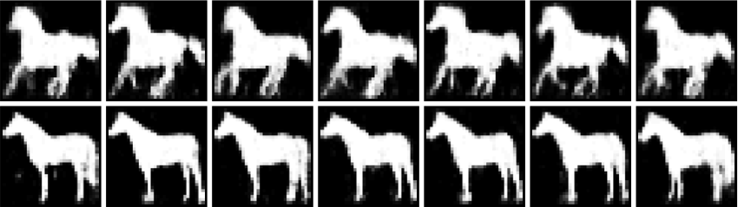


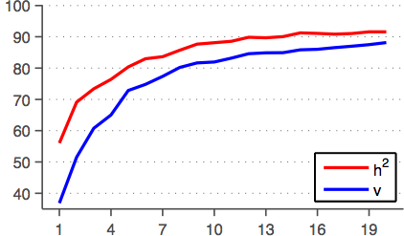
What does h² do?
Weizmann horses
Pose information
Multiple categories
Class label information
Accuracy
Number of training images

Slide 44
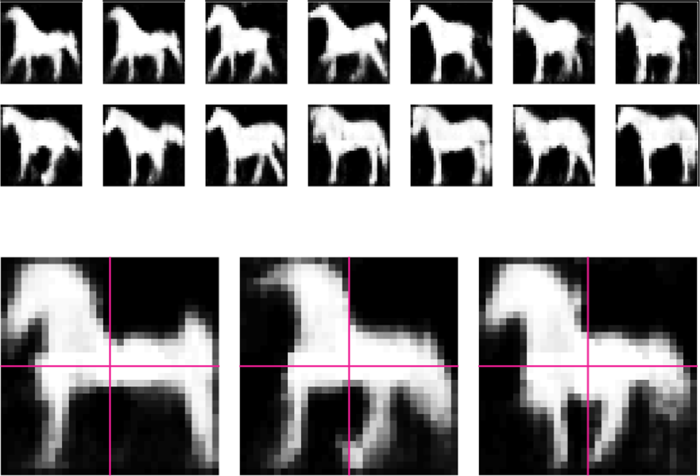
What does h² do?

Slide 45
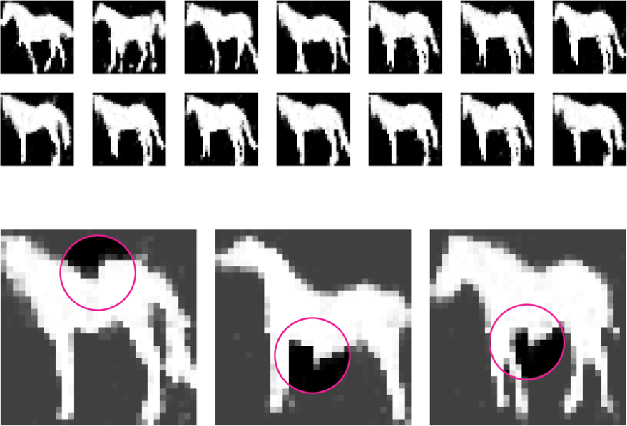
What does the overlap do?

Slide 46
Summary
Shape models are essential in applications such as segmentation, detection, in-painting and graphics.
The ShapeBM characterizes a strong model of shape:
  Samples are realistic,
  Samples generalize from training data.
The ShapeBM learns distributions that are qualitatively and quantitatively better than other models for this task.

Slide 47

Questions
MATLAB GUI available at
http://arkitus.com/Ali/

